Slide 1
What does Jesus mean to Christians today?
What would a Christian believe about Jesus based on this quote?
………………………………………………………………………………………………………………………………………………………………………………………………………………………………………………………………………………………………………………………………………………………………………………………………………………………………….............
“For God so loved the world, that he gave his only Son, that whoever believes in him will have eternal life.”
John 3:16
Why might some people not believe or agree with this quote? ………………….
………………………………………………………………………………………………………………………………………………………………………………………………………………………………………………………………………………………………………………………………………………………………………………………………………………
Justify your own opinion about Jesus based on this quote. …………………………………………
………………………………………………………………………………………………………………………………………………………………………………………………………………………………………………………………………………………………………………………………………………………………………………………………………………………………………………………………………………………………………………………………………………………………………………………………………………………………………………………………………………………………………………………………………………………………………………………………………………………………………………………………………………………………………………………………

Slide 2
Learning Objectives
To understand that people have different opinions about Jesus.
To be able to explain a Christian opinion about the importance of Jesus.
Justify your own opinion about who Jesus is and his importance today.
Literacy Objective: Extended writing
Key Words:
Blaspheming: speak in a way that is unholy about God or sacred things.
Pharisee: a member of an ancient Jewish sect who strictly keeps the law; a self-righteous person.
Characteristic: a feature or quality belonging to a person and serving to identify them.

Slide 3
Matthew 16:13-18
‘Jesus asked his disciples, “Who do people say I am?” They said, “Some say a holy man, some say a prophet. The Pharisees say you are a blasphemer and a liar.”
He said to them, “But who do you say that I am?” Simon Peter replied, “You are the Christ, the Son of the living God.” And Jesus answered him, “Blessed are you, Simon. This has been revealed to you by my Father who is in heaven.”
What different opinions are shown about Jesus?
Why did people find it difficult to believe one thing about Jesus?
Can people be convinced about who Jesus is by reading the bible?
What would a Christian think about this bible passage?
LO1: To understand that people have different opinions about Jesus.

Slide 5
Clip 1 | Clip 2 | Clip 3
Describe how you imagine Jesus. | What Christian views are given in the clip? Why is this a Christian opinion? | Why do some people think Jesus is important today? Why do some people think Jesus is not important today?
Which opinion do you agree with most? Explain why. | What non-Christian views are given in the clip? Why is this a non-Christian opinion?
LO1: To understand that people have different opinions about Jesus.
LO2: To be able to explain a Christian opinion about the importance of Jesus.
Notes:
Clip 1 (0-1.13 min), Clip 2 (1.13-3min30), Clip 3 (3.30-5.30min)

Slide 6
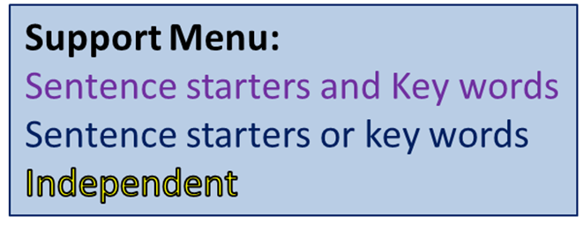
Do you think Jesus is still important today? Explain why you think this.
Sentence Starters:
Give two reasons for your opinion:
I think that Jesus is/is not important today because…
For example…
I also think this because…
For example…
Key Words:
Christian Church
Son of Man
Father
Saviour
Crucified
Disciples
Pharisees
Characteristics
Give one developed reason why someone would disagree with you.
LO3: Justify your own opinion about who Jesus is and his importance today.

Slide 7
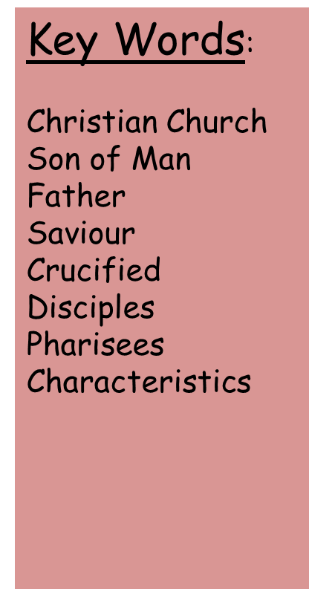
Self Assess
I think that Jesus is/is not important today because…(1)
For example….(1)
I also think this because…(1)
For example…(1)
WWW:
I included…….points to support my opinion.
I gave….examples.
I included…..key words.
I included a Christian opinion.
EBI: ………………………………………………………..

