Slide 1
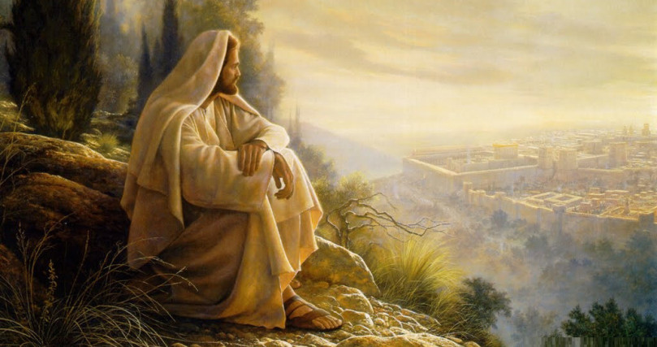
Weekly Worship
Week Beginning: 08/02/2021
Collective Worship Theme: Peace and Quiet

Slide 2
Sundays Gospel Reading
A reading from the Holy Gospel according to Mark
‘He cast out devils and cured many who were suffering from disease'
On leaving the synagogue, Jesus went with James and John straight to the house of Simon and Andrew. Now Simon’s mother-in-law had gone to bed with fever, and they told him about her straightaway. He went to her, took her by the hand and helped her up. And the fever left her and she began to wait on them.
That evening, after sunset, they brought to him all who were sick and those who were possessed by devils. The whole town came crowding round the door, and he cured many who were suffering from diseases of one kind or another; he also cast out many devils, but he would not allow them to speak, because they knew who he was.
In the morning, long before dawn, he got up and left the house, and went off to a lonely place and prayed there. Simon and his companions set out in search of him, and when they found him they said, ‘Everybody is looking for you.’ He answered, ‘Let us go elsewhere, to the neighbouring country towns, so that I can preach there too, because that is why I came.’ And he went all through Galilee, preaching in their synagogues and casting out devils.

Slide 3
Gospel Reflection
The Gospel stories tell us that as well as healing, casting out demons, and preaching, Jesus was in the habit of going off to a quiet place to pray. Often we are all in need of some peace and quiet and dedicated time for prayer and reflection.
Just as Jesus needs to take himself away, on his own to pray, to prepare, to have a moment of stillness before he begins his day it is also useful for us.
Take 5 minutes right now, no screens, no music, no distractions. Just 5 minutes to sit in stillness and prayer to ready yourself for the day.

Slide 4
Weekly Prayer
“Be still, and know that I am God”
Psalm 46:10
Heavenly Father,
May my day be blessed
by moments of quietness,
light in my darkness,
strength in my weakness,
grace in my meekness,
joy in my gladness,
peace in my stillness.
May my day be blessed.
We ask this prayer through Christ our Lord. Amen.

Slide 5
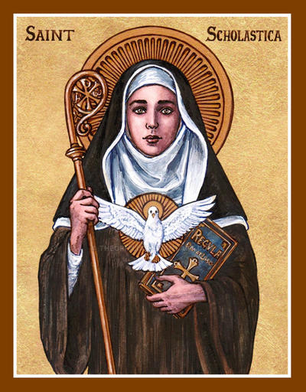
Saint of the Week
Saint Scholastica
Feast Day: 10 February
Born in 480 of wealthy parents, twins Scholastica and Benedict were brought up together until he left central Italy for Rome to continue his studies. Little is known of Scholastica’s early life. She founded a religious community for women near Monte Cassino, five miles from where her brother governed a monastery. The twins visited each other once a year in a farmhouse because Scholastica was not permitted inside the monastery. They spent these times discussing spiritual matters. According to the Dialogues of St. Gregory the Great, the brother and sister spent their last day together in prayer and conversation. Scholastica sensed her death was close at hand and she begged Benedict to stay with her until the next day. He refused her request because he did not want to spend a night outside the monastery, thus breaking his own Rule. Scholastica asked God to let her brother remain and a severe thunderstorm broke out, preventing Benedict and his monks from returning to the abbey. Benedict cried out, “God forgive you, Sister. What have you done?” Scholastica replied, “I asked a favour of you and you refused. I asked it of God and he granted it.”
Brother and sister parted the next morning after their long discussion. Three days later, Benedict was praying in his monastery and saw the soul of his sister rising heavenward in the form of a white dove. Benedict then announced the death of his sister to the monks and later buried her in the tomb he had prepared for himself.
Prayer to Saint Scholastica
O God, to show us where innocence leads, you made the soul of your virgin Saint Scholastica soar to heaven like a dove in flight. Grant through her merits and her prayers that we may so live in innocence as to attain to joys everlasting. This we ask through our Lord Jesus Christ, Your Son, Who lives and reigns with You and the Holy Spirit, One God, forever and ever. Amen

Slide 6
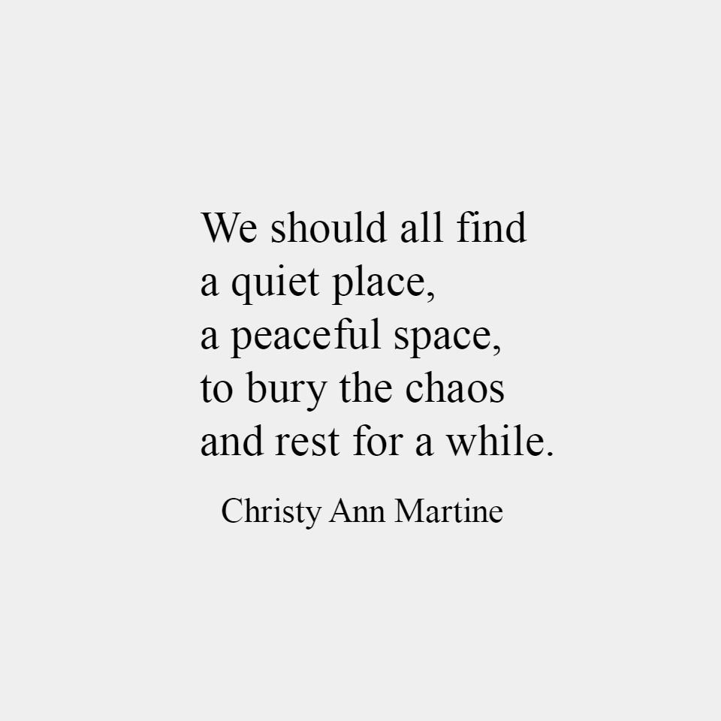
Quote of the Week

Slide 7
Ullathorne Way
This terms focus is Faith-Filled and Prophetic

