Slide 1
Wednesday 15th July
There are notes in the note section underneath certain slides.
We remain in ordinary time, week 15, so the Church will be in green
But today is the Memorial of St Bonaventure, Bishop and Doctor of the Church

Slide 2
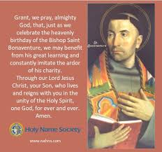
Let us pray
Notes:
St Bonaventure was born in Italy in 1218. He entered the Franciscan Order and met St Thomas Aquinas whilst also a lecturer in Paris. He is considered the greatest mystical thinker of the middle ages.

Slide 3
Bible readings: Matthew 11:25-27
At that time Jesus said, “I praise you, Father, Lord of heaven and earth, because you have hidden these things from the wise and learned, and revealed them to little children. Yes, Father, for this is what you were pleased to do.
“All things have been committed to me by my Father. No one knows the Son except the Father, and no one knows the Father except the Son and those to whom the Son chooses to reveal him.

Slide 4

It’s interesting that as today we think about St Bonaventure and his work asking the holy spirit to be with us, we maintain our novena to St Francis, the order of which St Bonaventure belonged also.

Slide 5


Slide 6
Let us pray
God of all creation,
your spirit dances throughout the earth.
You give drink to the trees,
shade for the birds,
bread for the hungry.
You bring life and make all things holy.
Flood our hearts with your grace,
so we may sow seeds of love, justice and beauty,
and reflect your kingdom here on earth.
We ask this through your Son, our Lord Jesus Christ,
Amen.

Slide 7

Hymn for peace

