Slide 1
Religious Studies: Unit 3 Exam Walking, Talking Mock: Last minute hint and tips

Slide 2
The first thing you need to do is choose the right question for you. Spend a couple of minutes reading through both questions. Look carefully at the c) and d) questions. Never pick a question based on whether you know the keyword or not

Slide 3
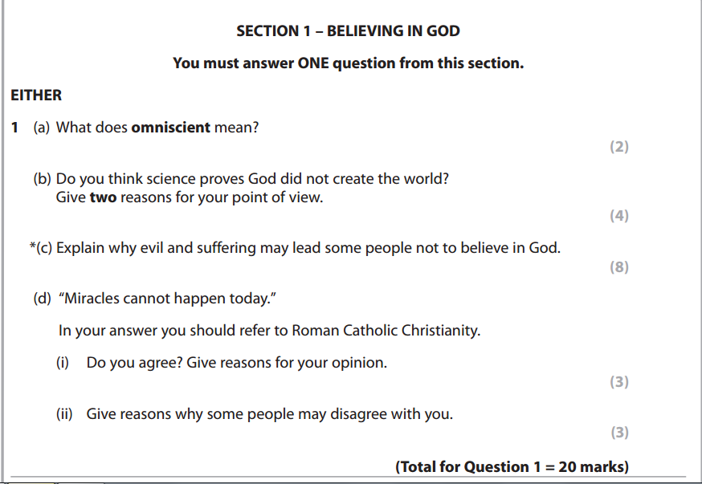
Nice c) question here that you could have a really good go at. The d) question is pretty interesting too!

Slide 4
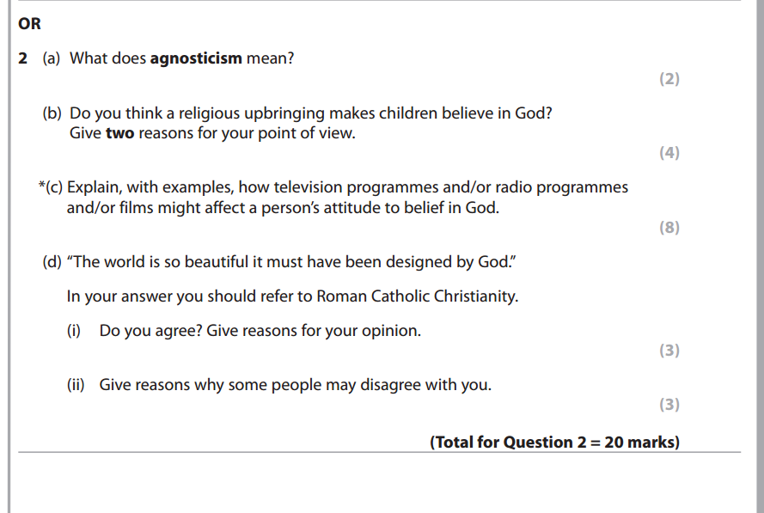
The advice from your RE teachers is to avoid media questions if you can. Lots of marks at stake if you attempt a c) on media and get it wrong. Also the d) is about design, which is difficult. In this situation I would definitely answer question 1!

Slide 5
Keyword questions:
Write the definition that we have learnt in class.
If you are not sure that your definition is exact, give an example or develop the point you have made.
Omniscient is the belief that God knows everything that has happened and everything that will happen. 2/2
‘Omni’ means all, so for example you could also say that God is all seeing. 2/2

Slide 6
If you are not sure of your own opinion, think about what a Catholic priest may have to say about it!!
b) questions (4 marks)
Must include ‘I think’.
Yes because I think OR No because I think (NOT BOTH)
Must have 2 reasons for your point of view that are developed.
A developed reason should be 2 sentences. The easiest way to develop your reason is to give an example
Should be set out as 2 short paragraphs.

Slide 7
If you are not sure of your own opinion, think about what a Catholic priest may have to say about it!!
b) questions (4 marks)
Must include ‘I think’.
Yes because I think that Science has lots of evidence for its theories.
For example there are fossils that back up the theory of evolution and these theories do not need God in order for them to make sense.
Also yes because I think that science does not refer to God at all in the theory of the Big Bang.
For example science says that the matter of the universe is eternal, there is no need for a creator like God. 4/4

Slide 8
Explain (‘c’) Questions
Explain – 8 marks.
Aim to write 4 paragraphs.
Aim to include at least 2 sentences in each paragraph.
USE THE WORD BECAUSE IN EACH PARAGRAPH.
Aim to make sure that each paragraph covers a different reason.

Slide 9
c) Questions
If the question asks about religion you must include religious teachings.
If the question is non religious do not include religious teachings.

Slide 10
c) questions are spag marked (spelling, punctuation and grammar) where you see this * symbol. This will include:
Spelling of keywords and religious words,
Paragraphing,
Use of capital letters and full stops,
Use of commas and apostrophes where appropriate.

Slide 11
c) Questions (8)
One reason why evil and suffering may lead some people not to believe in God is because if God was omnipotent he would be powerful enough to stop it. God does not stop evil so some people would then believe that he must not exist.
Nice question- Go through all three omni words in three of the paragraphs, final paragraph you could suggest that people pray to end suffering all the time but it still happens so God can’t exist.

Slide 12
C) Questions
If the c) question asks you to explain Catholic/Christian beliefs or attitudes you must include teachings:
CAFOD is a Catholic charity and they aim to end world poverty because in the Parable of the Sheep and Goats it says to feed the hungry. Feeding the hungry is one way to tackle world poverty.
Another reason CAFOD try to end world poverty is because of the Golden Rule. If you were living in poverty you would want someone to help you.
A third reason is because Jesus said to love our neighbour, ending world poverty is an act of love.
A final reason is because the Parable of the Good Samaritan shows someone helping a person in need. This is a good example of helping others like CAFOD aims to do. 8/8

Slide 13
d) questions (6)
You must include a Catholic opinion
You must evaluate the quote (agree and disagree with it)
Ensure you are answering the question set. This one specifically says “today.” I must focus on that in my answer.

Slide 14
d) questions (6)
3 reasons to disagree might include:
As a Catholic I disagree because I think that miracles can happen at any time. The Church says that God decides when and where.
Also because I have read about/seen modern miracles for example we watched a video of a woman who was saved from a car under water. There was no other explanation of how it happened
Also because miracles happen at Lourdes all the time, including the present day.

Slide 15
d) questions (6)
3 reasons to agree might include:
Some people may agree with the quote because they think that all miracles are fake like when Dynamo walked on water.
Also because it is easy to photo-shop or edit footage to make things look like an apparent miracle.
Also because we can now explain things through science that would have once been considered a miracle. In the future we may have an explanation of all such things that does not include a miracle of God!

Slide 16
Don’t forget spend ….
20 minutes on each section and no more!

Slide 17
Don’t forget!!!!!!!
Keep writing. RE is marked positively, the more you include the more likely you are to get more marks.
Do not sit at the end looking around doing nothing!!!!!!!!!!!!!!!
If you are stuck and the question is about Christianity it is worth trying some of our fall back teachings:

Slide 18
Jesus
… because Jesus said:
Love one another as I have loved you.
Love thy neighbour.
Golden Rule: Treat other people as you would like to be treated.
Greatest Commandment: Love God and love your neighbour

Slide 19
Jesus
…because of the example which Jesus set us:
He forgave others.
He treated all people equally.
He put other people before himself.
He was never violent and he rebuked Peter for being violent.
He never condemned people – he gave them second chances.

Slide 20
Parables
Parable of the Good Samaritan.
Parable of the Sheep and Goats
Parable of the Lost Son
Parable of the Talents

Slide 21
Christian teachings:
The Decalogue- ‘Do not kill/do not commit adultery’
Situation ethics- do the most loving thing
Judgement day- Heaven for the good/Hell for the bad
St Paul- ‘women should be silent in Church’
‘God has no favourites’
‘Women should submit to their husbands’
‘We are all one in Christ Jesus’
If you are not sure who said something and it definitely wasn’t Jesus it might be St Paul!!

Slide 22
The Catholic Church
The Church teaches:
It’s in the Catechism
Sanctity of life
Equality
Life begins at conception
Justice/fairness

Slide 23
Don’t forget spend ….
20 minutes on each section and no more!

Slide 24
GOOD LUCK from Mrs Poole, Miss Grolik, Mrs Butler and Mr Scott!
HAVE FAITH IN YOURSELF!

