Slide 1
Tuesday 28th April
There are notes in the note section underneath each slide.
We are currently in the Third week of Easter.
Easter Sunday was 12th April.
In church the altar cloth would be white and the priest would be wearing white garments.

Slide 2
Let us pray
Dear Lord,
Today we give thanks for all the beautiful things we have around us. For our families that we live with, the clean air that we breath and the colourful gardens that surround us. Help us to see you in the glory of nature all around us.
In Jesus’ name we pray,
Amen

Slide 3
Bible readings: John 6:30-25
They replied, “What miracle will you perform so that we may see it and believe you? What will you do? Our ancestors ate manna in the desert, just as the scripture says, ‘He gave them bread from heaven to eat.’”
“I am telling you the truth,” Jesus said. “What Moses gave you was not the bread from heaven; it is my Father who gives you the real bread from heaven. For the bread that God gives is he who comes down from heaven and gives life to the world.”
“Sir,” they asked him, “give us this bread always.”
“I am the bread of life,” Jesus told them. “Those who come to me will never be hungry; those who believe in me will never be thirsty.

Slide 4
The bread of life
Read back through the Gospel passage. Jesus is making a really big prediction about what is going to happen next. What do you think this means?
“it is my Father who gives you the real bread from heaven. For the bread that God gives is he who comes down from heaven and gives life to the world.”
Notes:
Jesus is telling people that he is god, come down from heaven (this is called the incarnation- god made flesh, this is why we celebrate Christmas) and that he will be dying and that this sacrifice will give life to the world, in that his death will bring forgiveness for all people so that we can then go to heaven when we die.

Slide 5
Task
The next page has a crossword of connected words to answer. Try to answer the questions and then if you can email them for checking. Maybe then see if you can create your own crossword using today and yesterdays reflection.

Slide 6
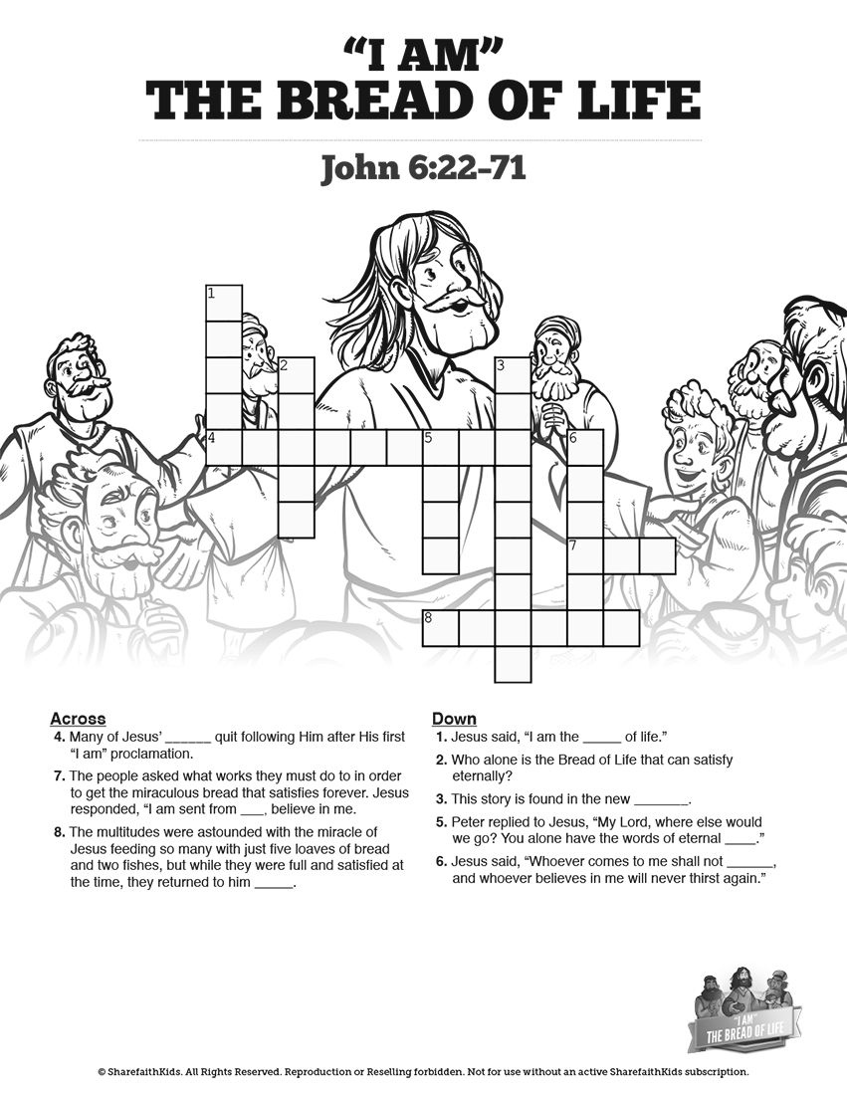

Slide 7
Let us pray
Dear Lord,
Help us Lord to hear your message always. We know that through you we gain eternal life. Help us to be worthy disciples of yours.
In Jesus’ name we pray,
Amen

Slide 8
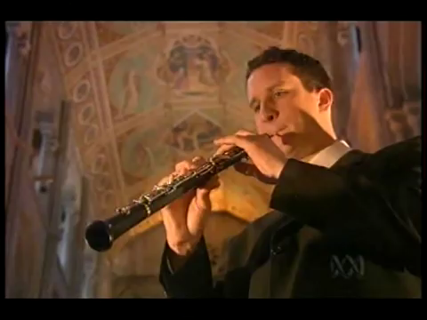
Hymn
Notes:
https://www.youtube.com/watch?v=9-D_aT8CXyc
Lord of all hopefulness
636,018 views
•Nov 24, 2012
3:49 seconds.

