Slide 1
Daily prayer & collective worship
Friday 15TH January 2021

Slide 2
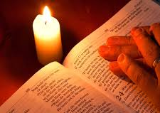
Collective Worship
Let us start with the Sign of the Cross
In the name of the Father and of
the Son and of the Holy Spirit.
Amen

Slide 3
Gospel:Mark 2:1-12
The Son of Man has authority on earth to forgive sins
When Jesus returned to Capernaum, word went round that he was back; and so many people collected that there was no room left, even in front of the door. He was preaching the word to them when some people came bringing him a paralytic carried by four men, but as the crowd made it impossible to get the man to him, they stripped the roof over the place where Jesus was; and when they had made an opening, they lowered the stretcher on which the paralytic lay. Seeing their faith, Jesus said to the paralytic, ‘My child, your sins are forgiven.’ Now some scribes were sitting there, and they thought to themselves, ‘How can this man talk like that? He is blaspheming. Who can forgive sins but God?’ Jesus, inwardly aware that this was what they were thinking, said to them, ‘Why do you have these thoughts in your hearts? Which of these is easier: to say to the paralytic, “Your sins are forgiven” or to say, “Get up, pick up your stretcher and walk”? But to prove to you that the Son of Man has authority on earth to forgive sins,’ – he turned to the paralytic – ‘I order you: get up, pick up your stretcher, and go off home.’ And the man got up, picked up his stretcher at once and walked out in front of everyone, so that they were all astounded and praised God saying, ‘We have never seen anything like this.’

Slide 4
Thoughts from pope Francis
Praise is the proof that I believe that Jesus Christ is God in my life, that He was sent to me to ”forgive me" – if I have the ability to praise God. To praise the Lord. It is free - praise is gratis. It is a sentiment the Holy Spirit gives and it leads you to say: ”You are the One God.”

Slide 5
Let us pray
Let us pray for the Church, that through her ministry of reconciliation, she may bring all people to recognise their sins, repent and find forgiveness in the Lord. Lord hear us Lord Graciously hear us
May the Lord bless all parents and carers in our school community that they may be strengthened by the Holy Spirit in the guidance and care they give their children.
Lord hear us Lord Graciously hear us
Please help everyone to find some happiness at this time, whatever their circumstances. Encourage those who find it difficult to be happy at this time to find peace in you. Let our hearts be full of love for each other and remember that your light shines for the whole world.
Lord hear us Lord Graciously hear us

Slide 6
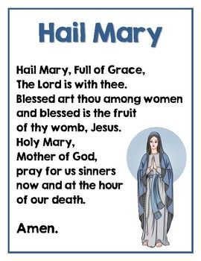
Let us pray together

Slide 7
Activity
In the bible today we witness a miracle of the paralysed man picking up his stretcher and walking again. The people who witnessed it were astounded and praised God.
For today’s activity, I’d like you to think of things you could praise God for.
Watch the video for some examples
https://www.youtube.com/watch?v=xwUpEo9Qow4

