Slide 1
Education campus payments For Schools
Archdiocese of Birmingham School Business Managers Network Meeting

Slide 2
Education campus payments For Schools, Colleges and Universities
sQuid is a multi-use transactional platform providing payment, e-learning and attendance solutions
Fast and easy administration and management of catering and campus income
Dedicated training and support for all staff
Seamless reconciliation with back-office and weekly settlement to nominated bank accounts
Dedicated Customer Service Team, for parent enquiries
Notes:
Squid benefits

Slide 3
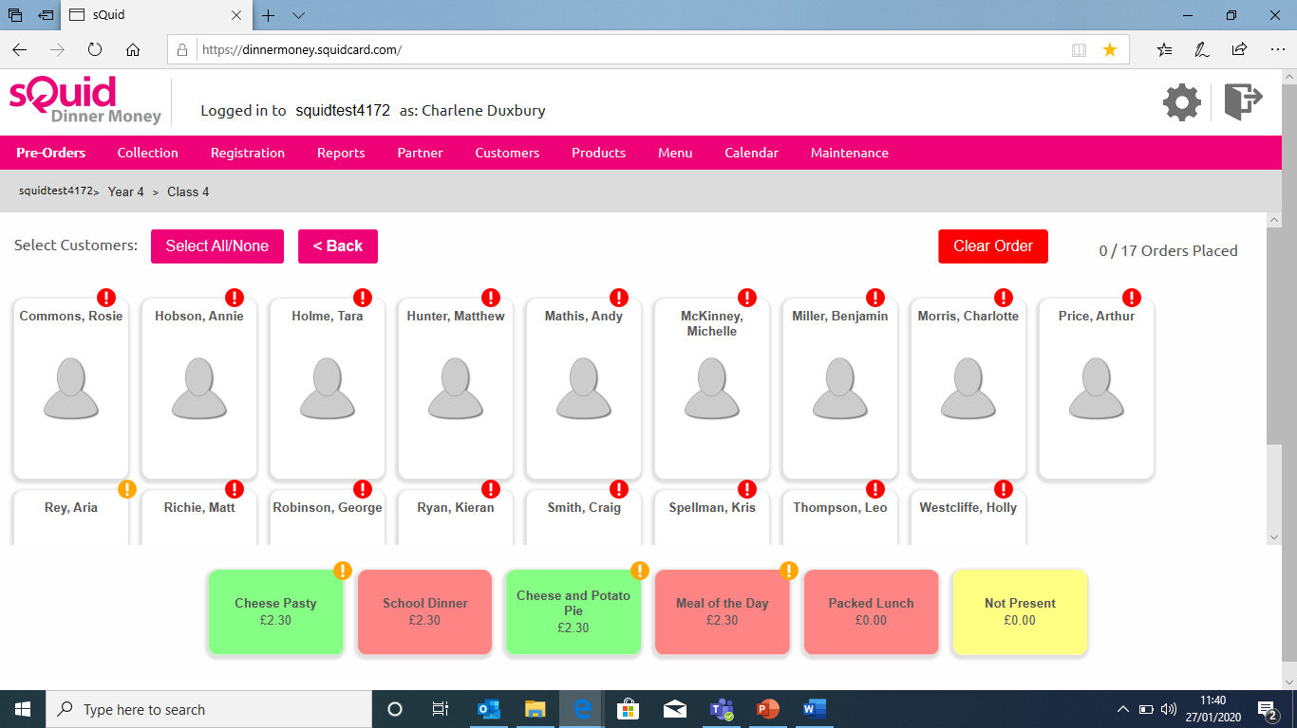
Notes:
Easy, user friendly clean dashboard, making meal ordering and registration simple and streamlined, saving time in the office.

Slide 4
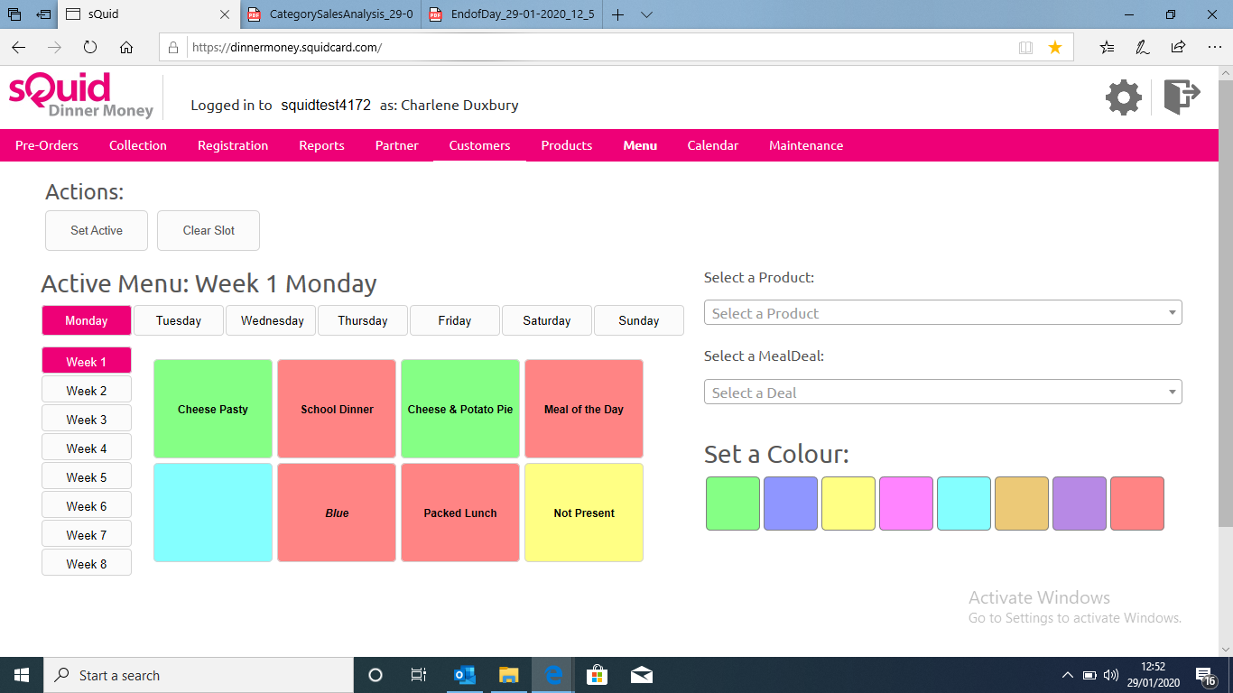
Notes:
Example of a menu

Slide 5
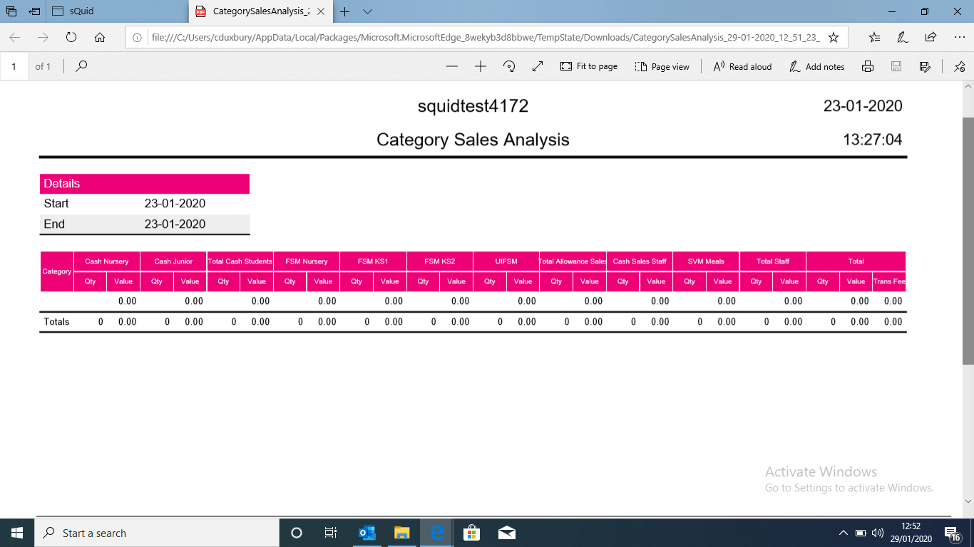
Notes:
Variety of reports at your fingertips- total sales for the day

Slide 6
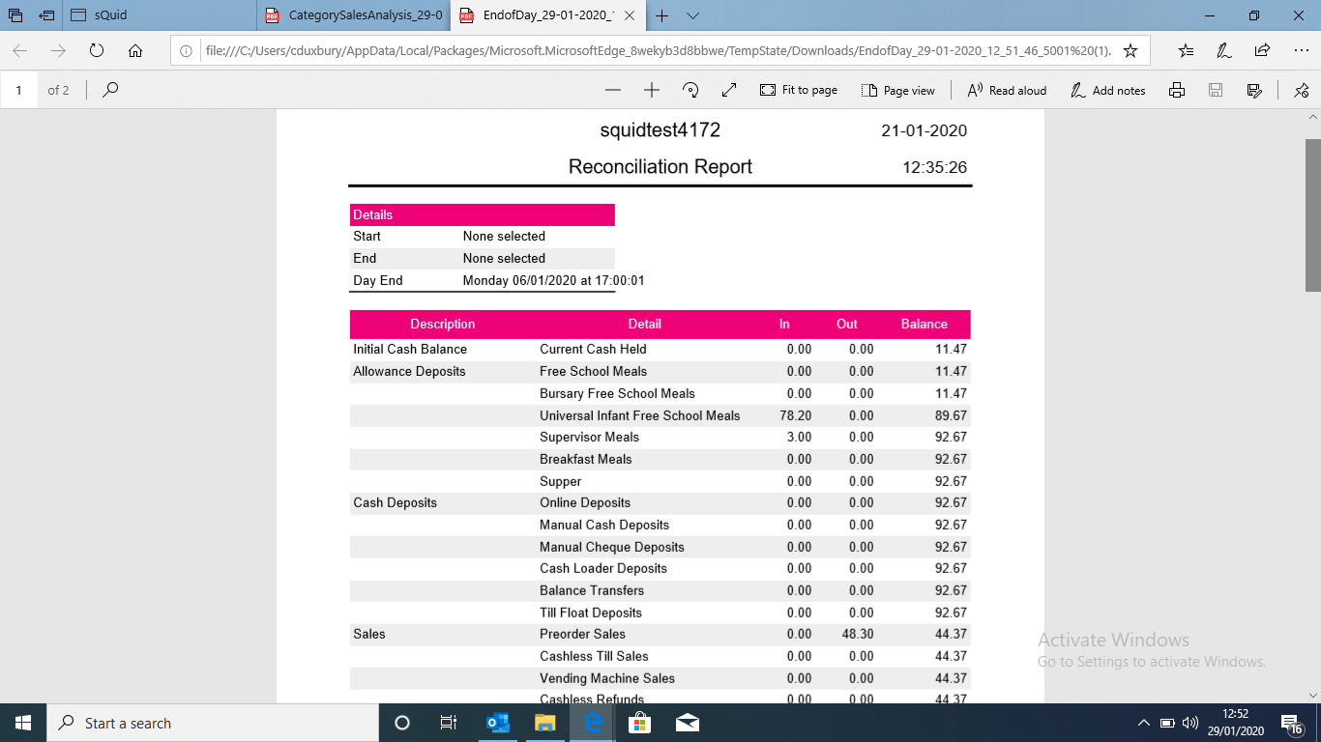
Notes:
Example daily reconciliation/ end of day report

Slide 7
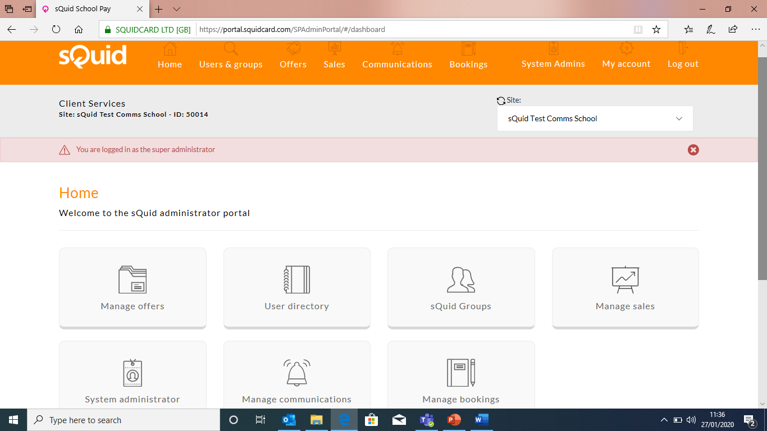
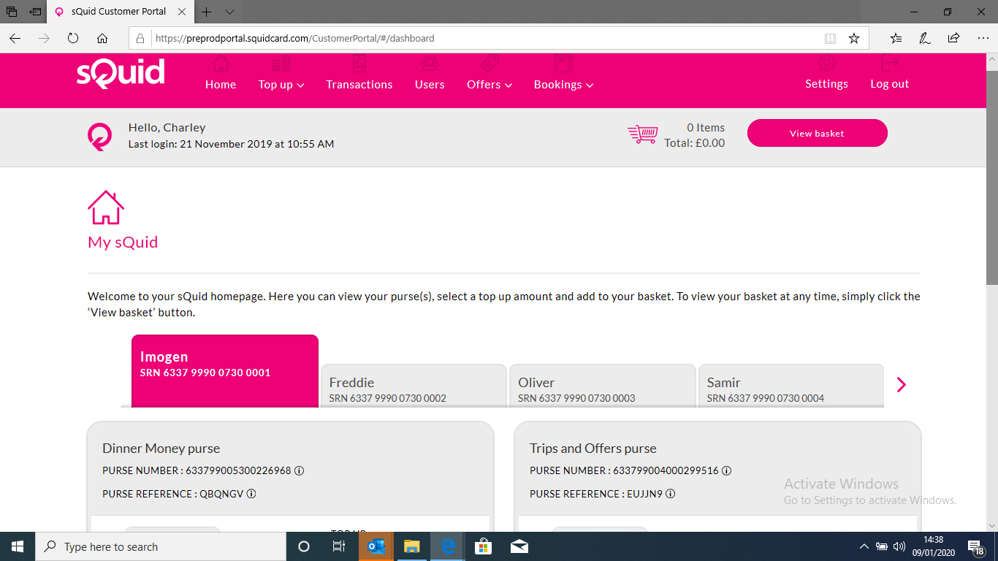
Notes:
What the parents see on the app. Simple and straighforward

Slide 8
Notes:
Use schoolpay to book school trip and offers

Slide 9
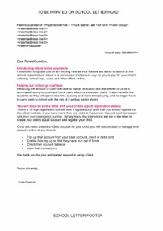
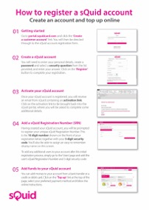
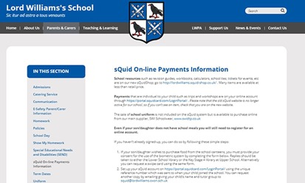
Customer onboarding
Marketing communications support to drive awareness and take up
Welcome letters, information sheets and ‘how to’ guides
Guidance material for campus web page creation
Customer
on-boarding
Digital account
Customer follows guidance materials to create and top up their account
Hard-copy posters and digital assets for on-campus use
Notes:
A comprehensive and supportive onboarding process, designed to keep workload to a minimum for schools. Ongoing support from a dedicated account manager

Slide 10
Why you should choose sQuid
Cuts cash-handling costs and streamlines administration time
sQuid support parents directly – significantly reducing hassle for catering and administration staff
Socially inclusive
Bespoke reports from individual transactions through to centralised aggregated reports
Safe and secure – sQuid is regulated by the FCA
Notes:
Why choose us?

Slide 11
For more information, please contact:
(e) cmckillen@squidcard.com
(m): 07795420299
(T) +44 (0)208 339 2111

