Slide 1
Spirituality across a MAC
Presentation by
Francis Waugh & Megan Ford

Slide 2
All Saints’ Catholic Collegiate
St Thomas More Catholic Academy is part of the All Saints Catholic Collegiate, a Multi Academy Company (MAC) consisting of one secondary school and four primary schools. The Multi Academy was formed in November 2013.
St Thomas More Catholic Academy
St Gregory's Catholic Academy
St Maria Goretti Catholic Academy
St Augustine's Catholic Academy
Our Lady's Catholic Academy.

Slide 3
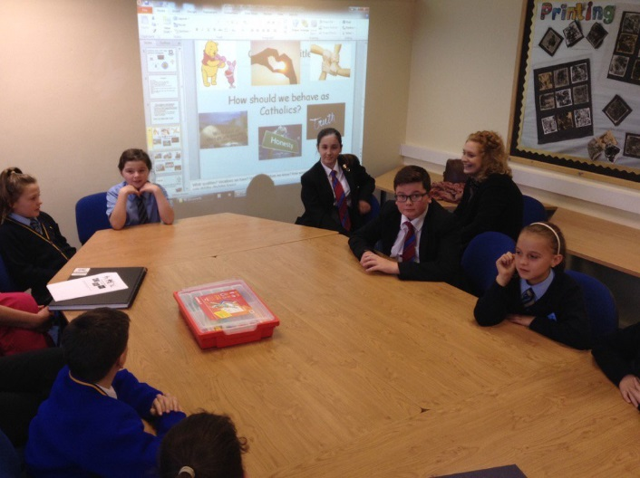
MAC Mission Group
This is a group of staff and pupils that have scheduled meetings to focus on Catholic life / share good practice. Focus areas include:
Development of the MAC Prayer
Development of the MAC Mission Statement and Motto
Development of the MAC Logo
Catholic Virtues
Vocation in our schools
Prayer Life
Recognising God in all things
Spiritual personal reflection – colouring, mind jars, meditation

Slide 4
St Thomas More Catholic Academy Mission Statement
Christ is at the heart of our community, where everyone is known and loved.
In fulfilling our mission we are a school of prayer. We live as a community of love, peace and reconciliation, valuing everyone’s dignity as a child of God to promote and celebrate the growth and achievement of the whole person.
Aspire to be More

Slide 5
All Saints Catholic Collegiate Mission Statement
Our Academy ensures that Christ is at the centre of all that we do and that every member of our community is known, loved and respected.
Through the Gospel Values of love, reconciliation, justice and peace we recognise everyone as a Child of God.
We work together so that our pupils are supported to serve others and achieve their full potential in a caring, safe and secure environment.
United in Faith, Love and Learning

Slide 6
MAC Logo This was the result of a competition for student designs. These were judged by the mac mission group of pupils and then approved by the directors of the MAC.
by the directors of the MAC.

Slide 7
MAC Prayer
Lord Jesus,
Give us guidance from the Holy Spirit.
Bless each of our five academies with
Truth, wisdom, grace and love,
So that we may learn to serve you and one another.
Help us to grow, work, play and pray together as a family.
Help us to keep your love in our hearts
and bring peace to others.
Amen

Slide 8
Events 2016
Year 6 Retreat Morning 09.30- 12pm Tuesday 13 Sept 2016.
MAC Catholic Life CPD @ OLCA - Tuesday 13 September 2016
MAC Mission group Meeting @ OLCA- 6 October 2016
Combined Schools Mass/ MAC Twilight – 13th October 2016.
MAC Catholic Life CPD @ SGCA- 8th November 2016.
MAC Mission Meeting @ STACA- Thursday 17 November 2016
MAC Advent Retreat Week 28 November 2016.
Year 5 Advent Liturgy 09.30-12pm – 9 December 2016.
Teachers Mass 31st January 2017 St Gregs 7pm
MAC Catholic Life CPD @ STMCA – 28th February 2017
MAC Lenten Retreat Week 6 March 2017.
Godspell Performance 30th / 31st March 2017
Year 4 MAC Lenten Retreat Event- 0930-12pm 3 April 2017
MAC Catholic Life CPD @ STACA – 25th April 2017

Slide 9
CPD for New Staff/ Associate Teachers
MAC Catholic Life CPD @ Our Lady's Catholic Academy - Tuesday 13 September 2016
(Induction to Catholic Schools)
MAC Catholic Life CPD @ St Gregory’s Catholic Academy - 8th November 2016 ( Advent Focus)
MAC Catholic Life CPD @ St Thomas More Catholic Academy– 28th February 2017
(Lent Focus)
MAC Catholic Life CPD @ St Augustine’s Catholic Academy – 25th April 2017- (Focus TBA)

Slide 10
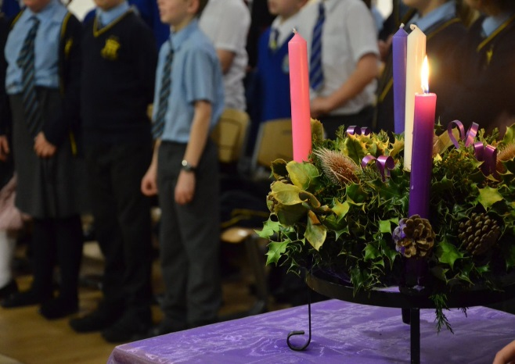
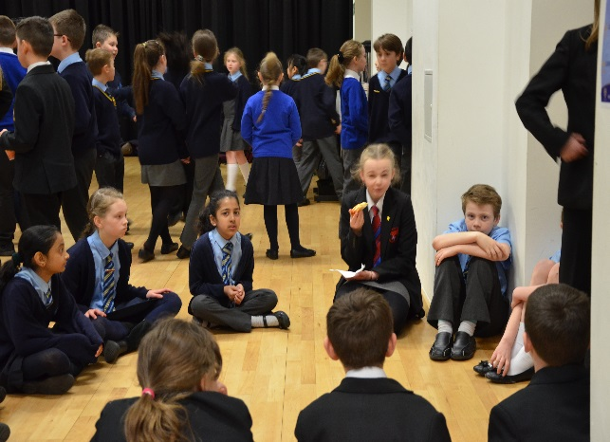
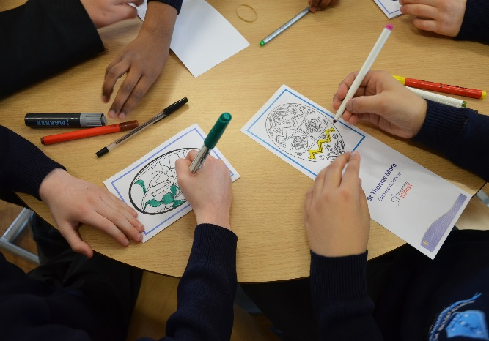
Retreat Programme 2016
We have MAC Retreat days, where Primary Students come to St Thomas More Catholic Academy to participate in these retreat days.
We have them spread out over the year and we mark the beginning of a New school year, Advent and Lent by carrying out a variety of activities and celebrating a liturgy on that theme.
Our YCT (Youth Chaplaincy Team) assist leading sessions on these days.

Slide 11
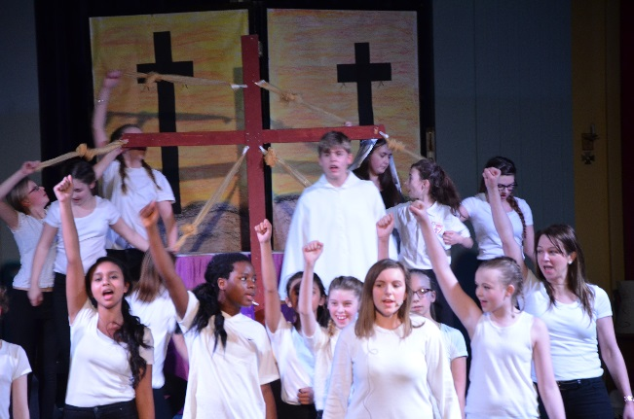
School Productions
Born for This
We have performed Born for This for the last 3 years during Lent. This has been performed at St Gregory’s Catholic Church for the last 2 years
Godspell
This is being performed this year over 2 nights at STMCA.
In both performances MAC schools have participated in this with the choir/ vocal group.

Slide 12
Staff Spirituality
Spirituality weeks Lent and Advent including Emmaus Walk, Meditation, Taize Service, Alpha Course Taster, Stations of the Cross, Advent Prayer service, Spiritual Mindfulness.
Staff INSET Event- see further information
Nightfever Event at St Gregory’s Catholic Church in November 2016 with MAC Staff
Alpha Course- pilot course run at STMCA for staff over 12 weeks

Slide 13
INSET for all MAC staff
Inset 1 2015 Full day INSET – hosted at STMCA with a focus on the role of Catholic Education in our schools, with grateful support of the Diocesan team.
Inset 1 2016 Twilight INSET – hosted at STMCA with a focus on vocation and Catholic Virtues in our MAC, with grateful support of the Dan Vince and Beccy Roseman.
19 September 2016 Margaret and Barry Mizen. Parents of Jimmy Mizen, visited STMCA. The Mizen’s led a very inspirational talk on the Diocesan leadership to all year groups and then to MAC staff .

Slide 14
Liturgy
CATSC- The MAC takes a lead in the organisation of the Catholic Association of Teachers, Schools and Colleges- North Staffordshire Branch
Combined Schools Mass- annual celebration for all schools in the deanery
Vocations Mass-annual celebration for all schools in the deanery ( hosted by ASCC this year)
Teacher’s Mass-annual celebration for all staff in the deanery
Good Shepherd Mass-annual celebration for all school in the deanery ( Fr Hudson’s society focus)

Slide 15
Next Steps…..
Consolidation of the CPD sessions
Consolidation of the Staff Spirituality Week
Promoting staff residential retreat opportunities
Development of SVP across the MAC
MAC Mission

