Slide 1
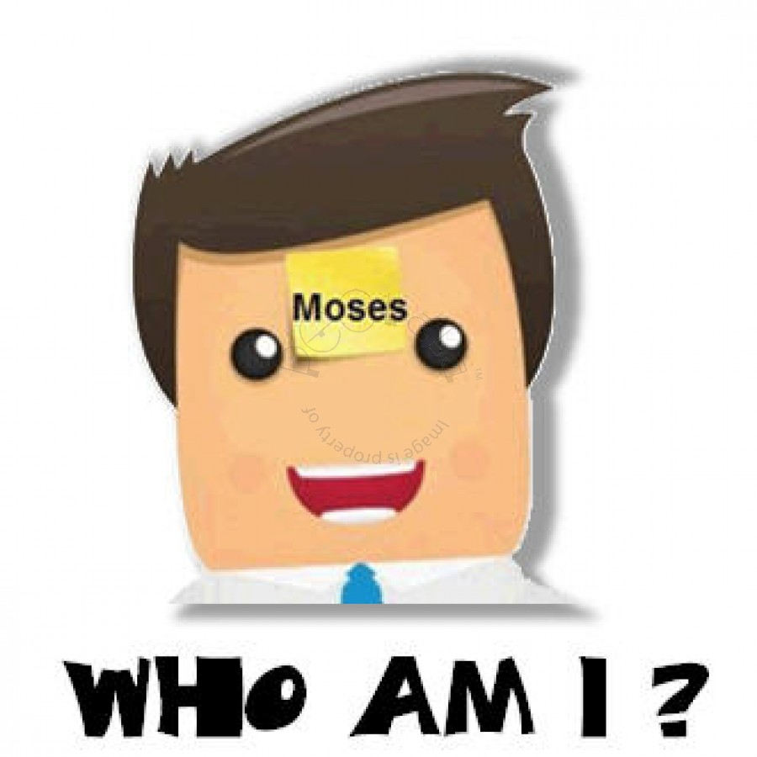
Switch on 2 learning –
Who am I, what am I game?
You will be given the name of:
A person
Film
Book
Event
You MUST ask questions about who you are and you will be told yes or no.
Can you guess who you are?

Slide 2
6 in 5 starter test
What is meant by quality of life?
Who was St. Catherine of Siena?
What was the Stigmata?
What is meant by sanctity of life?
When do Roman Catholics believe life begins?
When do Humanists believe life begins?

Slide 3
Get creative challenge
In pairs you must tell your partner:
WHAT your favourite book is.
WHY you love it.
HOWEVER, you are not allowed to speak or write.
You MUST find a creative way to explain your answer to your partner.
E.g.
A mime
A dance
Acting
Building a model

Slide 4
Y10: Foundational Theology
Where did the Bible come from?
Learning objective:
To examine the origins, structure and literary forms of scripture.

Slide 5
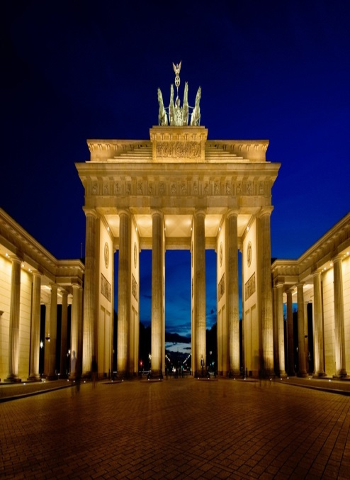
Experiment Wednesdays
As a class today you are going to create a book about Germany.
Challenge 1: On two post it notes, write any two things about Germany.
Then put them on the floor at the front along with everyone else’s facts.
Challenge 2: Categorise your information by –
Genre
Historically
Ancient/Modern
Fact/Fiction/Linguistic
Discussion question:
Where did you get your information from?

Slide 6
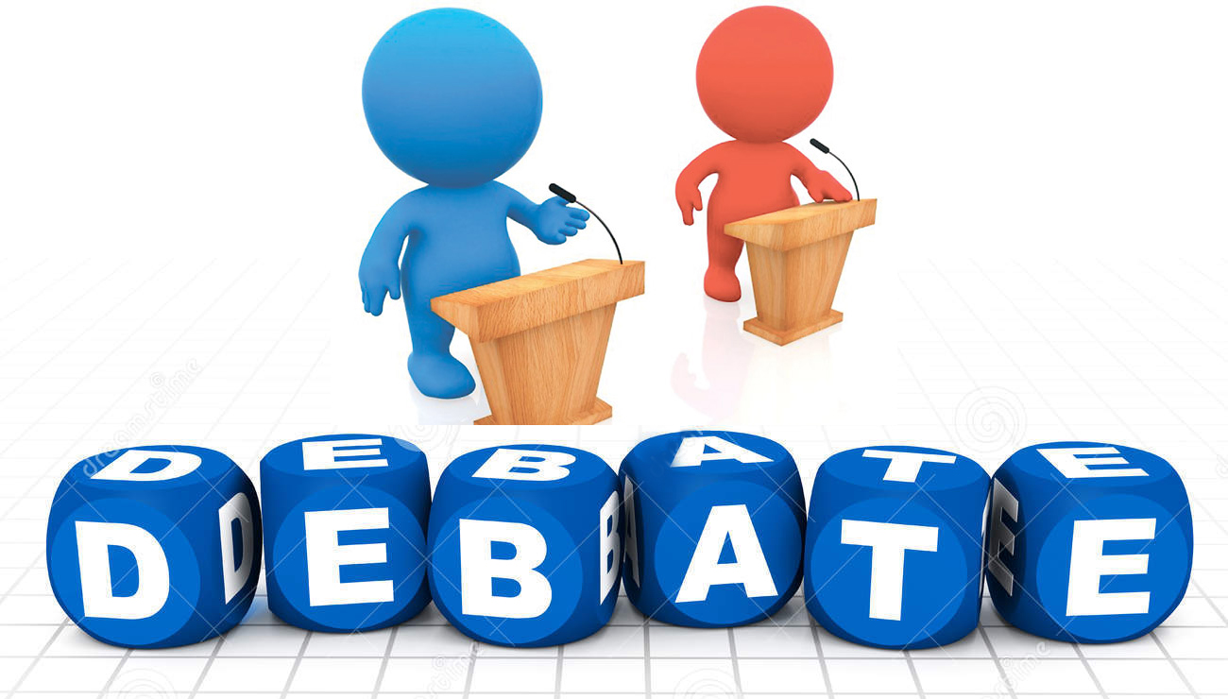
Experiment Wednesdays
As a class today you are going to create a book about Germany.
Challenge 3:
Only 30% of your information can go into your book.
Hold a class council meeting to discuss what information/sections you will keep in the book and what you will keep out.
Discussion question:
Is it easy to make this type of decision?

Slide 7
How was the bible formed?
Watch all the clips. Make a bubble map of as many facts about the formation of the Bible as you can.
Facts
https://www.youtube.com/watch?v=r0Zm8_B_4wA
https://www.youtube.com/watch?v=6k-C3Kse17I

Slide 8
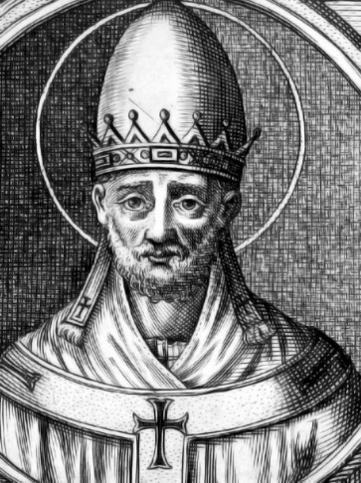
How did the bible take form?
In exactly the same way as you wrote your class book on Germany, so too did the Bible take a similar form over the course of around 2000 years.
Oral teachings: In the days of Noah and Moses writing was a very rare skill. People told each other stories of the Prophets and passed on their teachings verbally to each other, handing down story to their children and their children in turn.
Written teachings: Around 1000BC scribes began to write down the oral stories. These were copied by other scribes and distributed around the Greco-Roman World. This process went on till the 3rd Century, with Gospel writers writing down stories of Jesus and prophets like Paul writing letters to early Churches.
Collecting: In the year 382 a great Council of Bishops was called to bring together all of the scrolls that had been written about Old Testament prophets and Jesus and the early Church. This council decided what should be part of this ‘Bible Canon’ and what should not. In 382 Pope Damasus decreed that the books currently in our Bible were the ones that should be in it.

Slide 9
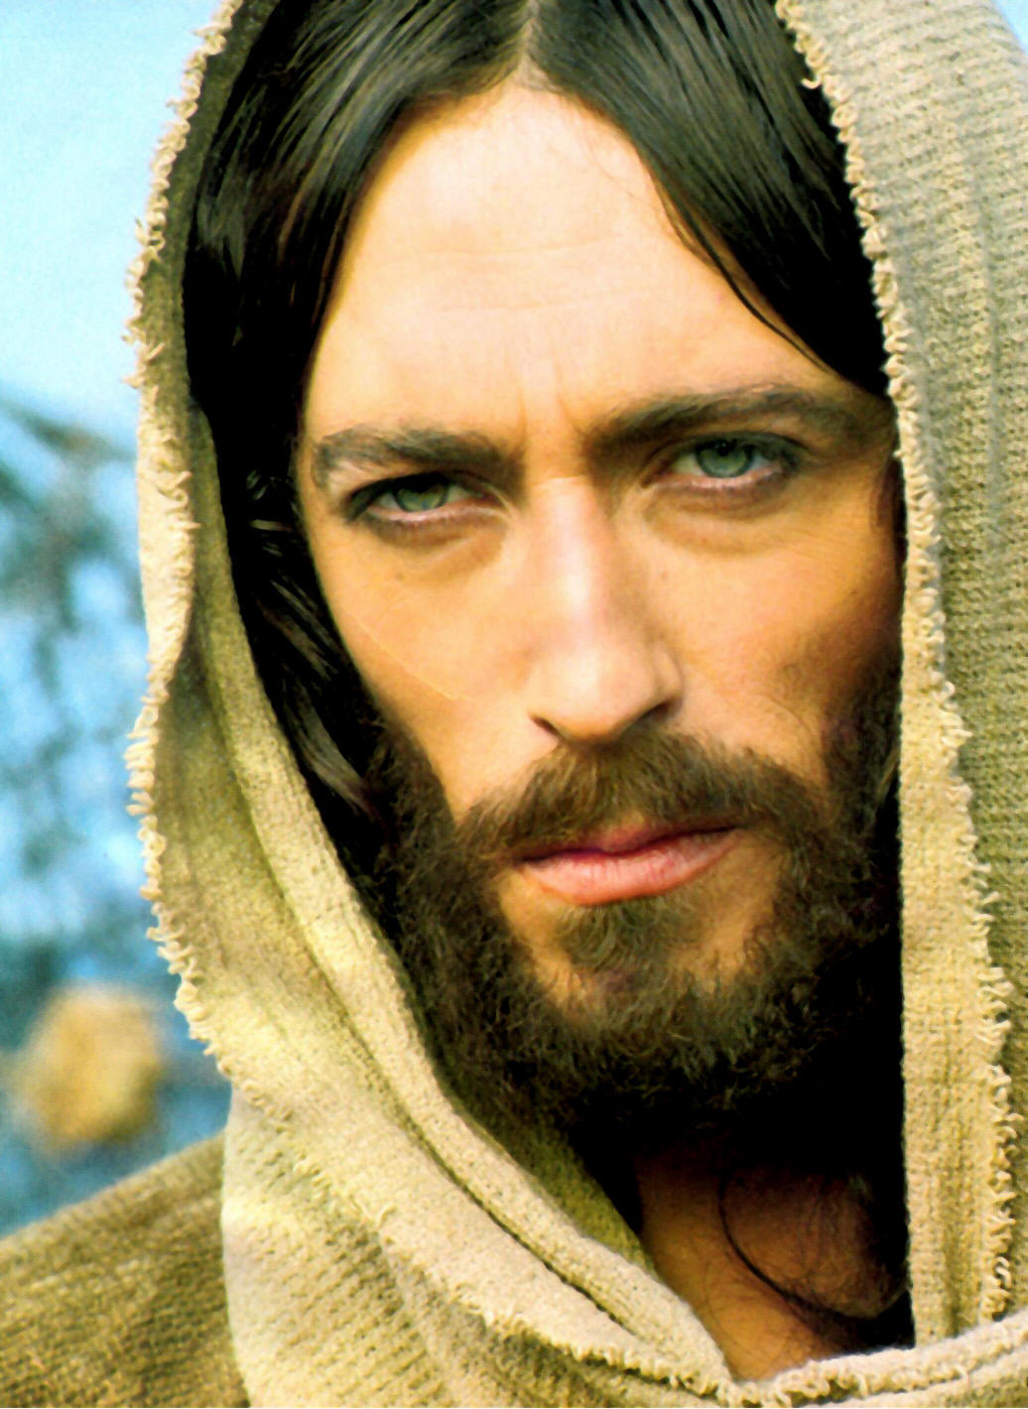
Corners game
What do we already know about the Bible?
Read each question below and move to the wall that you think is the right answer. Those in the wrong corner go out.
Which testament is about Jesus’ life?
The OLD testament
The NEW testament

Slide 10
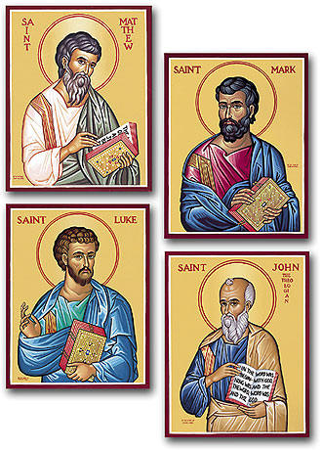
Corners game
What do we already know about the Bible?
Read each question below and move to the wall that you think is the right answer. Those in the wrong corner go out.
Which of the 4 Gospels was written first?
Matthew
Mark
Luke
John

Slide 11
Corners game
What do we already know about the Bible?
Read each question below and move to the wall that you think is the right answer. Those in the wrong corner go out.
The New Testament represents what percentage of the Bible?
10%
23%
33%
55%

Slide 12
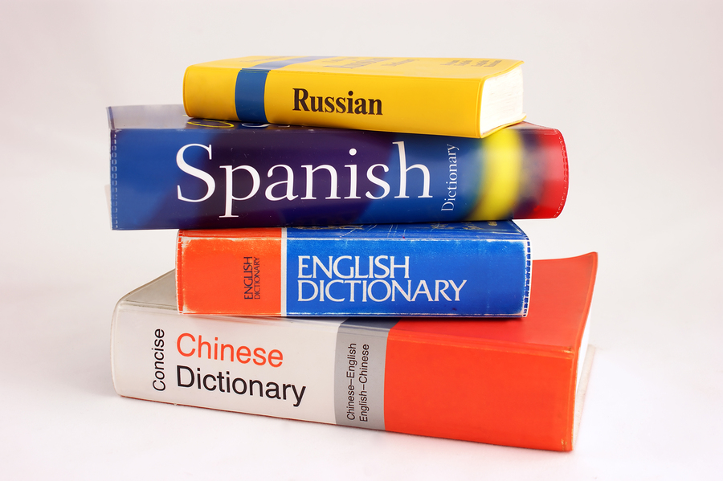
Corners game
What do we already know about the Bible?
Read each question below and move to the wall that you think is the right answer. Those in the wrong corner go out.
What language did Jesus speak?
Aramaic
Hebrew
Greek
English

Slide 13
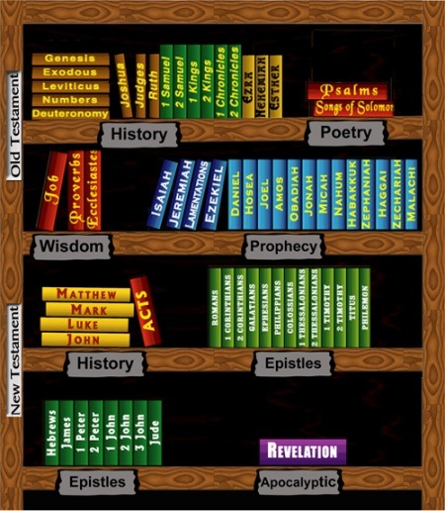
Bible library
The Catholic Bible has 73 books inside it.
These range from history books, to poetry, prediction books, songs, biographies, rule books to letters.
Reading the Bible is just like going to a modern library – there is literally loads of TYPES/GENRES of books in it.
It has been described best as an ‘inspired library’ because of the vast amount of books it contains.

Slide 14
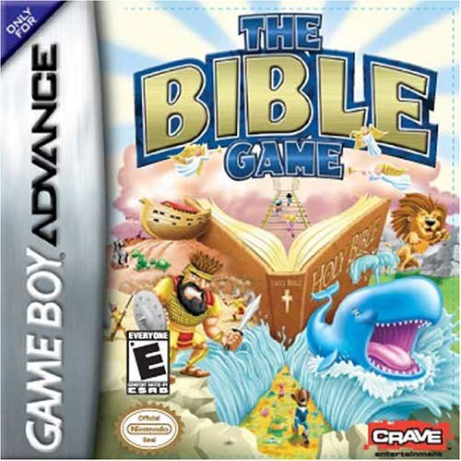
Computer game challenge
You have been invited on to the BBC show the ‘Dragon’s Den’ to pitch your brand new game – the Bible. Today you MUST:
Design your own bible computer game – levels and theme.
Design the front and back cover of your game.
Write a speech explaining what GENRE of game it is? What do people do in it and why should the Dragon’s give you £100,000 to invest in the Bible Game.

