Slide 1
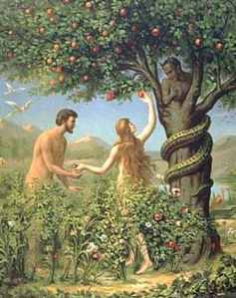
One thing I know about this story is…
One thing that I would like to know more about is…
It would be interesting if…
I believe that the point of this story is…
I can identify a key piece of scripture in the Christian worldview.
Notes:
This slide is to be printed and given to the class as bellwork

Slide 2
How is Christ the new Adam?
Outcmes:
I can know the scripture of Adam and Christ
I can understanding the links between Adam and Jesus, according to scripture
I am able to (referring to scripture/teaching) explain how Christians view Christ as the New Adam in a GCSE C question.

Slide 3
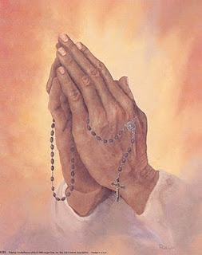
Lord,
Help us in our work today,
Grant us the understanding to achieve, the wisdom to succeed and the courage to let your love guide our way.
We ask this through Christ our Lord.
Amen

Slide 4
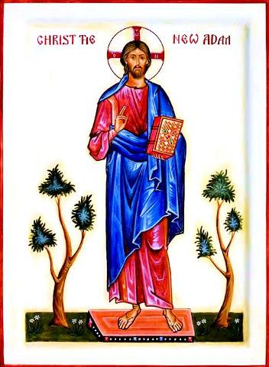
"The first man, Adam became a living being; the last Adam became a life-giving spirit.”
In 1 Corinthians 15:45, St. Paul compares Jesus to Adam
What might this mean?

Slide 5
Task
Why is God angry in Hosea 6:6-7?
How might Isaiah 24:5 give rise to the idea that a saviour is needed?
Romans 5:17-19 makes it clear that…
Read John 17:21-22…rememebering today’s TWAL, what do you think Jesus means by all this?
I can show and understanding of the links between Adam and Jesus, according to scripture

Slide 6
Review – Self Asses
Use your
Green pens!
Why is God angry in Hosea 6:6-7?
How might Isaiah 24:5 give rise to the idea that a saviour is needed?
Romans 5:17-19 makes it clear that…
Read John 17:21-22…rememebering today’s TWAL, what do you think Jesus means by all this?
I can show and understanding of the links between Adam and Jesus, according to scripture

Slide 7
Research – Jesus as the ‘New Adam’
I will give you a number 1-8 and you must start at the station number I give you.
You will visit 8 stations and read the info before you at each station.
After reading the info, answer the questions on your research sheet in the relevant box.
Do not move on to the next station until I say.
3/4 minutes at each station.
I can independently research and annotate effective notes on the Christian narrative from Adam to Christ and the idea of the Cross as The Tree Of Life

Slide 8
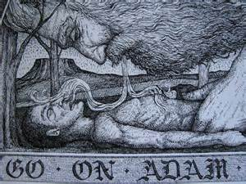
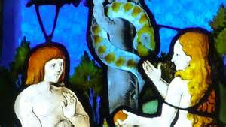
1. Adam – The Fall
In Genesis 1, we learn that Adam was formed out of the dust of the earth by God. God breathed the breath of life into Adam.
The perfect and sin-free Adam eventually fell in Genesis 3 by disobeying God, accepting the lies of the Devil (about not dying and being like God), and eating the forbidden fruit from a tree, which allowed sin and damnation to enter the world.
God then told Adam that he would have to toil the earth to obtain his daily bread. He would do this with sweat on his brow, and the ground would be full of thorns. Adam, the bridegroom of Eve, was naked, and had to start wearing clothes as a result of his disobedience (became aware of shame).

Slide 9
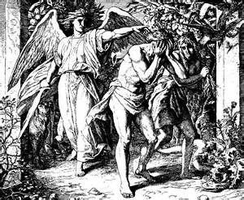
2. Adam - Expulsion
Adam was ejected from Paradise by God, so that he would not eat the fruit of another tree in the Garden of Eden, known as the tree of life, which would give him eternal life.
An angel with a sword was then stationed at the gate of Paradise to guard it so as to prevent Adam from re-entering.

Slide 10
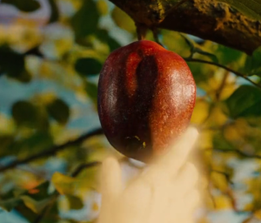
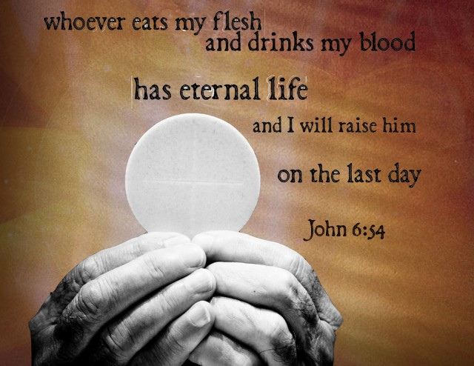
3. The Two Lies
The Devil said that if you eat the forbidden fruit, “You shall not die.” (LIE!). By eating the fruit of the cross, the flesh and blood of Christ, “You shall live forever,” said Jesus (TRUTH!).
The Devil also told Adam that if he ate the forbidden fruit, he would be like God (LIE!). Jesus said that if we eat His flesh and drink his blood, He would abide in us, and we in Him (TRUTH!).

Slide 11
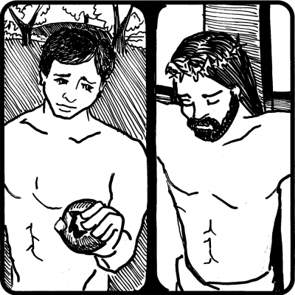
4. Jesus - The New Adam
The perfect and sin-free Jesus declared Himself to be The Bread of Life in John 6.
He said that we must eat His flesh and drink His blood to have eternal life. This reference to eating, of course, is the medication to overcome what Adam did.
Jesus, who died on the tree of life known as The Cross, commands us to eat the fruit from that tree (His flesh and blood), so as to give us eternal life and to overcome the two lies of the Devil to Adam.

Slide 12
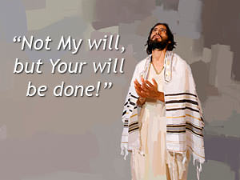
5. Obedience
Just as Adam’s disobedience to God allowed sin and damnation to enter the world, the obedience of Jesus, the new Adam, to God, his loving Father, allowed salvation to enter the world.
Just as Adam threw away his sinless status through disobedience, Jesus kept his sinless status through obedience.
Jesus said that the Devil is the ruler of this world, in John 14:30. Jesus is the ruler of the everlasting world, in Heaven. Just as the Devil once conquered man in Paradise, the dwelling place of God, now, Jesus, a man who is not only like God, but who IS God, conquers the Devil in his dwelling place, this world.

Slide 13
6. Adam’s Curse vs. Jesus’ Passion
Adam | Jesus
Disobedience led to a fall from perfection to hard work on the land. This involved sweat on Adam’s brow and thorns on the land | Garden of Gethsemane – Jesus sweat blood, and then in Jerusalem, when he had a crown of thorns placed on His head.
Adam was naked and had to put clothes on as a result of his disobedience. | Jesus, through His obedience to God, was clothed on the way to Calvary, and then stripped naked before crucifixion.
Adam was formed out of the dust of the earth. | Jesus fell three times into the dust of the Via Dolorosa on the way to Calvary.
Adam fell because of the wooden tree of knowledge of good and evil. | Jesus fell under the weight of the wooden cross.
God breathed the breath of life into mankind. | Jesus suffocated on the cross through the actions of mankind. The only one who could atone for Adam’s sin.

Slide 14
7. Cross as the Tree Of Life
In essence, the cross represents the intersection of two lines. The vertical axis is the divine, the horizontal is the human, and the meeting point between them represents the unity of heaven and earth, human and divine. It is like meeting the divine in the human heart.
With the Fall of Adam and Eve this unity was disrupted, according to Christian perspective. So the crucifixion of Christ becomes necessary to restore this unity through his self-sacrifice in order to atone for Adam and Eve’s partaking in the fruit of the Tree of Knowledge of Good and Evil.
Catholics believe that the cure for Adam and Eve’s disobedience when they ate of the fruit of the Tree of Knowledge of Good and Evil is to eat of the fruit of the Cross (the Body and Blood of Christ).
Notes:
This slide is very important!

Slide 15
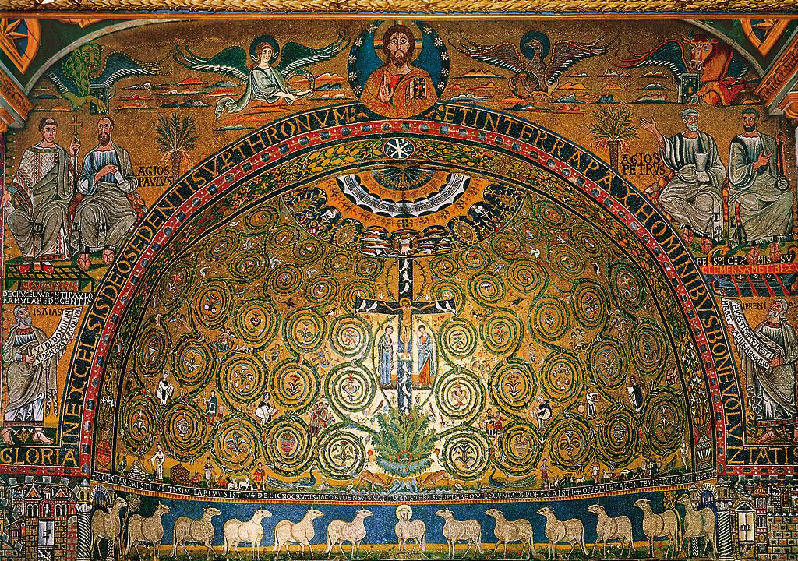
7. Cross as the Tree Of Life

Slide 16
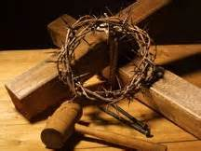
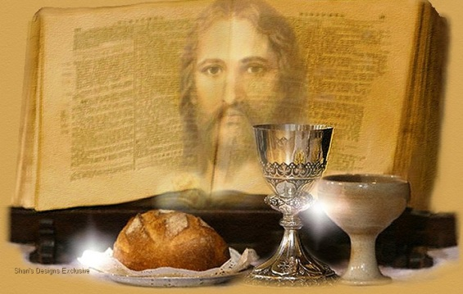
8. Other Imagery In The Bible
Jesus - a man who made his living with wood, using a hammer and nails, was slain by mankind with a hammer, wood, and nails.
Jesus, the Bread of Life, was born in the town of Bethlehem, which means in English “House of Bread.” His mother placed him in a manger which is a feeding trough for sheep.
Jesus offers Himself as daily bread in Mass, which is something Catholics pray for every time they say the Our Father – “Give us this day OUR DAILY BREAD (daily bread is a reference to manna, the supernatural bread for the people of God in the desert after they escaped slavery in Egypt).

Slide 17
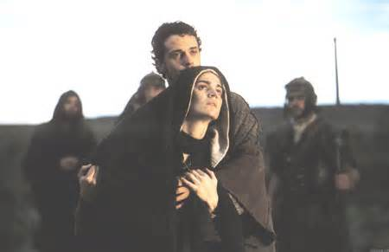
8. Jesus The Bridegroom.
Many Christians also see bridegroom imagery during the Passion of Christ as well.
It was previously mentioned that Jesus was stripped naked before crucifixion. This is something that the bridegroom does before his bride on the wedding night.
Jesus said from the cross to his beloved disciple, “Behold your mother.” And to Mary he said, “Behold your son!” These are words that one would normally hear in a maternity ward, at the birth of a new child. But here the words are in reference to Jesus giving birth to the Church.

Slide 18
Section C practice GCSE question
‘’Explain the theological concept of Jesus as the New Adam’’
8 Marks
4x RE needed to gain full marks
1 X RE - First
1 X RE – Secondly
1 X RE – Thirdly
1 X RE – Finally

Slide 19
Review - Peer Assess
Use your
Green pens!
Reminder of possible material in a good answer:
I can effectively judge the quality of another's exam answer
Notes:
Your research sheets will also help you assess your partner’s work.

Slide 20
Review – think outside the box
How might this song be linked to today’s lesson? Draw your own links between faith and popular culture.
Sigh No More (click on this link)
Lyrics on the next slide

Slide 21
Serve God love me and mend This is not the end Live unbruised we are friends And I'm sorry I'm sorry
Sigh no more, no more One foot in sea one on shore My heart was never pure You know me You know me
And man is a giddy thing Oh man is a giddy thing Oh man is a giddy thing Oh man is a giddy thing
Love that will not betray you, dismay or enslave you, It will set you free Be more like the man you were made to be There is a design, An alignment to cry, Of my heart to see,
The beauty of love as it was made to be
Love that will not betray you, dismay or enslave you, It will set you free Be more like the man you were made to be There is a design, An alignment to cry, Of my heart to see, The beauty of love as it was made to be
Love that will not betray you, dismay or enslave you, It will set you free Be more like the man you were made to be There is a design, An alignment to cry, Of my heart to see, The beauty of love as it was made to be

