Slide 1
Monday 27th April
There are notes in the note section underneath each slide.
We are currently in the Third week of Easter.
Easter Sunday was 12th April.
In church the altar cloth would be white and the priest would be wearing white garments.

Slide 2
Let us pray
Dear Lord,
As we continue with Lockdown and these uncertain times we pray in thanksgiving for all those people in key jobs such as the NHS, care workers and those in supermarkets. We give thanks for their work and their commitment to helping others. We pray that we will be as generous with our talents when the time comes.
In Jesus’ name we pray,
Amen

Slide 3
Bible readings: John 6: 22-29
Next day the crowd which had stayed on the other side of the lake realized that there had been only one boat there. They knew that Jesus had not gone in it with his disciples, but that they had left without him. Other boats, which were from Tiberias, came to shore near the place where the crowd had eaten the bread after the Lord had given thanks. When the crowd saw that Jesus was not there, nor his disciples, they got into those boats and went to Capernaum, looking for him.
When the people found Jesus on the other side of the lake, they said to him, “Teacher, when did you get here?” Jesus answered, “I am telling you the truth: you are looking for me because you ate the bread and had all you wanted, not because you understood my miracles. Do not work for food that spoils; instead, work for the food that lasts for eternal life. This is the food which the Son of Man will give you, because God, the Father, has put his mark of approval on him.” So they asked him, “What can we do in order to do what God wants us to do?” Jesus answered, “What God wants you to do is to believe in the one he sent.”

Slide 4
The bread of life
So this story happens straight after the feeding of the 5000. Why are the people so desperate to see Jesus again so soon? Perhaps because they think he will take away their hunger for ever and will always make sure that they get plenty of bread and fish ! But Jesus tells them that this kind of food will mean they will get hungry again, He instead Jesus tells them to “work for the food that lasts for eternal life. ”
This is often called The bread of life. What do you think this is?
Notes:
Think about when bread is used in Church, what does it represent? Why might Jesus be called the bread of life? How does having the bread that Jesus offers give us life and is this life only on earth or in heaven too?

Slide 5
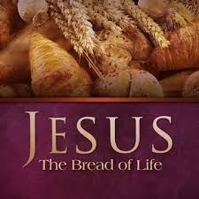
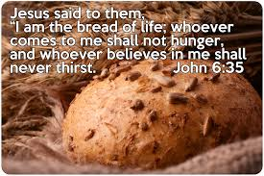
Jesus is telling us that he is the bread of life.
Notes:
When we take communion we are taking Jesus’ body in to ourselves, we are taking in the sacrifice won on the cross. This new food is the living bread that will last forever and hel us to gain eternal life.
Why did Jesus chose to use the example of bread? Because bread was and is a common, cheap food. One that all people eat and it fills you up, for many in Jesus’ time without bread thy would have starved, so Jesus is saying that God, as the new bread, is what will fill us up. Without God we will be hungry forever.

Slide 6
Task
The next page has a word search of connected words to find. If you can try and highlight them on this PP if you cant print it out. Or maybe use the words and create your own word search. See if your family can find your words.

Slide 8
Let us pray
Dear Lord,
Help us Lord to hear your message that you are the Bread of Life. Help us to know that what we crave for is you, that you are the only thing that can fill us up entirely.
In Jesus’ name we pray,
Amen

Slide 9
Hymn
Notes:
https://www.youtube.com/watch?v=1CRMbh8ViUI
I am the Bread of Life
Mar 11, 2015
3:49 seconds.

