Slide 1
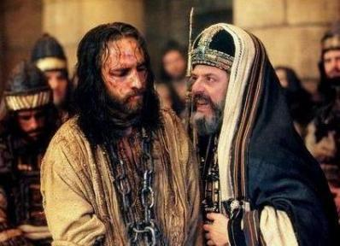
The Trial of Jesus
Who accused Jesus of committing a crime?
Think-pair-share
What was Jesus accused of at the trial?
If you were put on trial when you had done nothing wrong how would you feel? What would you do or say?

Slide 2
Learning Objectives
To understand what happened at Jesus’ trial before the Sanhedrin and Pontius Pilate.
To evaluate the different opinions about Jesus during the trials and justify your own opinion.
Key Word:
Sanhedrin: Jewish ruling council at the time of Jesus.
Calvary: The hill where Jesus was crucified. Also known as Golgotha.

Slide 3
What would you do?
In groups of four, make a plan to decide how you would resolve this problem and get the people to support your party again.

Slide 4
How would you make the plumber an example to stop other revolutionaries from coming forward and destroying your good reputation?
How would you convince people that your views were the right views?
In groups of four, make a plan to decide how you would resolve this problem and get the people to support your party again. Answer the following questions:
How would you stop the plumber from spreading his views?

Slide 5
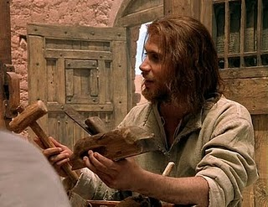
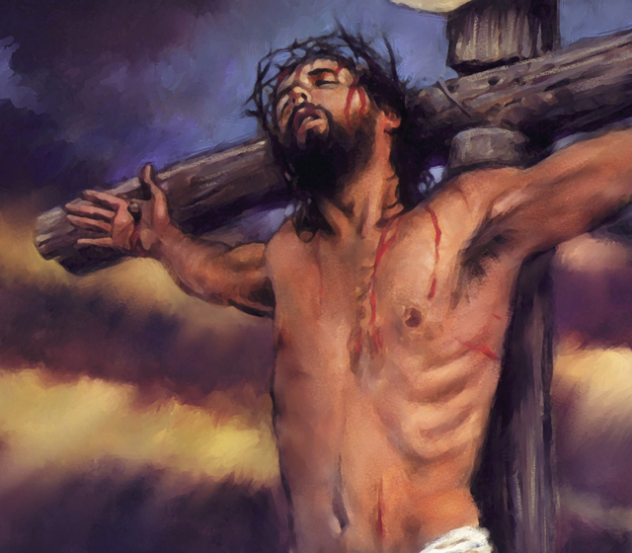
That story is very much like the story of Jesus.
Jesus was a carpenter who lived a simple life.
He would join in listening to teachings in the temple and would sometimes teach others.
For a while the Pharisees and Jewish leaders listened but then Jesus began to criticise their actions and they became angry.
They taught about God but did not love God — they did not enter the kingdom of heaven themselves, nor did they let others enter.
The leaders decided to do something about this revolutionary, they had him trialled before the Sanhedrin, sent to the Roman Court and sentenced to death!!!

Slide 6
Matthew 26:57-68
Jesus Is Questioned by the Council
⁵⁷ After Jesus had been arrested, he was led off to the house of Caiaphas the high priest. The nation’s leaders and the teachers of the Law of Moses were meeting there. ⁵⁸ But Peter followed along at a distance and came to the courtyard of the high priest’s palace. He went in and sat down with the guards to see what was going to happen.
⁵⁹ The chief priests and the whole council wanted to put Jesus to death. So they tried to find some people who would tell lies about him in court.^{[a]} ⁶⁰ But they could not find any, even though many did come and tell lies. At last, two men came forward ⁶¹ and said, “This man claimed that he would tear down God’s temple and build it again in three days.”
⁶² The high priest stood up and asked Jesus, “Why don’t you say something in your own defense? Don’t you hear the charges they are making against you?”⁶³ But Jesus did not answer. So the high priest said, “With the living God looking on, you must tell the truth. Tell us, are you the Messiah, the Son of God?”^{[b]}
⁶⁴ “That is what you say!” Jesus answered. “But I tell all of you,
‘Soon you will see
the Son of Man
sitting at the right side^{[c]}
of God All-Powerful
and coming on the clouds
of heaven.’”
⁶⁵ The high priest then tore his robe and said, “This man claims to be God! We don’t need any more witnesses! You have heard what he said. ⁶⁶ What do you think?”
They answered, “He is guilty and deserves to die!” ⁶⁷ Then they spit in his face and hit him with their fists. Others slapped him ⁶⁸ and said, “You think you are the Messiah! So tell us who hit you!”

Slide 7
Luke 23:1-12
Pilate Questions Jesus
¹¹ Jesus was brought before Pilate the governor, who asked him, “Are you the king of the Jews?”
“Those are your words!” Jesus answered. ¹² And when the chief priests and leaders brought their charges against him, he did not say a thing.
¹³ Pilate asked him, “Don’t you hear what crimes they say you have done?”¹⁴ But Jesus did not say anything, and the governor was greatly amazed.
The Death Sentence
¹⁵ During Passover the governor always freed a prisoner chosen by the people.¹⁶ At that time a well-known terrorist named Jesus Barabbas^{[a]} was in jail. ¹⁷ So when the crowd came together, Pilate asked them, “Which prisoner do you want me to set free? Do you want Jesus Barabbas or Jesus who is called the Messiah?” ¹⁸ Pilate knew that the leaders had brought Jesus to him because they were jealous.
¹⁹ While Pilate was judging the case, his wife sent him a message. It said, “Don’t have anything to do with that innocent man. I have had nightmares because of him.”
²⁰ But the chief priests and the leaders convinced the crowds to ask for Barabbas to be set free and for Jesus to be killed. ²¹ Pilate asked the crowd again, “Which of these two men do you want me to set free?”
“Barabbas!” they replied.
²² Pilate asked them, “What am I to do with Jesus, who is called the Messiah?”
They all yelled, “Nail him to a cross!”
²³ Pilate answered, “But what crime has he done?”
“Nail him to a cross!” they yelled even louder.
²⁴ Pilate saw that there was nothing he could do and that the people were starting to riot. So he took some water and washed his hands^{[b]} in front of them and said, “I won’t have anything to do with killing this man. You are the ones doing it!”
²⁵ Everyone answered, “We and our own families will take the blame for his death!”
²⁶ Pilate set Barabbas free. Then he ordered his soldiers to beat Jesus with a whip and nail him to a cross.

Slide 8
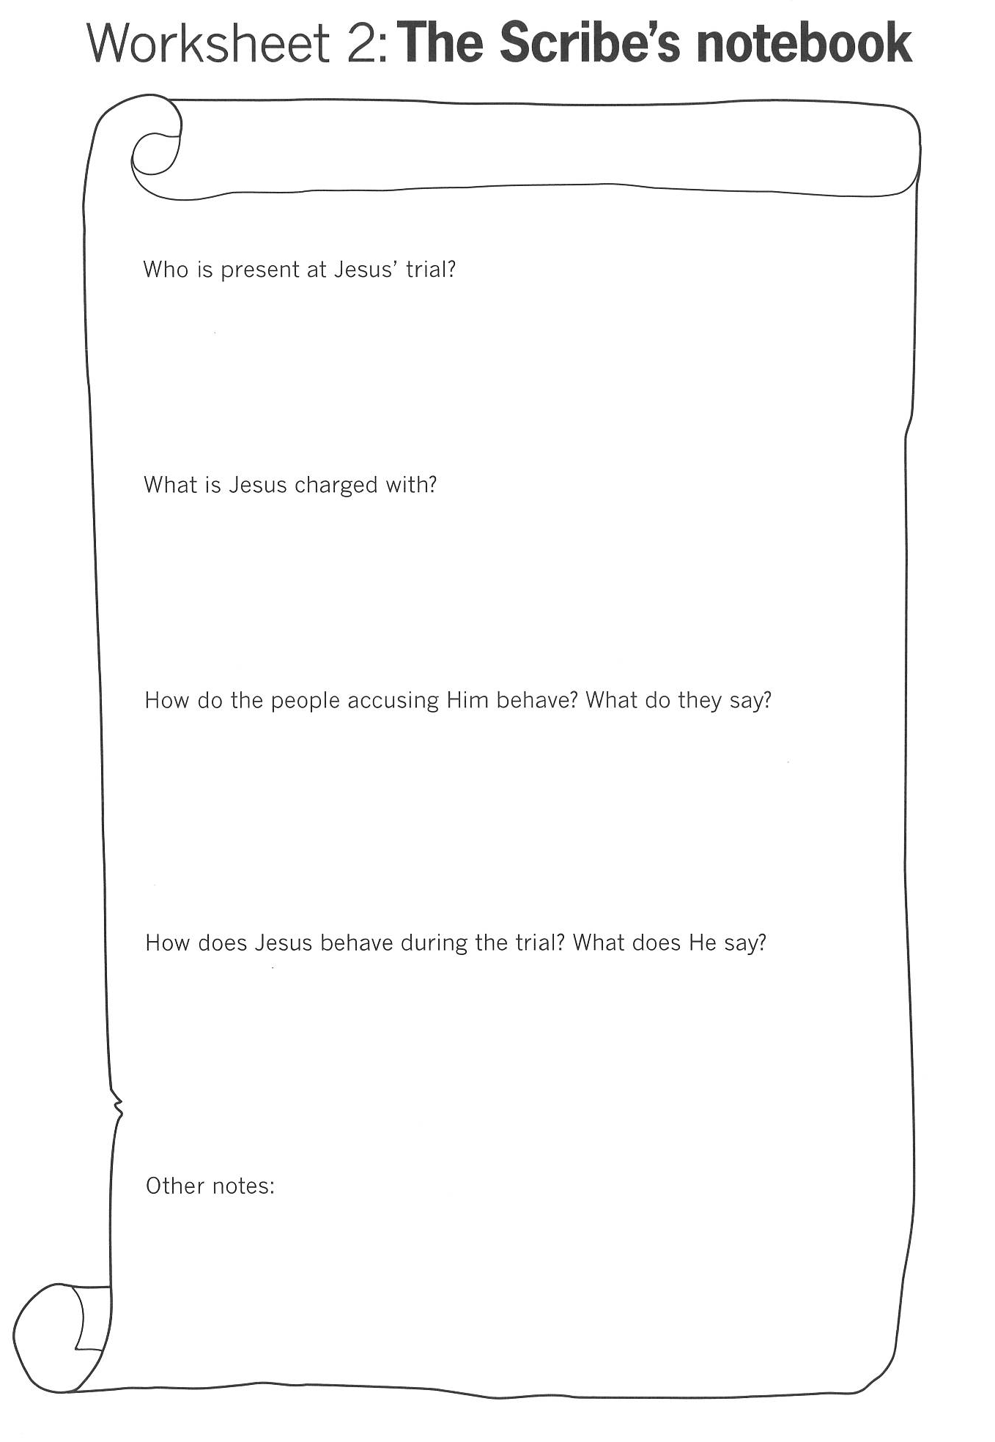
The scribes notebook drawing information from the Gospels.

Slide 9
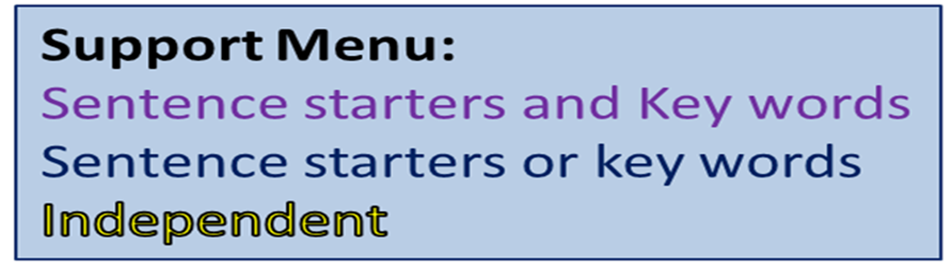
Under the title ‘Who does he think he is?’ write a newspaper article for the Jerusalem Journal all about the trial and crucifixion of Jesus.
Things to include:
Brief description of what happened at the trials.
Different witnesses opinion about Jesus and whether he deserves to be sentenced to death.
Your opinion about Jesus & whether he deserved to be sentenced to death.
Who was with Jesus?
Who decided Jesus should be killed?
What Jesus said and did.
Key Words
Disciple
Sanhedrin
Holy Week
Passion
Pharisees
Calvary
Peter’s Denial
Pontius Pilate
Resurrection
Crucifixion
Covenant

Slide 10
What have we learnt today?
What is a Sanhedrin?
Who tried Jesus?
Who sent Jesus to Pilate?
What was Jesus accused of?
Who decided Jesus should be sentenced to death?

