Slide 1
Starter test 5 in 5
You have 5 minutes to answer 5 questions about what we have studied recently
Name two ways you can be a good steward.
Name three features of the ‘Tree of Life’ mosaic.
Name two biblical laws that some biblical fundamentalists follow.
What is the difference between genesis 1 and genesis 2?
In what year was the current law on abortion made?

Slide 2
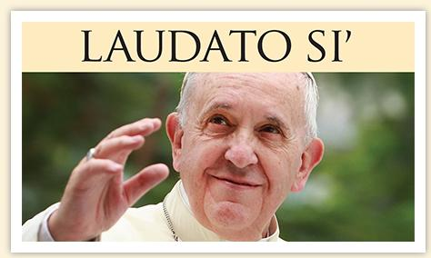
Y10: Foundational Theology
Imago dei and catholic social teaching
Learning objective:
To examine the importance and teachings of Catholic Social teachings.

Slide 3
Dilemma Wednesday’s
You are walking down the street when you see in front of you a woman on her own being mugged.
The mugger is violent and seems to be carrying as weapon.
The woman sees you and screams for you to help her.
Blue hat:
What will you do?
White hat:
What are your reasons for this choice?
Yellow hat:
What are the benefits of your choice?
Black hat:
What are the problems of your choice?

Slide 4
Catholic social teaching
Watch the parable of the Good Samaritan from the Tramps Parables series.
What is the message of this parable?
How can Catholics live out the message of this parable today?
http://www.bbc.co.uk/programmes/p01117f8
http://www.bbc.co.uk/programmes/p0110xlk

Slide 5
Mirror image game
Today we are going to play an exciting game.
Standing in pairs you must label yourselves A and B.
A is going to face B.
A must imagine they are looking in a mirror and can do anything they want.
B must copy.
Then after a minute you will switch and B will lead and A will copy.

Slide 6
Imago dei experiment
Catholics follow social teachings like the parable of the Good Samaritan because we see that God is in everyone.
We believe that everyone is made in God’s image, that each person is made unique by God and therefore we must make the world a better place for each other.
We must be good stewards, care for one another, follow the Golden rule and ‘love thy neighbour’ also.

Slide 7
CST in 3 minutes
What is CST?
https://www.youtube.com/watch?v=ELyLdMlFdzA
Learning objective:
To examine the importance and teachings of Catholic Social teachings.

Slide 8
Cst in a nutshell
For Catholics:
Everyone is made in God’s image.
Everyone is equal.
Everyone should be looked after – Catholics have a duty to help the poor.
Help should be practical e.g. teach people to farm, give them the tools to fish, help them set up micro-businesses.
Learning objective:
To examine the importance and teachings of Catholic Social teachings.

Slide 9
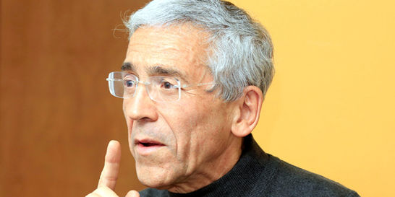
Cst in action
Father Pacho was a Catholic Priest who worked with CAFOD during the Columbian Dictatorship.
Father Pacho stood up for the rights of the poor, the innocent and defenceless.
His life was threatened many times but he stood up to campaign for food, water, healthcare, education and human rights for the innocent.
The rebels who ran the government arrested him and sentenced him to death. Fortunately he was freed in 2012.

Slide 10
Cst in action: Romero
How does Romero live out CST?
https://www.youtube.com/watch?v=aZ2j9W780Mo
https://www.youtube.com/watch?v=IuZV6whwj1g

Slide 11
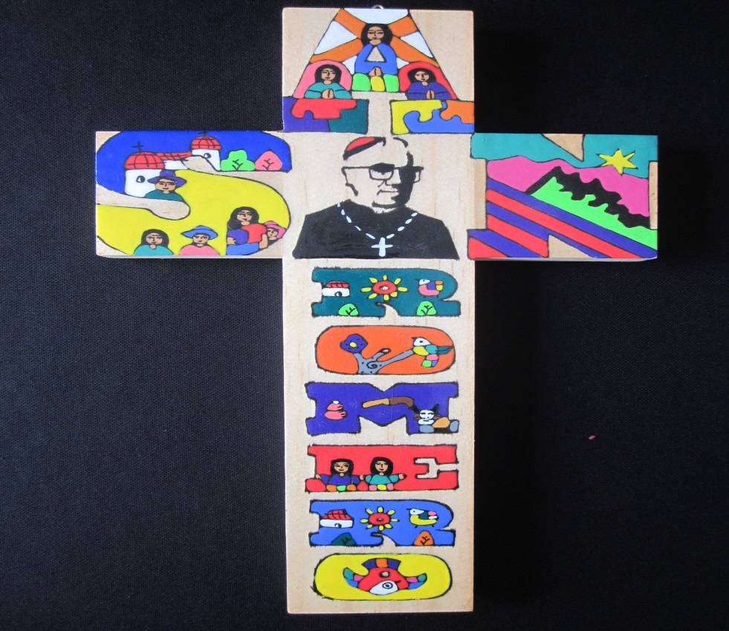
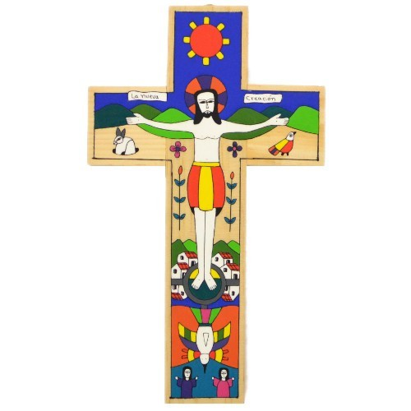

Slide 12
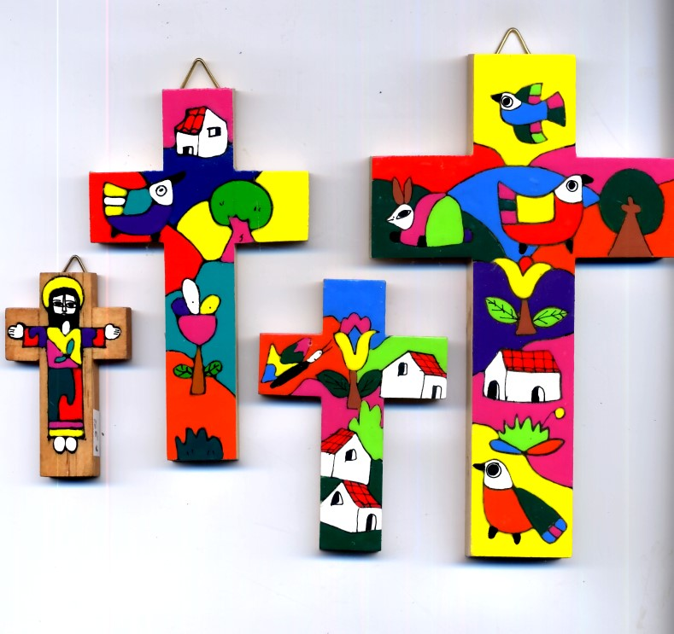
El salvadorian crosses plenary
El Salvadorian crosses tell a story.
Often about the life of someone like Romero, Jesus, Noah or Father Pacho.
In cultures where people cannot read or write they are a pictoral way of telling someone’s story.
Challenge: Design an El Salvadorian cross to show how Catholics can live out the Catholic Social teachings today.
Your cross must be:
Eye-catching,
Colourful
Informative.

