Slide 1
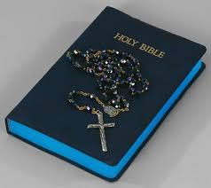
How do these images reflect our mission as teachers of Religious Education?

Slide 2
Deep understanding of the Catholic faith
A love of learning!

Slide 3
On your post it…
Write one example of good practice which you’ve experienced when teaching the Catholic Christianity aspect of the new GCSE course so far…

Slide 4
Give students a lot of information about a topic and challenge them to find key information from the information by providing a ‘board rush’ with a selection of appropriate questions.
BOARD RUSH
Individual, Pairs or Groups!
Students can be challenged to complete this task independently, with another student or a group of students…

Slide 5
Nicene Creed
What is the Nicene Creed? | What was the approximate overall attendance and the attendance of bishops at the Council of Nicaea? | What are the two key purposes of the Nicene Creed? | Why is it called the Nicene Constantinopolitan Creed? | Why was Nicaea chosen as the place for the meeting of all the Church’s bishops?
Why were the Church divided over around the time of the Council of Nicaea? | Why were many of the Bishops at the Council of Nicaea sensitive to the details of the doctrine? | How were the Heretics, led by Arius challenging the concept of Trinity? | Where had the concept of ‘trinity’ been referred to prior to the Council of Nicaea? | What was the main purpose of the Council of Nicaea?
In which language was the original Nicene Creed written? | When did the Nicene Creed become part of the mass? | What was the Council of Nicene? | How long did the council take to agree on the original Nicene Creed? | Why did Emperor Constantine call for a meeting of all the Church’s bishops?

Slide 6
EUCHARIST
What does ‘the Eucharist is the course and summit of the Christian life’ mean according to the Catechism of the Catholic Church? | Which 3 areas of controversy surround Christian beliefs about the Eucharist? | Which 3 key purposes of Eucharist does the Catechism of the Catholic Church identify? | Why do Catholics believe that transubstantiation is so significant for Catholics? | How do the Eastern Orthodox Church define the bread and wine becoming the body and blood of Jesus?
Why is the receiving of the weekly gift of grace so important for Catholics? | Which belief about the Eucharist do Eastern Orthodox Churches and Nonconformist Protestant Churches share? | How does the celebration of the resurrection through the Eucharist effect the lives of Catholics? | For which 3 reasons do the Salvation Army and Quakers have no Eucharist and no sacraments? | How do members of the Church of England differ in their attitudes to the Eucharist?
What does ‘Commemoration’ mean? | How does an Eastern Orthodox priest symbolise the coming of Heaven to Earth in the body and blood of Jesus? | What do Catholics believe happens to the bead and wine during mass? | How does the belief of Nonconformist Protestant Churches that Holy Communion is a commemoration of the Last Supper change their view of the bread and wine? | Why is the joining together for the Eucharist significant for Catholics?

Slide 7
Reviving ‘old’ textbooks
CCT Beliefs and Values p18-25
Jesus, The Holy Spirit, Sin and Salvation
Christianity p6-29
The Trinity, Nicene Creed, Sin and Salvation, Holy spirit, Judgement, Forgiveness, Salvation, Reconciliation, the Sermon on the Mount, the two greatest commandments
Catholic Christianity p106-115
Creator, Trinity, Father, Incarnate , Spirit
Unknown various pages
Catholic marriage ceremony, divorce, the seven sacraments

Slide 8
Catechism Quotes
Marriage is the sacrament in which a baptised man and woman vow to belong to each other in a permanent, exclusive, sexual partnership of loving, mutual care, concern and shared responsibility in the hope of having children and bringing up a family
The Catechism of the Catholic Church

Slide 9
Clips from CAFOD resources
https://www.youtube.com/watch?v=8zhtPDXRthM&feature=youtu.be
Human dignity clip animation
http://cafod.org.uk/Education/Secondary-schools/Laudato-Si-animation
Laudato Si’ animation
https://www.youtube.com/watch?v=LgboErSxni8
World Gifts - Wood-saving stoves in Uganda with Coronation Street’s Ben Price | CAFOD
https://www.youtube.com/watch?v=b1YrmZgStLQ
The meaning and significance of the ‘Reign’ or ‘Kingdom’ of God as expressed in the Lord’s Prayer.
https://www.youtube.com/watch?v=XNcBCPVbYDU
Fast-paced animation to introduce Catholic Social Teaching in AQA, Church and the Kingdom of God, Beliefs and teachings, and Sources of authority. Watch once, discuss, watch again, pausing where required for explanation.
https://www.youtube.com/watch?v=8G5YX2CACfE
How, through CAFOD, the Church in England and Wales helps young people in the Middle East to promote tolerance and racial equality.
https://www.youtube.com/watch?v=OKT5iLOU4ek
When looking at Catholic teaching about the Christian duty to take action against poverty and the causes of poverty: the Preferential option for the poor.
https://www.youtube.com/watch?v=TIN1U746ZGA
When studying the work of organisations active in conflict resolution and peacemaking, to show how CAFOD partners use sports to develop peace.

Slide 10
Clips
https://www.youtube.com/watch?v=LWJWyUy1vKc&list=PLFA_2Z1L-3tpgeisLhzHd6a2fKGFuhnf0
Jesuit priest (Fr. Jim Martin) who leads a pilgrimage to Israel and a daily diary over the 7 days, along with interviews with pilgrims from 27 Feb 2017
http://www.bbc.co.uk/education/clips/zmyjxnb
A creationist arrives at an age for the universe from Biblical records. He links the fossil record with 'Noah's flood' and asserts there is no conflict between scientific evidence and Biblical creation. He doesn't believe it possible to accept scientific evidence as neutral and mentions Isaac Newton and Richard Dawkins as examples of scientists whom he thinks interpret facts differently, on the basis of their prior beliefs. This creationist argues he doesn't need evidence for faith - the Bible is truth.
https://www.youtube.com/watch?v=9qtXUr2C6aI
My faith, my religion - Christianity.

Slide 11
Key Words…
Creation
Omnipotence
Revelation
Stewardship
Transcendence
Bingo!
Splat!
Key words card games – match up/Fan N Pick
Regular Testing! Spelling tests, identify the words when you see the meanings (with or without access to the words), identify the meanings when you see the words…

Slide 12
Power point presentations
PPPs from KS3 topics/TES etc. amended to suit the demands of the GCSE course:
Stations of the Cross
The Lord’s Prayer
Pilgrimage to Lourdes
Pilgrimage to Knock
Pilgrimage to Fatima
Christian prayer
CAFOD
Pax Christi

Slide 13
Exit Pass Exam Questions!
Give two beliefs about the meaning of baptism.
________________________________________________________________________________________________________________________________________________________________________________
Explain two ways in which confirmation affects the lives of Catholics.
________________________________________________________________________________________________________________________________________________________________________________
Support/Challenge? Sentence starter/Key Terminology/Connectives etc.

Slide 14
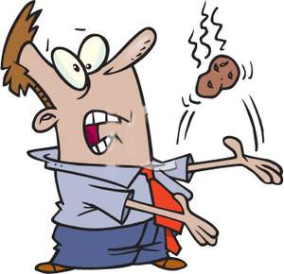
Hot Potato!
A good activity/ energiser to pick up pace in a lesson.
Assign a theme (preferably related to what is being studied), for example the sacraments of initiation. Use a ball that students throw to one another as the ‘hot potato’, they must say a word which is related to the sacraments of initiation which has not already been said e.g. baptism. Use a timer to encourage quick pace and engagement.
Out before the count?
Create up to three sentences that describe baptism. You must use as many words from the hot potato task as possible!
Merits available for each completed sentence.

Slide 15
Knowledge Organisers
God as One | God as creator | God as lawgiver and judge
‘Hear, O Israel! The Lord is our God, the Lord alone.’ (Deuteronomy 6: 4-5 Belief in one God – most basic principle in Judaism (monotheistic). Monotheism is not just the belief there is only one God – it is a way of viewing the world and all the contents of the world that they believe God created. It is God who is ever present in people’s lives – every sight they see, sound they hear, and experience they are aware of is regarded as a meeting with God. Shema – begins with an expression of the unity of God and the way humankind should respond to this belief – ‘You shall love the Lord your God with all your heart and with all your soul and with all your might.’ ‘Loving God’ – God requires total loyalty, just like loyalty is needed in a full loving relationship. ‘Soul’ – Jews need to have a spiritual dedication to one God. For Jews, God is a single, whole, indivisible entity who cannot be divided. He is infinite and eternal, beyond the full understanding of humankind. This makes him the only being who should be praised. | ‘When God began to create heaven and earth…’ (Genesis 1:1) God created the universe out of nothing, exactly how he wanted it to be. Genesis – God took 6 days to create the universe. Many Orthodox/ultra-Orthodox Jews believe this is a literal truth (6000 years ago). Reject scientific theories of evolution. Other Jews – not lliteral (God is still the creator). Accept evolutionary theory may be correct and that the universe is much older. 7th day God rested – Jews remember this each week at Shabbat. Jews believe that in order for God to have the ability and power to create the universe he is omnipotent, omniscient and omnipresent. God is the creator of everything – including evil. He gave people free will to choose what they know is right, and to reject evil as being completely against God. Some Jews – evil needs to exist to enable people to have free will and choosing good makes the act of doing good more significant. Some Jews – difficult to accept that God created the potential for evil – e.g. Holocaust – necessary consequence of free will. God sustains the universe – Jews must help. | ‘I beheld my Lord seated on a high and lofty throne’ (Isaiah 6: 1) God gave Jews laws to help them exercise their free will. Foundation of laws – ten commandments – given by God to Moses to set the basis of his relationship with his people.. Torah – 613 laws (mitzvoth) – basis of the Halakhah – accepted code of conduct for Jewish life – doing what God expects of them. Go d judges everyone based on their behaviour and beliefs fairly, lovingly,, mercifully and justly. Rosh Hashanah – Jewish New Year – God judges people for their actions over the past year. Jews reflect, repent and pray. Many Jews believe they will be judged after death, when God determines where they will spend their afterlife. Many Jewish writings refer to the Tabernacle – as being the early dwelling place for the divine presence of God (carried by Jews during Exodus). Shekhinah – associated with God’s presence among his people and their experience of the Spirit of God. The Tabernacle was replaced with Solomon’s Temple in Jerusalem.

Slide 16
Support Mats
Question 2 – Recall (2 marks) Give 2 simple points Each simple point should be a short sentence No need to give any development | Question 3 – Explain (4 marks) Give 2 developed explanations Each should be a paragraph Each paragraph should include at least 2 sentences
Question 4 – Explain with reference to scripture/sacred writings (5 marks) Give 2 developed explanations Each should be a paragraph Each paragraph should include at least 2 sentences A bible reference or quote from the Catechism or a papal document must appear somewhere in your answer | Question 5 – Evaluate a statement (12 marks) Refer to Christian/Jewish teaching Give developed arguments to support the statement Give developed arguments to support a different point of view Reach a justified conclusion

Slide 17
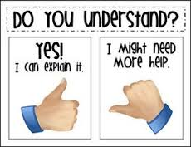
Every lesson begins with a check on learning from the previous lesson
Checking Learning!
True/False statement
‘Whiteboards up’(Groups/Pairs/Individual)
Fill in the missing words
May the odds be ever in your favour…

Slide 18
True or False?
Jesus was God disguised as a man

Slide 19
True or False?
Jesus was fully man and fully God

Slide 20
Which of the following does confirmation not lead to?
Salvation
Living a Christian life
Growing in faith
Marriage

Slide 21
Which word is missing?
‘Jesus Christ…who for us men and our _______________ came down from heaven.’
(Nicene Creed)

Slide 22
The twelfth principle of Jewish faith is the belief in ____________________ and the ______________________. Messiah means ‘__________________’ and was originally used in the __________ to refer to the kings of Israel. The first king of Israel was ________, who lived around the eleventh century BCE. In anticipation of ________ being made King, the prophet Samuel anointed him to show that he was chosen by God saying: ___________________________________________________________ Orthodox Jews believe that ____________________________________ __________________________________________________________ They believe the Messiah will ___________________________________________________________ ______________________________________________________________________________________________________________________ Reform Jews ___________ the idea of a Messiah. Instead they believe that _________________________________________________________________________________________________________________________________________________________________________________

Slide 23
Support Mats and Marking Targets
5 Mins
Question 2 – Recall (2 marks) Give 2 simple points Each simple point should be a short sentence No need to give any development | Question 3 – Explain (4 marks) Give 2 developed explanations Each should be a paragraph Each paragraph should include at least 2 sentences
Question 4 – Explain with reference to scripture/sacred writings (5 marks) Give 2 developed explanations Each should be a paragraph Each paragraph should include at least 2 sentences A bible reference or quote from the Catechism or a papal document must appear somewhere in your answer | Question 5 – Evaluate a statement (12 marks) Refer to Christian/Jewish teaching Give developed arguments to support the statement Give developed arguments to support a different point of view Reach a justified conclusion

Slide 24
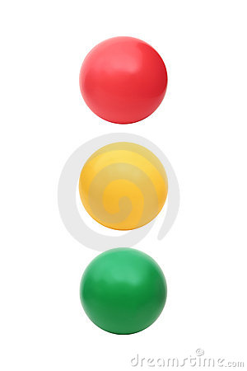
Question 5: Evaluate (A02 12 marks)
Red dot – Aim to refer to Christian/Jewish teaching
Amber dot – Aim to give more (*) or develop your (#) reason/s
Green dot – Aim to reach a justified conclusion
Finished?
Find somebody who has achieved full marks using different reasons/religious teachings? What could you add to your revision notes which could be useful to you?

Slide 25
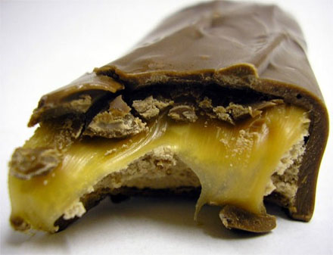
Challenge: Could you eat just the chocolate or the caramel or the nougat from your Mars bar without touching the other bits.

Slide 26
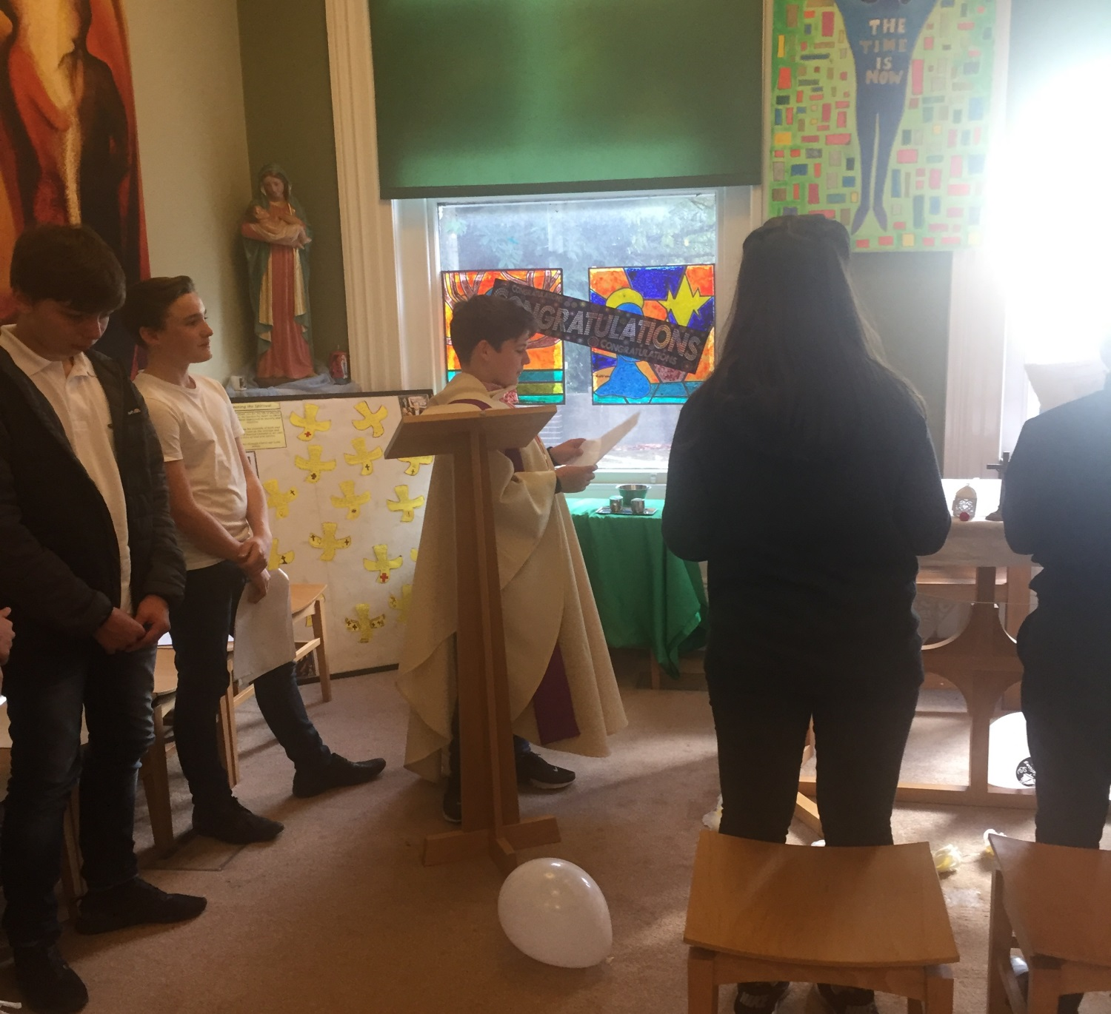
Class Wedding

Slide 27
In other news…
Starting A Level Religious Studies Peter Vardy and Dr David Webster

Slide 28
On your post it…
Write 1-3 ideas which you intend to try out with your students or share with your department when you are back at school…

