Slide 1
Raising aspirations for the lower and middle band

Slide 2
St Margaret Ward Catholic Academy Stoke- on-Trent
GCSE results A*- C had been around 70% for a number of years.
2015 = 73%
2016 = 81%
The middle band were a key area of underperformance for us and became a priority.

Slide 3
Consider your middle ability pupils what are your constraints and potential opportunities?

Slide 4
Mine were…..
Constraints/Issues
4a and 4b not converting for us. Problem with the middle of the middle band- why/weird?
Behaviour and attitude of the middle band
Lack of aspiration of the middle band
Lack of interest in the subject
Teaching middle band in 3 sets. (English/maths/science had 5!)
Timetabling
Rooming
Potential opportunities
AH in charge of timetabling is RE line manager
Deputy Head teaching middle band
Learning plan- lots of time for revision

Slide 5
Major issues to deal with: The Middle band!
4a and 4b not converting for us. Problem with the middle of the middle band- why/weird?
Behaviour and attitude of the middle band
Lack of aspiration of the middle band
Lack of interest in the subject
Timetabling
Rooming
For the me the issues seemed to be twofold. 1. Things I could definitely change within the dept. 2. Things that I needed to work on outside the dept.

Slide 6
To sort out issue 2 I began a year long campaign of pestering!
Timetabling
Double room/wall issue
More sets in the middle band
But in the mean time we had to get on and try to change the behaviour and attitude of the middle band to RE.

Slide 7
In order to change the attitude of pupils we:
Tried reverse psychology and it worked!
We told them they loved RE and RE loved them.
We started a campaign of praise but only for those that deserved it.
Went against school policy on the use of Period 7.
Gave them ridiculous amounts of support and extra revision lessons/materials but only for those who were working in class.
Had nine weeks of revision before the exam.

Slide 8
Level 4 pupils:
Every week Y11 intervention meeting. All members of the dept got together on Tuesdays after school for 20 mins and we discussed our level 4 pupils, shared resources that worked and discussed concerns.
We arranged meetings with the pupils, spoke to their mentors and made sure that they were aware they were a priority.
Gave them individual targets to achieve at regular intervals and made their mentors aware.

Slide 9
Revision
End of topic revision- 4 lessons at the end of each topic
One feedback lesson after each assessment
Nine weeks of revision before the May exams.
During this time we did lots of exam practice with a weekly check on learning and as much active revision as possible.
Pupil voice- they said this was a key factor in their success

Slide 10
Their favourite revision games as voted for by them!
You say we pay
Vote with your feet
Tennis
Musical chairs

Slide 11
“God clearly created the universe”
“Abortion can be a loving act”
“Science can explain everything about the creation of the world”
“St Augustine’s explanation that creation Ex Nihilo is hard to understand is not a good enough explanation”
The Catholic Church should focus on environmental issues more so than homosexuality and abortion”

Slide 12
“Capital punishment is acceptable for the very worst crimes”
“If God is omnibenevolent then there can’t be a Hell”
“It is impossible to ‘live simply’ in the modern world”
When God said “Rule” over creation he meant we could do what we want with it.
The Golden Rule is easy to say but almost impossible to do in practice

Slide 13
Walking, Talking, Mock.
I had a 20 min slot before the exam with the whole year group to give them last minute hints and tips.
Pupil voice - they thought this was a real factor to their success.

Slide 14
Religious Studies: Unit 3 Exam Walking, Talking Mock: Last minute hint and tips

Slide 15
The first thing you need to do is choose the right question for you. Spend a couple of minutes reading through both questions. Look carefully at the c) and d) questions. Never pick a question based on whether you know the keyword or not

Slide 16
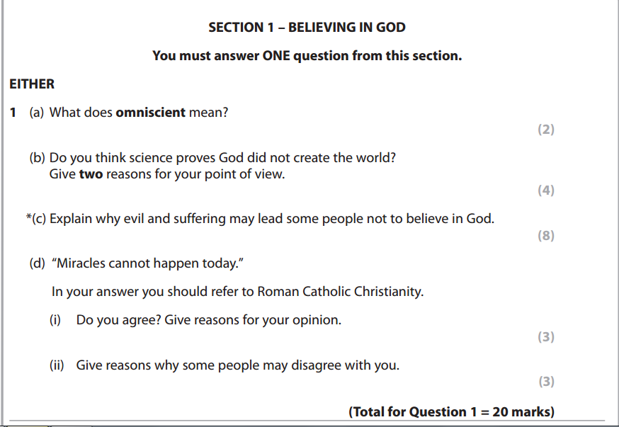
Nice c) question here that you could have a really good go at. The d) question is pretty interesting too!

Slide 17
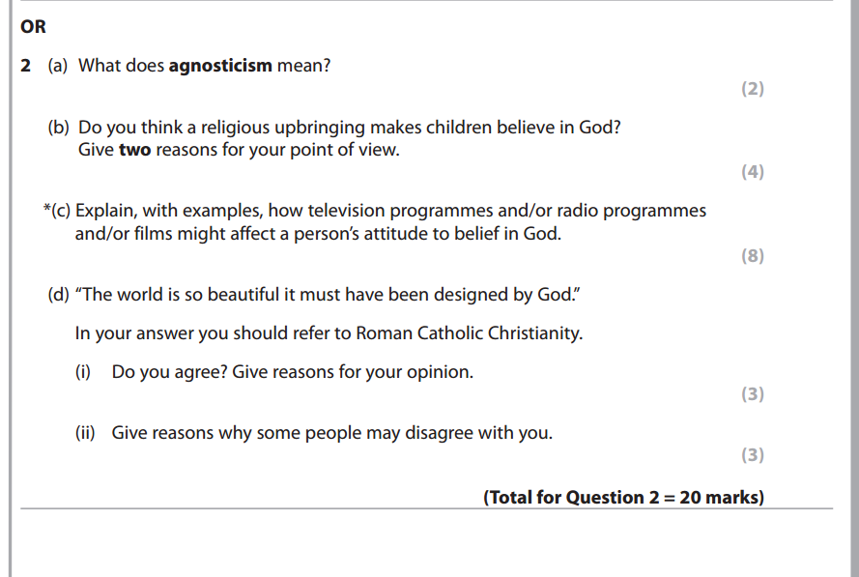
The advice from your RE teachers is to avoid media questions if you can. Lots of marks at stake if you attempt a c) on media and get it wrong. Also the d) is about design, which is difficult. In this situation I would definitely answer question 1!

Slide 18
Keyword questions:
Write the definition that we have learnt in class.
If you are not sure that your definition is exact, give an example or develop the point you have made.
Omniscient is the belief that God knows everything that has happened and everything that will happen. 2/2
‘Omni’ means all, so for example you could also say that God is all seeing. 2/2

Slide 19
If you are not sure of your own opinion, think about what a Catholic priest may have to say about it!!
b) questions (4 marks)
Must include ‘I think’.
Yes because I think OR No because I think (NOT BOTH)
Must have 2 reasons for your point of view that are developed.
A developed reason should be 2 sentences. The easiest way to develop your reason is to give an example
Should be set out as 2 short paragraphs.

Slide 20
If you are not sure of your own opinion, think about what a Catholic priest may have to say about it!!
b) questions (4 marks)
Must include ‘I think’.
Yes because I think that Science has lots of evidence for its theories.
For example there are fossils that back up the theory of evolution and these theories do not need God in order for them to make sense.
Also yes because I think that science does not refer to God at all in the theory of the Big Bang.
For example science says that the matter of the universe is eternal, there is no need for a creator like God. 4/4

Slide 21
What they told us they loved:
Assessment mats
Keyword games, short stories, booklets etc
Fun, memorable activities/lessons
Less writing
Revision guides
Teachings on the back of chairs
Sharing and being able to voice their opinions
Walking, talking, mock
A3 overview sheets
KIP sheets
Learning “stuff that will matter in life”
Their RE teachers
And……(finally, thank goodness) RE!!!!!

Slide 22
And after a year of pestering I won my battles:
Timetabling- Y10 lessons always in the afternoon. With the help of my line manager who is also in charge of timetabling I got the middle band 2 x morning lessons a week and I agreed to take a P.6 lesson with them in return.
Class sizes- I also got 4 sets instead of 3 in the middle band. Class sizes reduced from 30 to 23
A wall- I managed to persuade SLT to build a wall in the double classroom.
All these things had a significant impact in terms of behaviour, pace of the lessons and general attitude of the pupils to the subject.

Slide 23
Timetable 2014
2014 | Reg | 1 | 2 |  | 3 | 4 |  | 5 | 6
Monday | 9G | 9A RE 5 | 11M RE 5 | B | 10 BACC RE 1 | 8T RE 1 | L | 10M RE 1 | 9T RE 5
Tuesday | 9G | 9A RE 1 |  | R |  |  | U | 10M RE 1 | 10 BACC RE 1
Wednesday | 9G | Meet RP | 11 BACC RE 5 | E |  |  | N | 10M RE 3 | 11M RE 5
Thursday | 9G | 9T RE 5 | 7S Library | A | 11 BACC RE 5 | 11 B RE 5 | C | 10 BACC RE 1 | 11 BACC RE 5
Friday | 9G |  | 7G RE 1 | K | 8T RE 5 | 11 B RE 3 | H | 9G RE2 | 11M RE 5

Slide 24
Timetable 2015
2015 | Reg | 1 | 2 |  | 3 | 4 |  | 5 | 6
Monday | 10G |  |  | B | Lower 10 RE5 | 9W RE5 | L | 9G RE5 | 7T RE5
Tuesday | 10G | Middle 11 RE5 | Middle 10 RE5 | R | Upper 10 RE5 | Upper 11 RE5 | U | Lower 10 RE5 | 9G RE5
Wednesday | 10G | Middle 10 RE5 | Lower 10 RE5 | E |  | Upper 10 RE5 | N |  | Middle 11 RE5
Thursday | 10G | Y12 RE5 | Y12 RE5 | A | Y12 RE5 | Y12 RE5 | C | Upper 11 RE5
Friday | 10G | Middle 11 RE5 | Upper 11 RE5 | K | 9W RE5 | Upper 10 RE5 | H |  | Middle 10 RE5

Slide 25
Where we are trying to get to:
Insert RE every time you hear Monday!
https://youtu.be/VKcqoNL8enA

