Slide 1
Quiz Mondays
Using all of the learning that you have done this term so far debate the statements in pairs.
Decide whether you ‘agree’ or ‘disagree’ with them and state WHY.
Remember…
We’re off to see the wizard, the wonderful wizard of Oz,
BECAUSE, BECAUSE, BECAUSE!!!

Slide 2
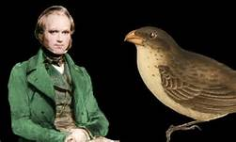
Re-capping prior learning
To re-cap our learning from last lesson grab a laptop in pairs and log on to:
www.classtools.net
Choose ‘fakebook’.
Imagine you were Charles Darwin.
Design Darwin’s fakebook account.
Include key information on Darwin.
Include 3-5 status updates explaining:
What you discovered?
What is meant by evolution?
What is meant by Natural selection?

Slide 3
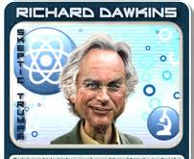
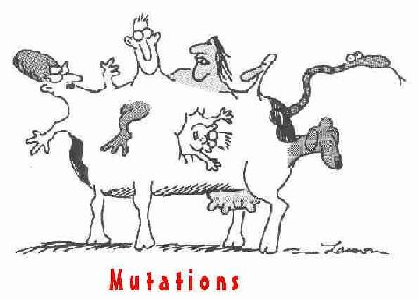
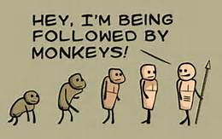
Foundational Theology
Unit 1: Origins and meaning
Dawkins, Neo-Darwinism and catholic beliefs
Learning objective:
To understand Dawkins’ Neo-Darwinism.
To examine how the Catholic Church responds to Dawkins’ beliefs.

Slide 4
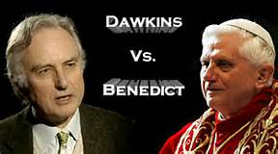
What does success look like today?
Lesson title: What is meant by evolution?
L.O.
To understand Dawkins’ Neo-Darwinism.
To examine how the Catholic Church responds to Dawkins’ beliefs.
Today’s success criteria:
You MUST understand what Dawkins believed about evolution.
You SHOULD explain the term Neo-Darwinism.
You COULD explain how Roman Catholics respond to this theory.

Slide 5
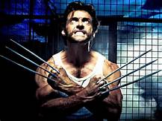
Clip analysis
https://www.youtube.com/watch?v=brkTLwEmdl8
White hat:
What happens in the clip?
Green hat:
How might the world change if this was possible?
Red hat:
Could this be an example of 21st Century evolution? Why/Why not?

Slide 6
Discussion questions:
What is Richard Dawkins saying here?
Do you agree with him?
Why/Why not?
https://www.youtube.com/watch?v=CW1Lpa23mOw
Learning objective:
To understand Dawkins’ Neo-Darwinism.
To examine how the Catholic Church responds to Dawkins’ beliefs.

Slide 7
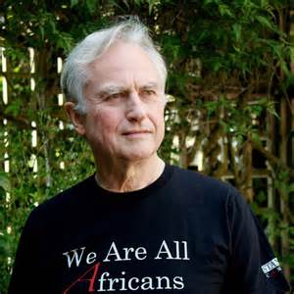
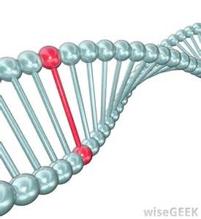
Dawkins and neo-darwinism
Dawkins is a big supporter of Evolution. In this photo he is shown wearing a T-Shirt saying ‘We are all Africans’ showing his belief that we all evolved from primates into humans in Africa, we came from one continent (pangea) and have evolved to our own societies today.
Dawkins looks at gene mutations. That is, how have our cells and DNA changed (evolved). It is called neo-Darwinism because it is a modern spin on Darwin’s evolution theory.
Dawkins rejects God and says evolution is the cause of our existence because when we look at Genes evolution has allowed those in Russia to survive in extreme cold, those in Africa to evolve to survive in immense heat, those in Northern Europe to have lighter skin to harvest as much vitamins from the sun in little light, to those near the equator to have dark skin to stop them getting skin cancers and skin disease. Humans who had these gene adaptions survived long enough to reproduce and pass on their genes to the next generation.

Slide 8
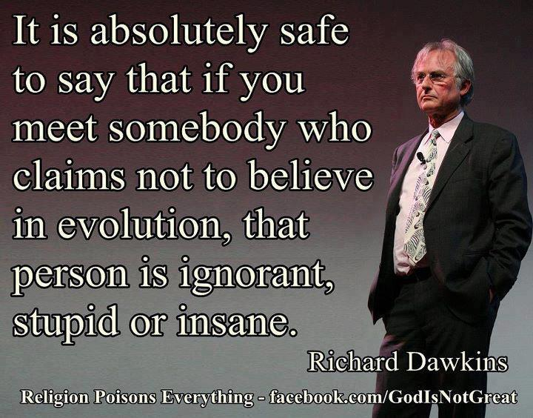
Dawkins and neo-darwinism
Dawkins says:
The Church is wrong. Evolution is not ordered by God…it is random.
All life is the product of random genetic chance.
We are not special beings with a soul, we are simply ‘carriers of information and DNA’.

Slide 9
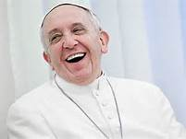
Catholic responses to dawkins
The Church argues that Dawkins is wrong because:
If we are here by just random chance, what caused the Genes and DNA to exist?
DNA and genes are ordered and structured, only something as omnipotent as God could have designed them in this way.
God is the guiding hand behind evolution.

Slide 10
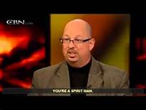
Do we have a soul? NDE’s
Dawkins claimed that we do not have a soul.
As Catholics one of the modern pieces of evidence that counters this belief is the phenomenon of Near Death Experiences (NDEs).
An NDE is the experience when your soul leaves your body, has a vision of heaven/hell/hereafter and then returns to the body.
Watch the clips and reflect on the title question above.
https://www.youtube.com/watch?v=ptel5AVvOUE
http://www.youtube.com/watch?v=7BUxP_RaWb0
http://www.youtube.com/watch?v=pgBdf1GqNlA

Slide 11
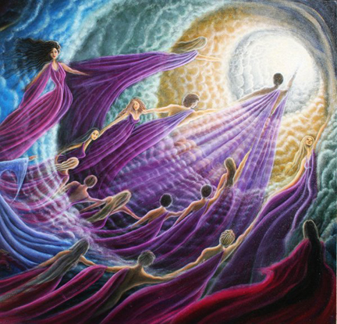
Lesson summary
For Dawkins we evolved through gene mutation.
We are the product of random chance according to Dawkins. We are souless carriers of information and DNA.
The Catholic Church disagrees – we are made in the image of God and sacred to God.
NDEs also prove we have a soul.

