Slide 1
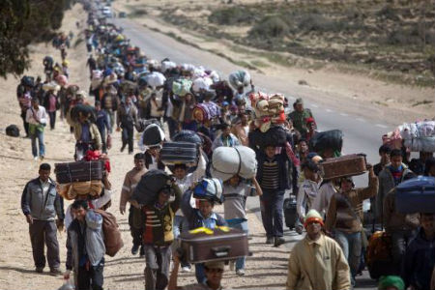
If you were the Government or part of the UN, what decision would you make as to where these people should go? On your tables you need to make a decision.
There are 5 million of then. Does that change your plan?

Slide 2
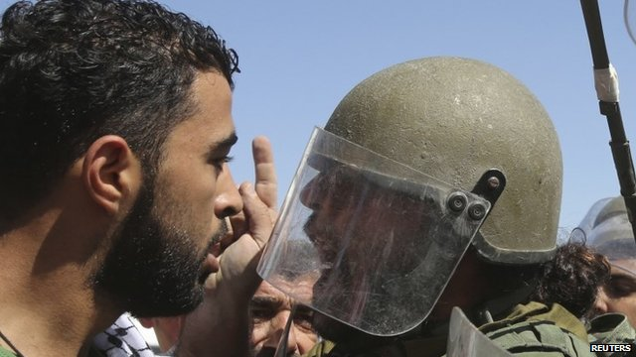
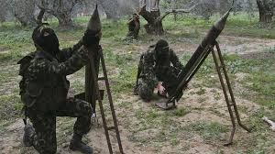
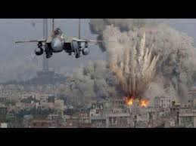
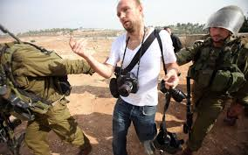
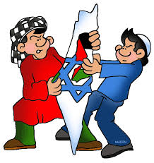
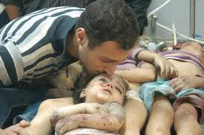
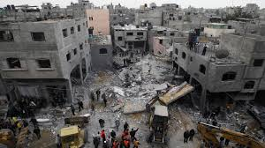
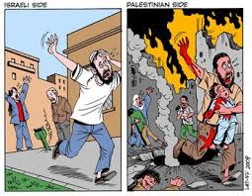
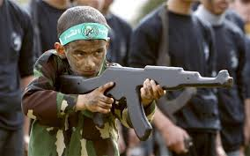
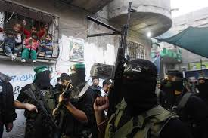
Who What Where How Why

Slide 3
Tuesday, 15 March 2016
Driving Question: What has happened to the ‘Promised land?
Warm
I can describe the nature of the war in modern day Israel.
Hot
I can explain with evidence both perspectives on the conflict.
I can evaluate the reasons and motivations behind the current conflict and conclude what should happen to Israel through a balanced argument.
Scorching

Slide 4
“The Jewish people have no right to own the land of Israel.”
Do you agree?
I can provide one detailed paragraph using one piece of historical evidence.
I can provide one detailed paragraph using more than one piece of historical evidence.
I can do a further paragraph explaining why some people may disagree with me.
P
I agree/disagree that Jewish people have no right to the land of Israel because…..
The evidence from (insert year) shows that….
Therefore……
Evidence Box
Link in Historical evidence
E
E

Slide 5
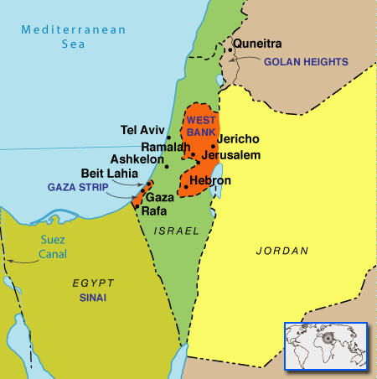
So what led to the conflict?
Israel/Palestine is a small area – 10,000 square miles (about the size of Wales) – the events on this tiny bit of land have a massive impact on the rest of the world.
Israeli-Palestinian conflict OR Arab-Israeli conflict

Slide 6
The central part of this conflict is POLITICS not really RELIGION.
Until 1948 the area that both groups (Palestinians and Jews) claimed was known as Palestine. But this all changed in 1948 when the land was divided into 3 parts: Israel, the West Bank and the Gaza Strip

Slide 7
A brief history of the Arab-Israeli conflict
Situation today
1250 BC
1947
1920’s
Early 1900’s
1939-1945
1948

Slide 8
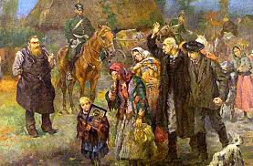
From 1250 BC to the present day the Jewish people have suffered and continue suffering much persecution at the hands of their fellow man. Some historians state that the Jewish people have been exiled from 108 countries over time, some countries repeatedly.

Slide 9
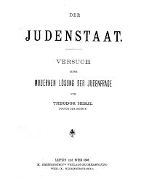
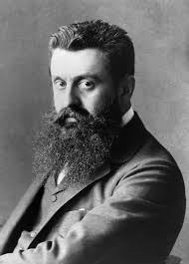
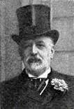
Start of a New Era- 1900’s
Powerful Jewish notables (Bankers, Politicians and Academics) from across Europe and the USA agreed that the only way that the Jewish people would avoid suffering and persecution was by having a country of their own. They began lobbying for a land they could call home.
Theodor Herzl
02/05/1860 - 03/07/1904
Baron Rothchild
08/11/1840- 31/03/1915

Slide 10
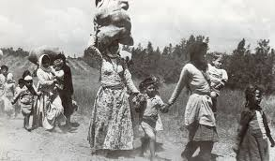
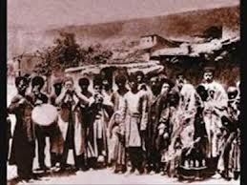
The Immigration
Jews that had been suffering persecution in Europe began immigrating to Palestine in the 1920’s for a better life on hearing of the British promising them land to rebuild upon. Initially the immigration was accepted by the Indigenous Palestinians as there were Jews living in Palestine already and had been doing so for over 1300 years, Christians were also present and all had lived in peace and for centuries and even helped the British in expelling the Ottoman rulers. After 10 years of continuous flow of European Jews coming in, problems for the indigenous Palestinians began, leading to unrest and eventually spilling into fighting, and finally a revolt.

Slide 11
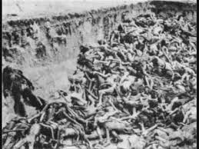
WWII
Then World War II started and Millions of Jews were tortured and murdered.
With persecution taking place all over Europe do you think the Jews had a choice other than to move?
What do you think? Write a short paragraph.

Slide 12
Problems start in Palestine?
The Palestinians claimed that with the immigration of more Jews to the land, new political systems were being created by the immigrants and they the Palestinians were being omitted from the decisions.
They also claimed that the immigrants were arriving and squatting on their land and building Illegally, and that the Jews migrating from Europe were bringing with them a form of militancy, whereby they were trying to control the indigenous Arabs through force.
The Jewish Migrants were claiming that the land had been promised to them by God 3000 years earlier, and therefore it was rightfully theirs anyhow.

Slide 13
Tensions rise between 1939-1947
The British mandate (rule or order) was no longer seen as viable by the Zionists after WWII, and insurgencies started.
Over 57 violent attacks were carried out by Zionist terrorist groups (e.g. Haganah, Lehi and Irgun)
Within Britain there were deep divisions over Palestine policy. Dozens of British soldiers, Zionist militants and civilians died during the campaigns of insurgency. The conflict led to heightened Anti-Semitism in the UK and, in August 1947, after the torture and hanging of two abducted British sergeants, by the Zionist terrorists the (Sergeants Affair) tensions led to widespread anti-Jewish rioting across the UK.^{[4]} The conflict caused tensions in Britain's relationship with the United States.

Slide 14
The British leave it to the UN
In February 1947 the British Government announced that responsibility for Palestine would be handed to the UN and troops would be withdrawn from Palestine by June 1948.
The Jewish people saw this as a “Victory of independence” but the Palestinian Arabs called it a “Catastrophe”.
http://www.britishforcesinpalestine.org/withdrawal.html

Slide 15
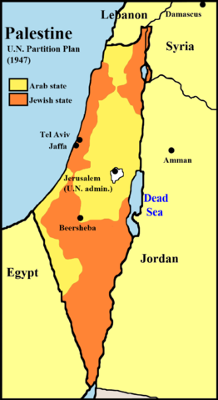
The U.N Divide
The newly created United Nations (U.N.) split the land between the Arabs and the Jews. The land split was seen as unfair by the Palestinians, but fair by the Jews.
Why would this split have been seen as unfair by the Palestinians?
Discuss for 2 mins.
The Jewish people were awarded 57% of the land and the remaining 43% was given to the Palestinian. The Palestinians also complained that the land given to them was not fertile and there were not many water links.

Slide 16
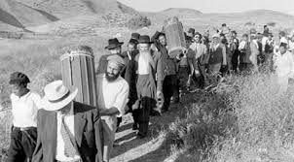
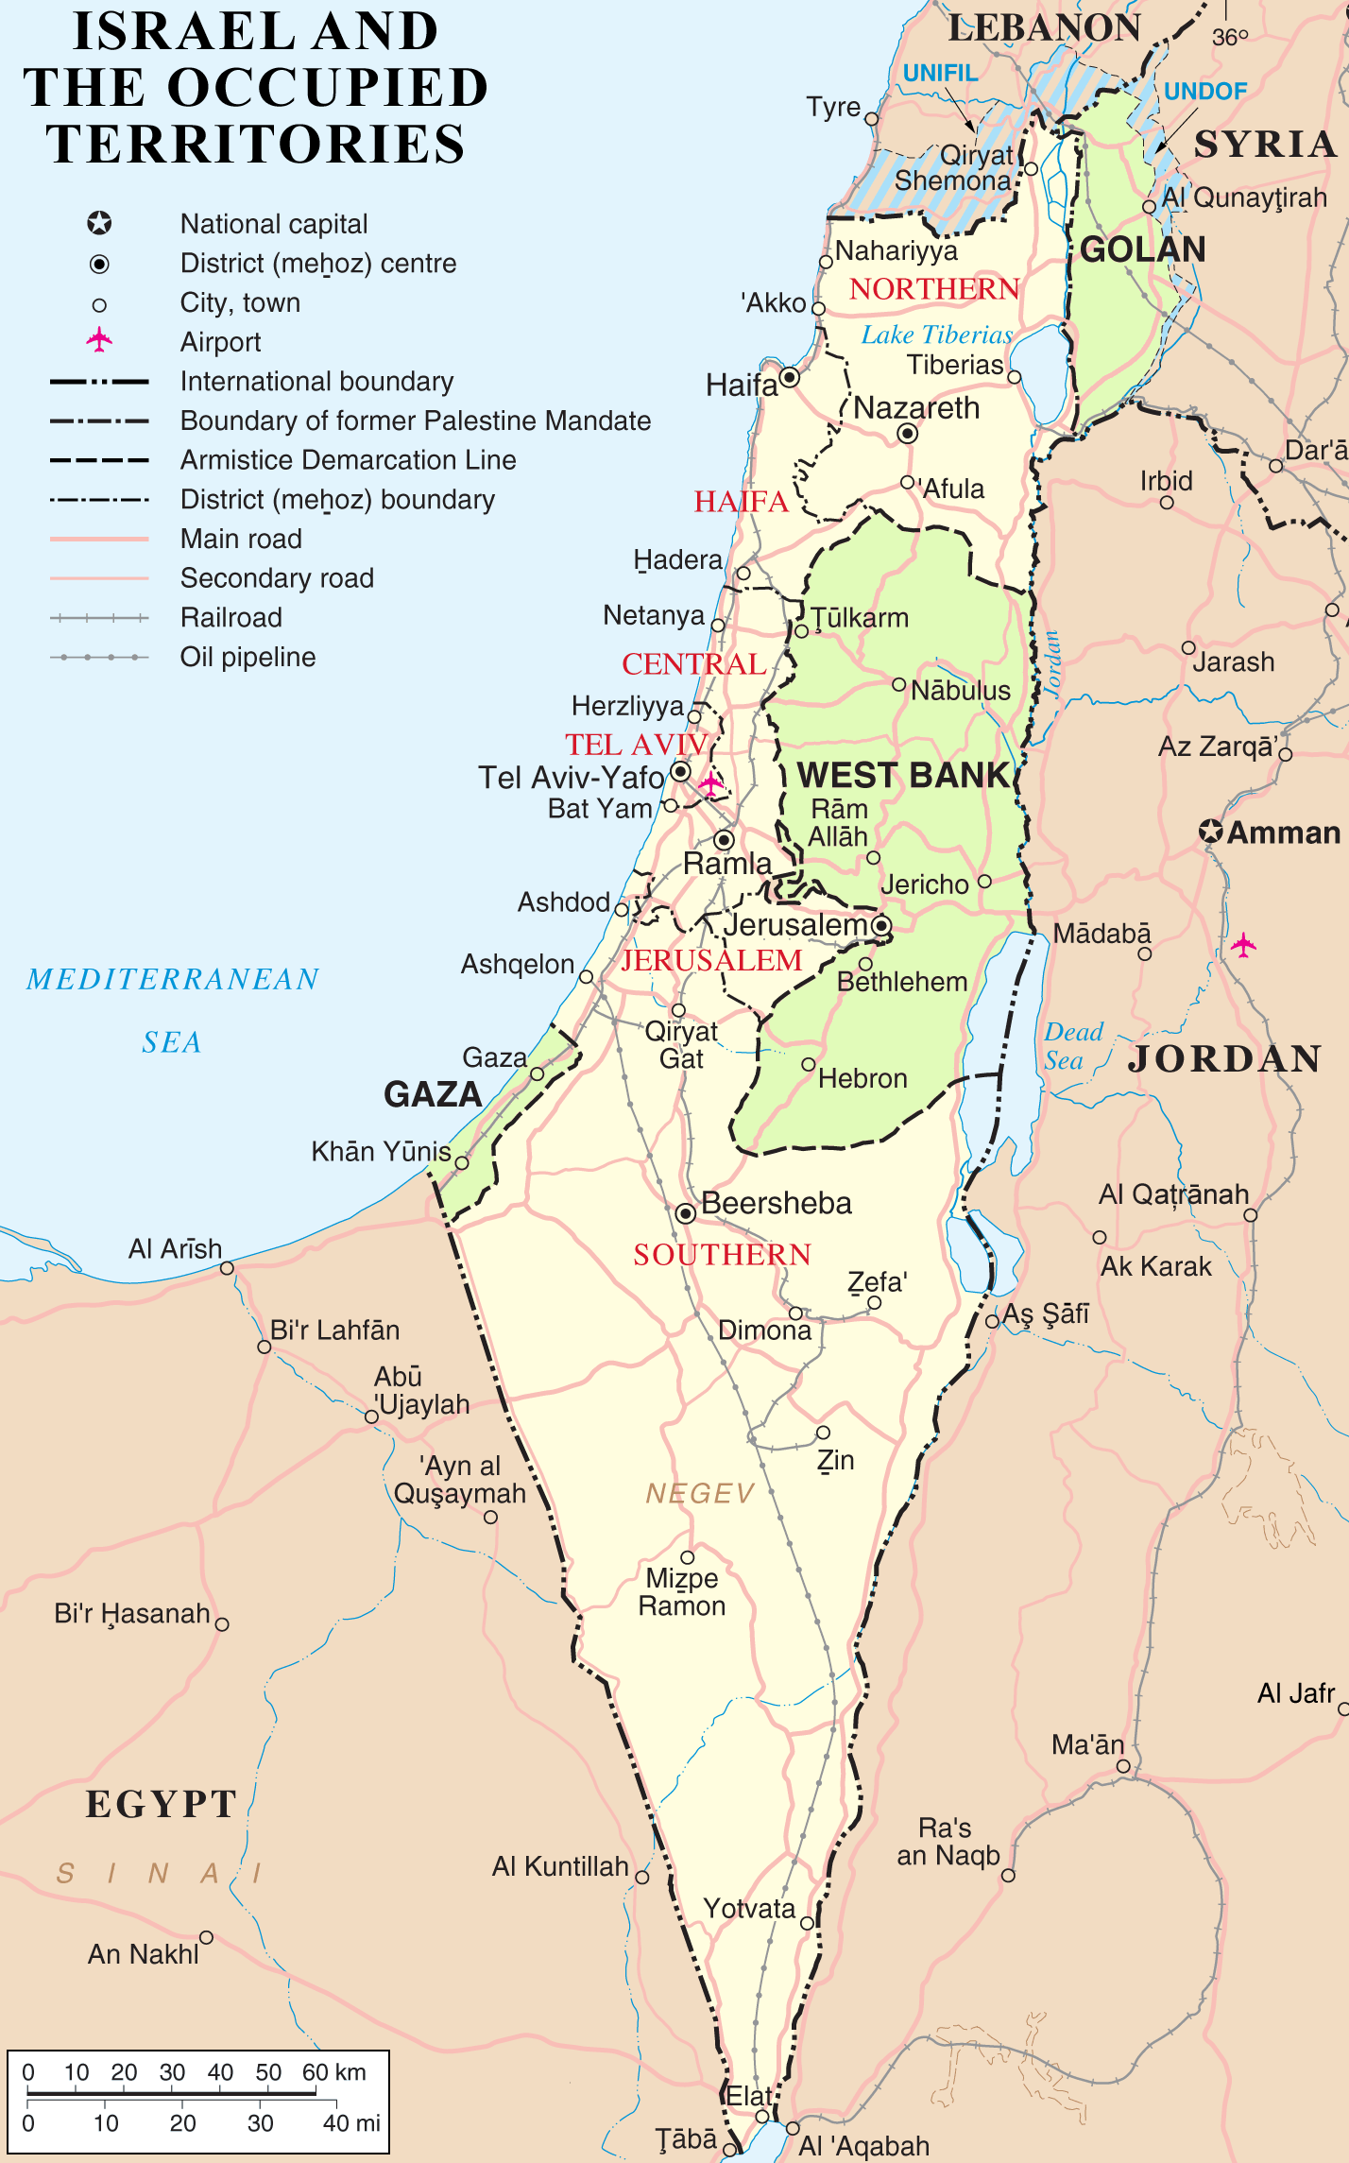
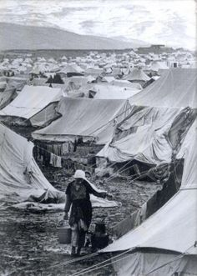
The Wars of 1948
The Neighboring Arab Countries were getting a continuous stream of Palestinian refugees flowing into their lands as more Jews migrated and tension grew.
The Arabs countries united and started a war with Israel. A war which they lost terribly.
During this war many Palestinian’s who were in the middle of the fighting fled their homes to the border setting up in camps, hoping to return when the fighting was over.
After the defeat of the Arab countries the Israelis would not allow the Palestinian's back to their homes and land. More Jews began immigrating to the newly conquered land in Palestine.

Slide 17
Watch the clip
Add any additional information to your timeline

Slide 18
“The Jewish people have no right to own the land of Israel.”
Do you agree?
I can provide one detailed paragraph using one piece of historical evidence.
I can provide one detailed paragraph using more than one piece of historical evidence.
I can do a further paragraph explaining why some people may disagree with me.
P
I agree/disagree that Jewish people have no right to the land of Israel because…..
The evidence from (insert year) shows that….
Therefore……
Evidence Box
Link in Historical evidence
E
E

Slide 19
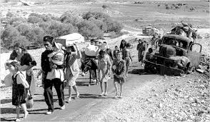
Activity 2
Discuss in your groups and make a list of 5 words that you think best describe how the Palestinians would be feeling.

Slide 20
2 minute Discussion
The Zionist argument was that after the war they had won the land fair and square, they were the Conquerors and therefore the land should be theirs.

Slide 21
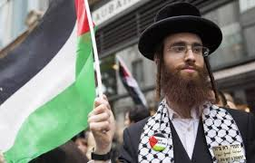
Now that’s one version of the history of the Israel Palestine Conflict.
Why do you think some Jewish people would be against this conflict?

Slide 22
Plenary
State 3 reason why you think peace has not been achieved.
Why is there ongoing conflict between the Arabs and Israelis?
Do you think a solution could be reached if people united and demonstrated the democratic way?

