Slide 1
Compare Genesis creation of human stories
Date:Thursday, 15 September 2016
Success Criteria:
I can define what it means to have been created
I can identify what I already know about Genesis creation of humans
I can understand and explain facts about how humans are created in accordance to Genesis
I can examine the creation accounts of Genesis
I can evaluate attitudes towards to how humans are created.
I can assess my knowledge through a GCSE question.

Slide 2
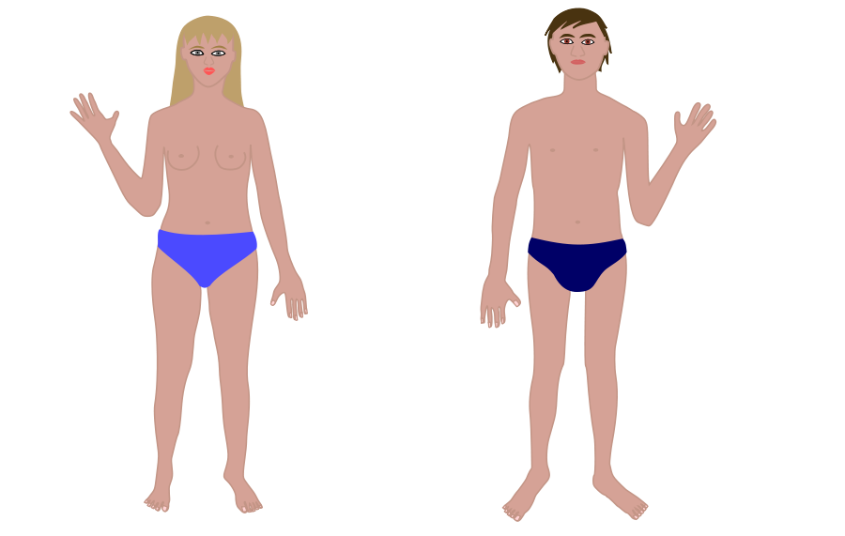
Create your own human
Use Playdoh or scrap paper
Your task is to create a human using the resources from your teacher
Notes:
Get the students to be creative- I use Play Doh for this. Recycled material. The main aim is to get the students to make something that looks like a human- you need to ask why is it not human? It cannot breathe- lead onto God’s breath into Adam and how we all have the breath of God within us.

Slide 3
What does the Bible say about the creation of humans?

Slide 4
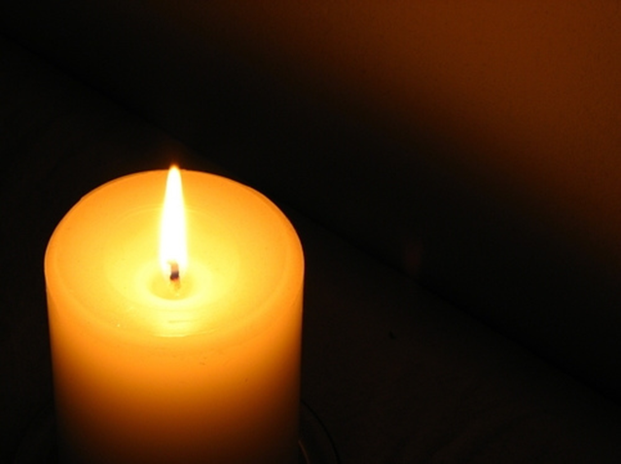
Breathing…
https://www.youtube.com/watch?v=7acxRdMzIjk&list=PLauZzlAGt3DpwSlMvObYwrwqRWav9Ke4B
The English word spirit (from Latin spiritus "breath")
Inspiration | “God breathed” The belief that the Spirit of God guides an individual to act or write what is good and true.
Notes:
Show the Rob Bell Breathe video- find on youtube. Link above worked at time of making lesson.

Slide 5
Investigation begins…
Get into groups of 4.
2 of you need to read Genesis 1:1-2:3
2 of you need to read Genesis 2:4-24
1. Write down what each account say about how humans are created.
2. Share your accounts with the other members of the group.
3. Compare the accounts on how humans were created and their relationship with God.
4. How do both accounts show the importance of Humans and their relationship with God?
For Help watch-
https://www.youtube.com/watch?v=OwSWRdbSQK0
https://www.youtube.com/watch?v=KOUV7mWDI34
You could print next two slides and use as information sheets.

Slide 6
Genesis 2 is another creation story in the Bible, which was written earlier than the poem of Genesis 1.
In Genesis 2, God personally creates human beings, ‘Adam’, from the dust. This stresses how precious humanity is, which is emphasized even more when God breathes in to man and he becomes a living being. In Hebrew the word for ‘breath’ is ru’ach, which is also translated as ‘spirit’. Humans share the breath or spirit of God.
All that humans need is provided for them. But God also gives humanity the gift of free will. God gives this gift when he tells Adam not to eat the fruit from the tree of knowledge of good and evil. Even though he commands Adam not to eat from the tree, he does not actively prevent Adam from doing so. He gives Adam the choice (or free will) to decide from himself what he wants: either for God to provide everything for humanity, or for humanity to provide for itself.
Notes:
You could print next two slides and use as information sheets.

Slide 7
The animals are made by God but presented to Adam to name. This naming gives each animal its nature. The fact that it is Adam who names the animals shows that humans have both authority and responsibility for them. None of the animals is a suitable helpmate for Adam, though, so God makes Adam fall into a deep sleep and from Adam’s rib, God creates Eve. This shows that humanity is subdivided into two complementary parts. This gives sense to verse 24, ‘Therefore a man leaves his father and his mother and clings to his wife, and they become one flesh.’ When husband and wife join together they become one whole, perfected being.

Slide 8
What do Christians believe the Creation story teaches about humanity?
Give a quote to support each point→
Humanity
Dominion / Stewardship
Soul
Sanctity of Life
Purpose of life

Slide 9
Section B practice GCSE question
‘’Describe how Catholics believe human beings were created ’
5 Marks
Answer the following question by drawing icons, diagrams but with no words

Slide 10
Task/ homework
You are working for NASA (National Aeronautics and Space Agency)
You are sending a spacecraft deep into space
You have to prepare a welcome guide about human beings that aliens might read
In your guide you have to explain what it means to be a human being

