Slide 1
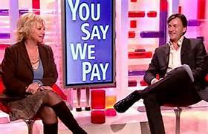
You say we pay

Slide 2
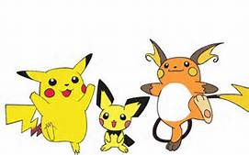
evolution

Slide 3
The three legged stool
analogy

Slide 4
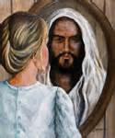
Imago dei

Slide 5
tradition

Slide 6
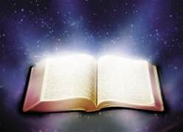
Sacred scripture

Slide 7
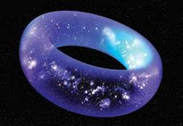
transcendence

Slide 8
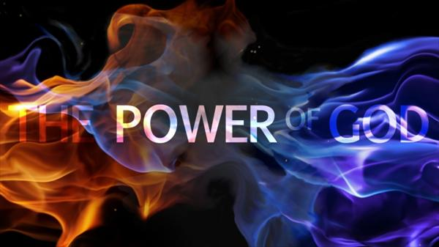
omnipotent

Slide 9
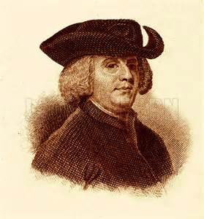
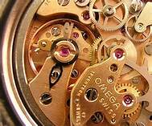
The design argument

Slide 10
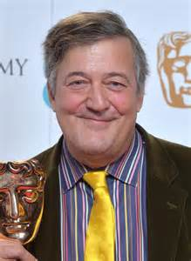
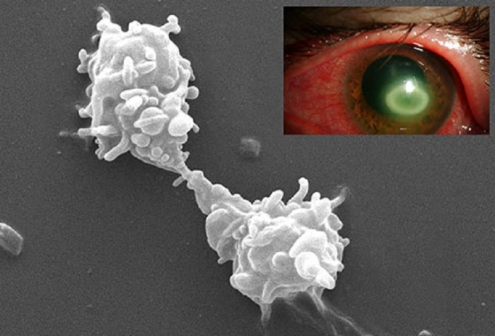
Stephen fry – god is a
‘monster and a maniac’

Slide 11
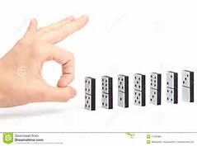
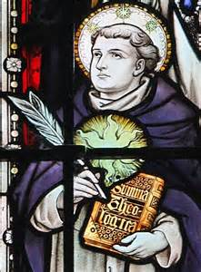
The first cause –
Cosmological argument

Slide 12
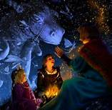
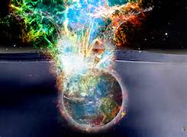
Foundational Theology
Unit 1: Origins and meaning
What do Catholics believe about the origins of the universe? Pt.2
Learning objective:
To examine the main beliefs of Catholics concerning the origins of the Universe.

Slide 13
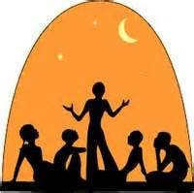
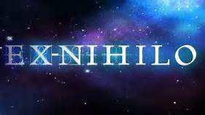
What does success look like today?
Lesson title: What do Catholics believe about the origins of the universe?
L.O. To examine the main beliefs of Catholics concerning the origins of the Universe.
Today’s success criteria:
You MUST understand Chasterton’s Story-teller analogy.
You SHOULD argue how logical this theory is.
You COULD explain St. Augustine’s ‘creatio ex nihlo.

Slide 14
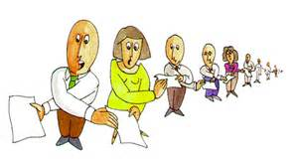
Story-writing game
We are going to write in groups a funny story about how the world was created.
Each person must write one line per paper before passing it on to the next person who writes the next line before they too pass it on.
There are 8 stages to the game.

Slide 15
Story-writing game pt.1
Beginning:
What existed before anything else.

Slide 16
Story-writing game pt.2
Beginning:
Describe the ‘thing/being’ that starts off your world.

Slide 17
Story-writing game pt.3
Action 1:
What is the first thing your being does.

Slide 18
Story-writing game pt.4
Action 2:
What is the second thing your being does?

Slide 19
Story-writing game pt.5
Action 3:
What is the third thing your being does.

Slide 20
Story-writing game pt.6
Action 4:
What is the fourth thing your being does.

Slide 21
Story-writing game pt.7
Action 5:
What is the last thing your being does.

Slide 22
Story-writing game pt.8
Ending:
How does your story end?

Slide 23
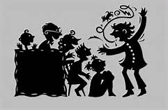
The story-teller analogy
Now you have finished your story its time to read out each of your collective stories to the rest of your table group.
Green hat thinking:
Can you have a story without a story teller/writer?
How might this link to the creation of the world?

Slide 24
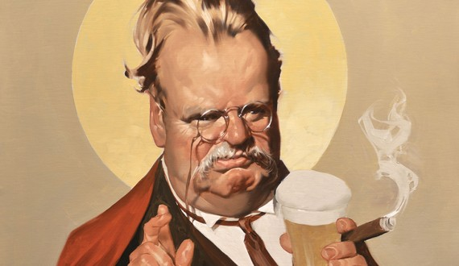
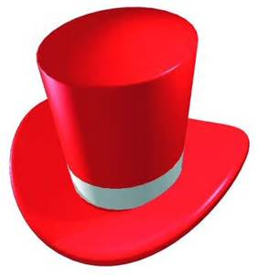
The story-teller analogy
G. K. Chesterton (A catholic journalist) created the ‘story-teller analogy’.
He said ‘just like every story needs a story-teller, so too does the world need an author…that story-teller Catholics called God’.
God for Chesterton is the one who gives the Universe meaning.
Discussion question:
Does the world need a story-teller?
If so, does it have to be God?
Discuss.

Slide 25
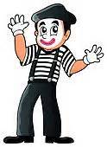
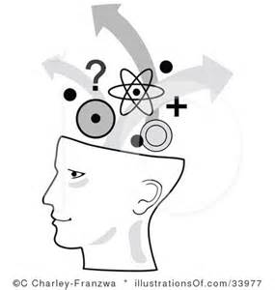
Mime challenge:
Below are some of the key Catholic beliefs about God.
You have 10 minutes in small groups to come up with a mime for each of them.
Omnipotent – God is all powerful.
Omniscient – God is all knowing.
Omnibenevolent – God is all loving.
Eternal – God is without beginning or end.
Transcendent – God exists outside of space and time.

Slide 26
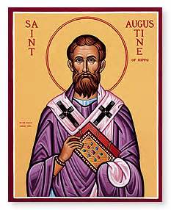
St. Augustine and creatio ex nihilo
St. Augustine, Bishop of Hippo, said that:
God created the world out of nothing – creatio ex nihilo.
That God is transcendent and eternal.
That God is omnipotent therefore only he has the power to create something out of nothing.
Learning objective:
To examine the main beliefs of Catholics concerning the origins of the Universe.

Slide 27
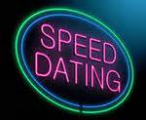
A happy date is a re
Speed date!
Standing in 2 lines (line A and line B) you will have 45 seconds with your partner to discuss the question on the board.
After 45 seconds your teacher will pick on a pair and ask them to share what they discussed.
Then people in line A will move along one partner and discuss the next question.
There are a total of 8 questions to discuss.
Good luck!

Slide 28
Number 1!
How do you believe the world was created?

Slide 29
Number 2!
Do you agree with Chesterton that the world needs a ‘story-teller’?
Why?

Slide 30
Number 3!
Do you believe that God is omnipotent?
What proof do you have that he is or isn’t?

Slide 31
Number 4!
If God was omnipotent he would have the power to end all wars in the world?

Slide 32
Number 5!
The world was clearly designed by God?
Discuss.

Slide 33
Number 6!
“Stephen Fry is stupid to call God a monster and a maniac”.
Discuss.

Slide 34
Number 7!
“God had to be the first cause of the universe”.
Discuss.

Slide 35
Number 8!
“God was the cause of the Big Bang.”
Discuss.

Slide 36
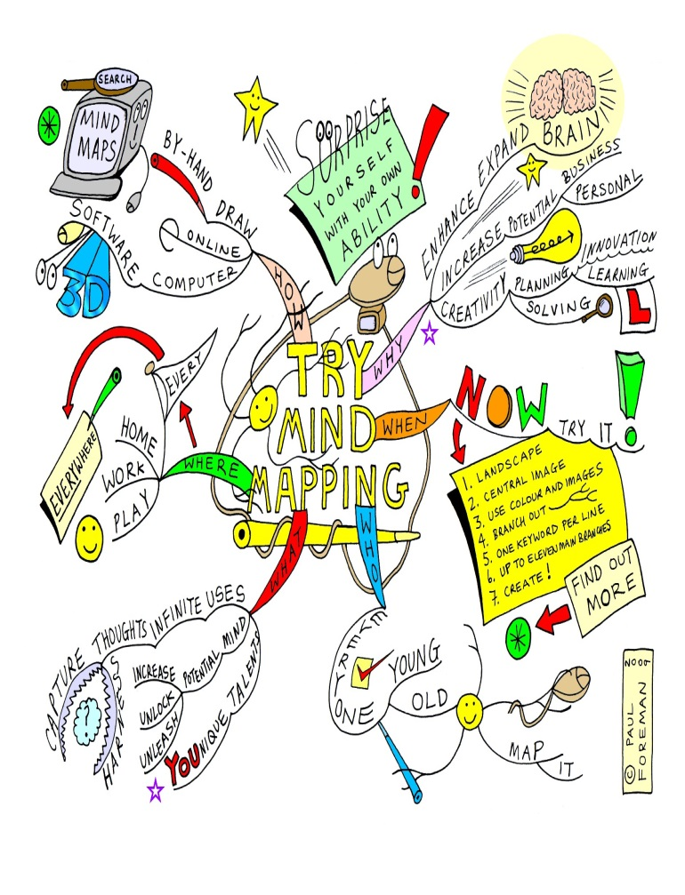
Plenary challenge
Design an A3 mind map using words and pictures to show the 4 main Catholic beliefs about the creation of the world.
You must include:
Paley’s Design Argument.
Aquinas’ Cosmological (First Cause) Argument.
Chesterton’s Story-teller analogy.
St. Augustine’s Creatio ex Nihilo theory.
Learning objective:
To examine the main beliefs of Catholics concerning the origins of the Universe.

