Slide 1
Peer Assess - Baptism
Baptism
Initiation
John the Baptist
Water
Godparents
Chrism
WWW
You have completed ………bullet points from the success criteria.
You have used……key words.
You have explained why baptism is important to Christians.
You have answered the superstar question.
EBI
What haven’t they done from the list above?
My Improvement:
Success Criteria
Baptism is a sacrament of………this means………..
Christians usually get baptised when…………but can choose to be baptised when…
Some of the things that take place during baptism are…
Baptism is important to Christians because…

Slide 2
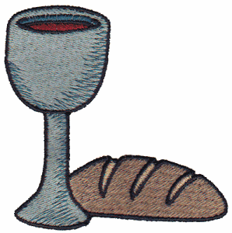
Initiation and The Eucharist
Eucharist = Thanksgiving
Starter:
Why are these things important to Christians?
Give 2 reasons for your point of view.

Slide 3
ALL: To be able to explain what the Liturgist of the Eucharist is and why it is important to Christians
MOST: To be able to evaluate the differences between Jesus’ last supper and the Passover in Exodus

Slide 4
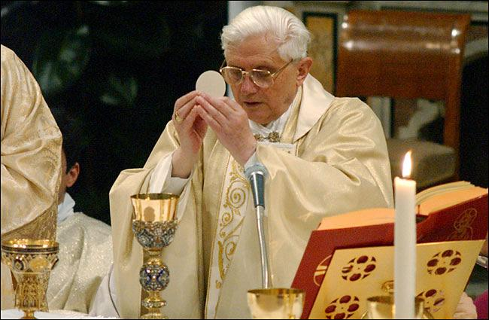
What happens at mass?
What does the priest say? What does he do?

Slide 5
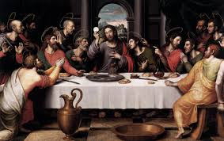
Transubstantiation =
The change that takes place during the sacrament of Holy Communion (Eucharist). This change involves the bread and wine becoming the body and blood of Christ.
Catholics believe that It has actually become the body and blood of Christ – this is why we have a Tabernacle for any left over hosts.
(RESPECT)

Slide 6
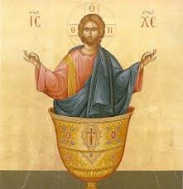

Slide 7
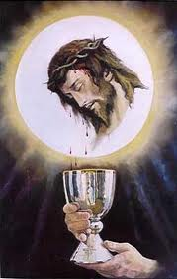
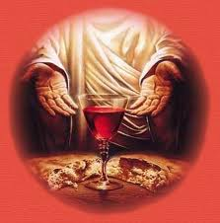
Catholics believe that It has actually become the body and blood of Christ – This is why we have a Tabernacle for any left over hosts.
(RESPECT)

Slide 8
Watch the following film of the Last Supper.
What does Jesus say?
What does Jesus do?
How do you think his disciples felt?
In the scene of Jesus at the Last Supper…

Slide 9
What does Jesus say?
What does Jesus do?
How do you think his disciples felt?

Slide 10
Passover and the Last Supper
Jesus was a Jew and so would have celebrated Passover every year just as all the other Jews would have done and still do today.
An important part of the meal is the flat bread called Matzoh & the red wine.
Jesus took these two things and gave them a completely different meaning.
He took the Matzoh, blessed it and gave it to his friends.
Then he took the red wine, blessed it and shared it among his friends.
The Last Supper: The first ever Eucharist

Slide 11
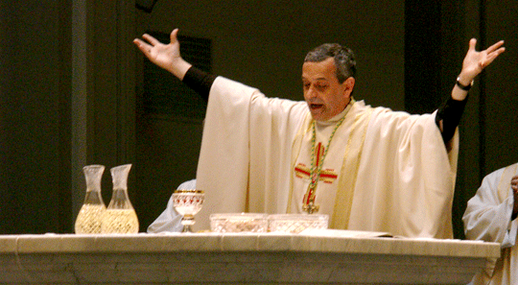
What happens today?
During the service all share in the bread and the wine.
This is a reminder to Christians of the Last Supper, when Jesus ate with his disciples for the last time, before he was arrested and put to death.
Christians share bread and wine as Jesus did with the disciples and through this they feel part of the last supper.

Slide 12
Alan the Alien and the Eucharist
Your task it to explain what the Eucharist is to Alan the Alien.
You must include all of the words!
Dear Alan,
I know you are from another planet so you probably do not know much about the sacraments but…
In the Eucharist….
I think this is important to Christians because…
Words to help you:
Beliefs
Bread and wine
Eucharist
Passover
Last Supper
Jesus
Reminder
Jewish

Slide 13
Plenary
Give the sacrament of Eucharist a mark out of 10 for its importance to Christians.
On your post it note – explain why you given it that number.

