Slide 1
The 12 Disciples - Bingo
Judas Iscariot
Simon (St Peter)
Andrew
James 1
John
Phillip
Bartholomew
Thomas
Matthew
James 2
Thaddeus
Simon
Matthias
Paul
Candidates to replace Judas after Jesus’ death.

Slide 2
Matthias (12th Apostle) - Peter declared that they must choose another to take the place of Judas. Matthias was chosen as the twelfth Apostle since he was present with Jesus Christ during his time on Earth as well as through his crucifixion.

Slide 3
James 2 – He is one of the disciples that very little is known about. James’ father shared his name with the father of Matthew and it is possible that they were brothers; however, this cannot be known for certain

Slide 4
Phillip - was slow to recognize Jesus; however, once he found Jesus he was quick to share His greatness with his friend Nathanael Bartholomew. Not a lot is known about Phillip.

Slide 5
Simon - The interesting thing about Simon is that he is never mentioned throughout The Bible, except to list his name as one of the twelve disciples.

Slide 6
James 1– James was a fisherman with John (his brother) and Peter. Jesus nicknamed both James and John “Sons of Thunder,” because of their bad tempers.

Slide 7
Thaddeus - There is some confusion as to whether Thaddeus was the brother or son of James but it is known that they were related. Thaddeus was not a leader of the twelve disciples and he is not mentioned often throughout The Bible.

Slide 8
Paul – (the other candidate for 12th Apostle) Paul was known as a persecutor of Christians and a Roman citizen until his conversion to Christianity.

Slide 9
Thomas –The phrase “doubting Thomas” come from Thomas’ reluctance to believe that Jesus had risen from the dead. Although he was gloomy, Thomas was a full believer in Christ and followed Him loyally throughout His life.

Slide 10
Matthew – writer of the first Gospel. He always refers to himself as Matthew the tax collector making note of the fact that he was once a sinner even though he followed the path of Christ.

Slide 11
Andrew – (Peter’s brother) the first disciple called by Jesus. He left his life as a fisherman to serve as one of the two disciples of John the Baptist. While John the Baptist sent Andrew to Jesus.

Slide 12
Judas Iscariot - Judas was the disciple who did not truly believe in the love of Jesus and when the chief priests were looking for a way to arrest Jesus Judas provided them with that way by identifying Jesus with a kiss in return for thirty pieces of silver.

Slide 13
Simon (St Peter) - Peter is characterized as a strong willed and courageous man; however, at times he could be quick to speak and impulsive. Peter held firm belief in the teachings of Christ.

Slide 14
Bartholomew - Bartholomew is known for being an honest man who was convinced by Jesus’ greatness upon his meeting with Him. Not a lot is known about him.

Slide 15
John – Wrote 5 books of the bible. John was particularly devoted to Jesus and is claimed to be the closest of all twelve disciples to Jesus, never straying far from him.

Slide 17
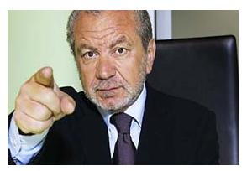
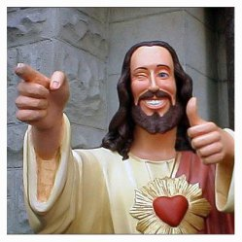
The Discipleship Challenge

Slide 18
Learning Outcomes
Understand what it means to be a disciple of Christ.
Identify the characteristics required to be a disciple of Christ.
Justify why your team possesses the characteristics/skills/beliefs required of a disciple.

Slide 19
Task
You are all budding Disciples!
However, not all of us can become Disciples.
Unfortunately Jesus is not available to make the decision.
So, Sir Alan (Miss Grattidge) and others will decide which budding Disciples should be HIRED!

Slide 20
Your Group Challenge
You must come up with an Advertisement campaign attracting people to Discipleship.
BEFORE YOU BEGIN:
You must nominate a Project Manger (PM)
The PM is the team decision maker and is responsible for the team.
The PM is required to explain after the presentation why their group choose to do their Advertisement campaign the way they have.
The PM must explain the teams decision process.

Slide 21
You can either:
Make a TV advert/Drama
A radio Advert/Drama
A poster
You could do a mix of both
You may also come up with other ideas but they must be ran by Sir Alan.
Your advertisement/presentation must not last longer than 5 minutes.
Be creative!!!
Success Criteria
Your Advertisement should include :
An explanation of what a Disciple is.
An outline of what a Disciple does.
The qualities/skills/talents Disciples need.
The benefits of being a Disciple.

Slide 22
Presentation time!

Slide 23
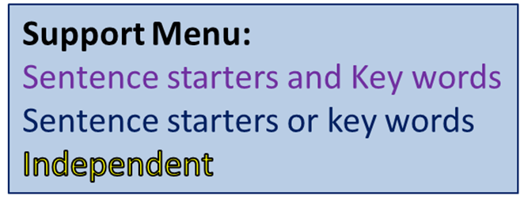
Pre Board Room create a speech explaining why you would make a brilliant disciple. Give it a title.
How did you contribute to your team?
What did you do?
What qualities have you shown?
What further skills, qualities, or talents could you bring to discipleship?
Why would Jesus pick you if he was hiring today?
Key Words
Discipleship
Loyalty
Unique
Faithful
Bravery
Love
Chosen
Conversion
Obedient
Trusting
Passionate

Slide 24
The Board Room
The PM will now choose one person from their team to compete to win discipleship (it can be the PM if the team agree).
All competitors will then face Sir Alan and perhaps others and battle it out in the board room.
They will have to explain why they will be the best Disciple.

Slide 25
Presentation time!

Slide 26
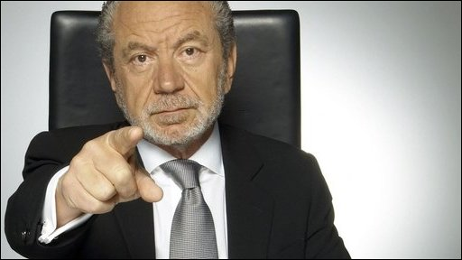
You’re Hired!
ONE OF YOU WILL BE HIRED BASED ON YOUR RESPONSES

Slide 27
Audience Participation
Once Sir Alan has made his decision, the audience will vote on whether the correct decision was made.
Using the whiteboards the audience will either write YES or NO.
Some members of the audience will be picked to explain their vote.
GOOD LUCK!!

