Slide 1
What do you think sin is?
…………………………………………………………………………………….
………………………………………………………………………………………
……………………………………………………………………………………..
What kind of sins do we often commit? Give examples. ……………………………………………………………
…………………………………………………………….
…………………………………………………………….
………………………………………………………………………………………………………………………………………………………………………………………………………………………………………………………………………………………………………………...
“We make excuses for our sins and like to sweep things under the rug. That is why God wants us to tell Him our sins so that we admit that we are not perfect.” -YouCat 228
Justify whether you think some sins are worse than others. Give examples.
……………………………………………………………………………………………………………………………………….
………………………………………………………………………………………………………………………………………………………………………………………………………………………………………………………………………………………………………………………………………………………………………………………………………………………………………………………………………………………………………………………………………………………………
LO1: To understand the term Sin.

Slide 2
Learning Objectives
To understand the term Sin.
To describe the term Original Sin.
To explain how Christians believe that Jesus died to save humanity from sin.
Key Words:
Sin – an offence against God, failing to love.
Original Sin – a sinful tendency that humans inherit from Adam and Eve’s disobedience.
Forgiveness – healing a friendship broken by wrong-doing.

Slide 3
Paired Discussion
This is a hard boiled egg:
What does an egg look like?
What does it feel like?
Este é um ovo cozido: O que um ovo se parece? Qual é a sensação?
Leaving someone out
This egg reminds me of our hearts before we know Jesus. Before we know Jesus our hearts are hard and messy and far from perfect.
Being rude
lie
murder
talk about people behind their back
stealing
be unkind
Emotionally abusing someone
Laughing at somebody
Este ovo me faz lembrar dos nossos corações antes de conhecer Jesus. Antes de conhecer Jesus nossos corações são duros e confuso e longe de ser perfeito
White lies
Taking the Lord’s name in vain
Not standing up for someone
Physically abusing someone
We’ve ALL done some of the things that are written on the egg!
None of us are without sin.
LO1: To understand the term Sin.

Slide 4
The Fall - Genesis - Adam and Eve
Eve heard a voice. "Has God told you that you can eat the fruit from all the trees?" the voice asked softly. Eve turned around to see a snake talking to her. She said, "God has told us we can eat all the fruit except for what grows on The Tree of Knowledge," “That’s silly. God knows that if you eat from The Tree of Knowledge you'll become just like God, and you will have all knowledge." The woman looked at the fruit and thought how tasty it looked. She thought how wonderful it would be to be as wise and powerful as God. She believed the serpent's lie and ate the fruit and also gave some to Adam, who was with her.
Sin was created!
Suddenly she realized that she was feeling guilty, she had disobeyed God.
As soon as they ate the fruit a change came over Adam and Eve. They became unhappy and fearful of God.
When God asked them if they had eaten from The Tree of Knowledge that He had told them not to touch, they blamed each other for their sins. God was sad that Adam and Eve had disobeyed them. He told them that they had to leave the Garden of Eden, and life would become difficult for them from now on.

Slide 5
Write the answers in your books, use full sentences:
What is original sin?
O que é o pecado original?
Where did it come from?
Onde é que ela vem?
What effect does it have on us today?
Que efeito isso tem sobre nós hoje?
LO2: To describe the term Original Sin.

Slide 6
Original Sin
We are born with it within us to do the wrong thing and make bad decisions.
Comes from the first sins of humans.
Pecado Original
Nós nascemos com ele dentro de nós para fazer a coisa errada e tomar decisões ruins.
Vem desde os primeiros pecados de seres humanos.

Slide 7
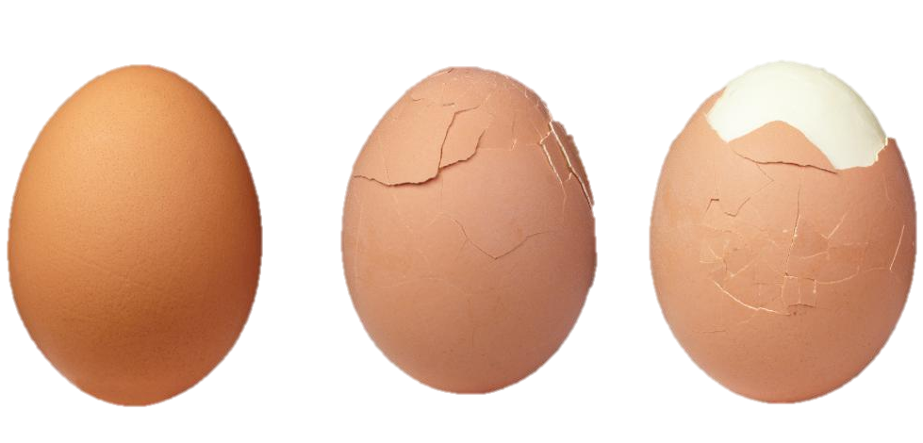
be unkind
Leaving someone out
Leaving someone
murder
murder
lie
lie
Not standing up for someone
Not standing up for someone
White lies
White lies
White lies
Laughing at somebody
Not standing up for someone
Laughing at somebody
Laughing at somebody
Emotionally abusing someone
Emotionally abusing someone
Emotionally abusing someone
murder
murder
murder
How would this peeled, hard-boiled egg feel?
How does it look?
What makes it different to the non-peeled egg?
What happens if we start to peel the egg?
LO3: To explain how Christians believe that Jesus died to save humanity from sin.

Slide 8
Jesus died on the cross for our sins. But He didn’t stay dead. After 3 days, He rose again and is now living in heaven.
Christians believe that if you are sorry for your sin, then Jesus can take away your sin just like taking off the dark, hard peel of an egg.
Think-pair-share
How does this egg help to explain about forgiveness?
What does the Catholic Church teach about forgiveness?
What has this got to do with Jesus?
That is what happens to our heart when we ask Jesus to forgive us for our sins. Our heart changes from messy and dark and hard to being clean and soft.
LO3: To explain how Christians believe that Jesus died to save humanity from sin.

Slide 9
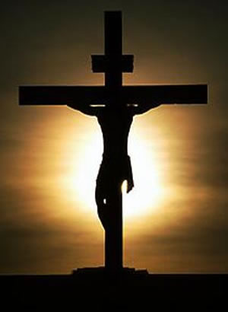
30 seconds
Discuss:
How does this picture relate to the story of original sin?
LO3: To explain how Christians believe that Jesus died to save humanity from sin.

Slide 10
 | How is this related to sin? | Explain how Jesus saved us from sin. | Analyse how this affects our daily lives.
“All children come to me, for the kingdom of heaven belongs to you.” | Young children are innocent because they have not begun to sin yet so they deserve to go to heaven. | Jesus saves us by allowing our sins to be forgiven so we can return to innocence like young children. | As we get older we are more likely to give in to temptation. We should try to be innocent like children.
‘We are all sinners but Jesus sets us free.’
‘Jesus saves us because he talks to God for us.’
‘It is in your heart that you believe God loves you but it is with your mouth that you must say sorry.’
LO3: To explain how Christians believe that Jesus died to save humanity from sin.

Slide 11
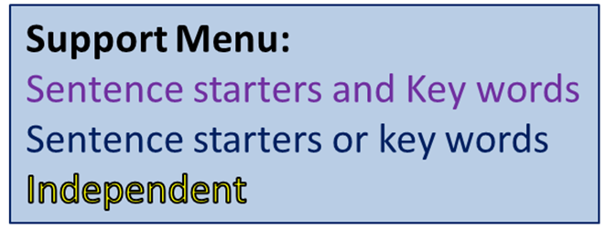
The Apostles wrote letters to tell people all about Jesus: Write a letter to tell people about Original Sin
Success Criteria (things to include):
What is sin?
Adam and Eve (fact or symbolic?).
The meaning of original sin.
How original sin affects us.
How Jesus saves us from sin.
Key Words
Contrition
Sin
Original Sin
Symbol
Sacrament
Sacrament of Healing
Forgiveness
What can we do to be forgiven from sin according to the Catholic Church?

