Slide 1
Starter
S A C r A M E N T
How many words can you
make out of this? The person with the most words wins a merit!
Notes:
Points for the best one!

Slide 2
Sacraments
Symbol | Something simple that leads one to imagine a bigger, more mysterious reality.
Symbolic Gesture | A special movement of hand or body, a movement that means something.
Sacrament | A living sign by which we receive God’s help for our souls in a particular way.
Divine | Of God, Godly.
Sacrament of Initiation | Sacraments by which a person is drawn into full membership of the church – Baptism, Confirmation and Eucharist (Holy Communion).
Sacraments of Ministry | Sacraments by which a person receives grace for a special role of service – Marriage, Holy Orders.
Sacraments of Healing | Sacraments to bring peace and wholeness in mind and body – Reconciliation, Anointing of the Sick.
Rite | The order and way in which a sacrament is celebrated.
Catechumen | A person preparing for Baptism.
Chrism | Perfumed oil used for anointing.
Original Sin | A sinful tendency that humans inherit from Adam and Eve’s disobedience.
Sin | An offence against God, failing to love.
Forgiveness | Healing a friendship, broken by wrongdoing.
Contrition | Being sorry in your heart for having sinned against God.
Penance | Something to make up for the damage done by sin; also a name for the sacrament of reconciliation.
Absolution | Complete forgiveness of sins.
Repentance | Turning to God and being truly sorry.
Key Word Bingo

Slide 3
Learning Objectives
Identify the difference between a sign and a symbol.
Understand how symbols are used to represent the sacraments.
Justify your opinion about the order of importance of the sacraments.
Key words:
Symbol: something simple that leads you to imagine a bigger, more mysterious reality.
Sacrament: a living sign by which we receive God’s help for our souls in a particular way.

Slide 4
Signs
Signs are everywhere.
They give us information and instructions.
The purpose of a sign is to have a clear and obvious meaning, that is understood the same way by everyone.
A sign is a quick, simple way of communicating facts and directions.

Slide 5
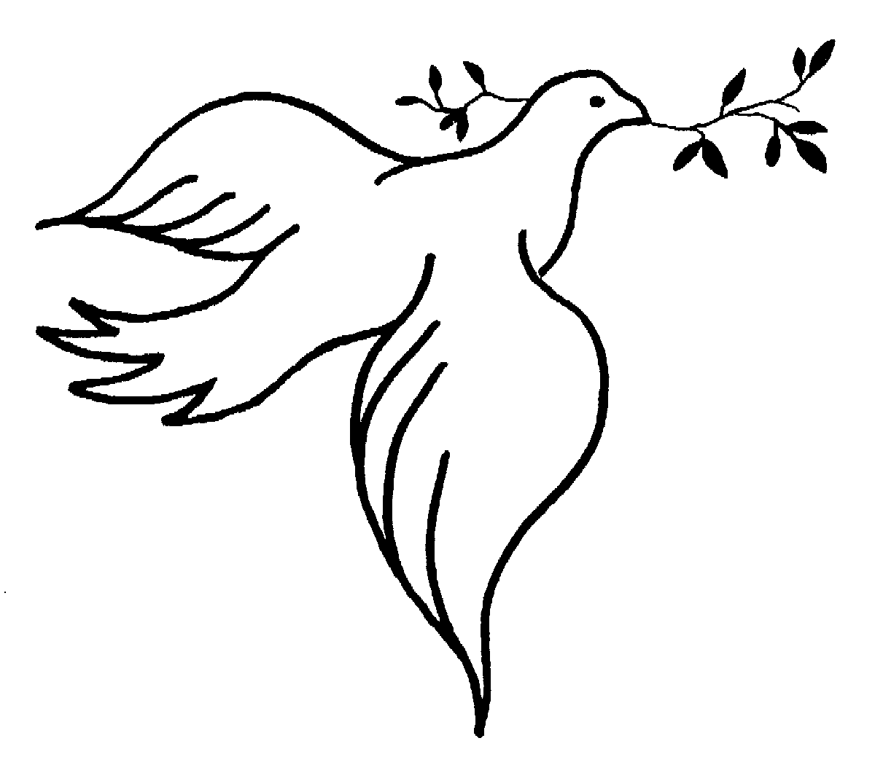
Symbols
Symbols express more complicated ideas. They can have several layers of meaning and symbols mean different things to different people.
Symbols say more than signs. They often stand for people’s ideas, feelings and beliefs.

Slide 6
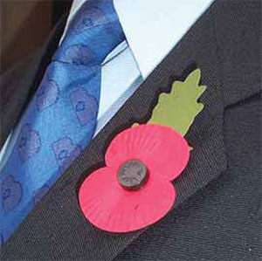
What do these mean?
In your own words explain the difference between a sign and a symbol.
The difference between a sign and symbol is that a sign is designed to…
A symbol is different to this because it is designed to…
Notes:
Poppy - WW2, veterans, bloody, battlefield, remembrance day. United nations – peace, negotiate, etc… Dove – peace, tranquility, etc… Statue of liberty – freedom, lack of oppression, tourism etc…
Sentence starter to write on whiteboard for L3-4. The difference between a sign and symbol is that a sign is designed to….

Slide 7
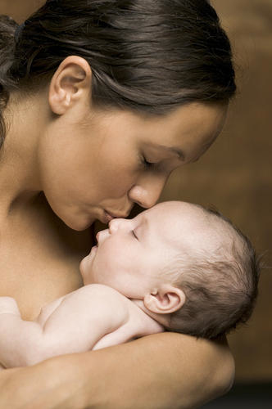
Mini title: Living signs.
A ‘Living Sign’ is a sign that is put into action.
An example being the way a mother shows her love to her child.

Slide 8
For all Christians, a sacrament is a living sign of love from God.
There are 7 Sacraments in Catholic teaching... All of these are ways in which a Christian can experience the love of God.
They are even seen as doors to God; when a Catholic Christian takes part in a sacrament, the door opens and God is there.
Can you name any of the sacraments? Some of you may have received them.

Slide 9
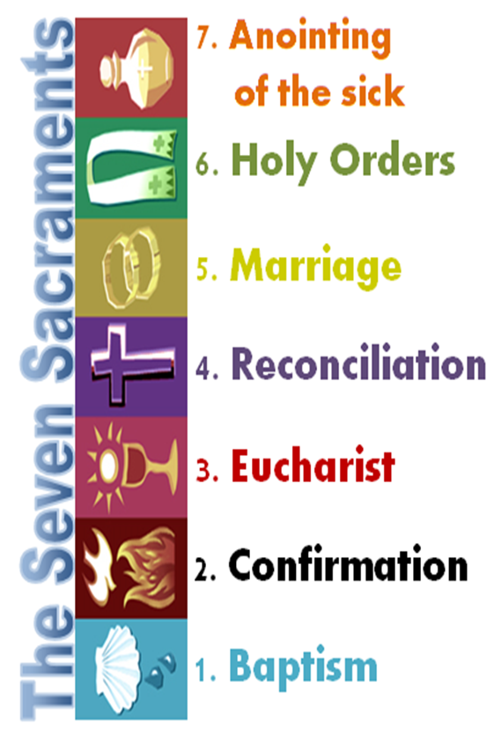
How does each symbol represent a sacrament?
7. The symbol is a jar of oil which is used to anoint the sick, usually before death.
6.
5.
4.
3.
2.
1.

Slide 10
Life is thought of as a journey; it has a start and a destination. The sacraments follow this journey starting with baptism
and ending with anointing.
Often anointing is done just before death so that the sick person can feel comforted as they pass on to the next life.

Slide 11
In green write the major events in your life. What age do you want them to happen?
Birth
First tooth
2. In orange write when you think each sacrament usually takes place.
Birth
First school
Change schools
First Girlfriend/Boyfriend
University/College
First Job
Marriage
First Child
Second Child etc...
Grand child
Retire
Death
Anointing of the sick
Death

Slide 12
Birth

Slide 13
Decide which sacrament you think is the most important. Design a symbol to represent this sacrament (something different to the examples given already).
Look at your colour level to help you.
Purple: Choose the most important sacrament. Describe why you believe it is important. Design your symbol.
Blue: Choose the most important sacrament. Explain why you think that it is more important than the others (name at least 2 others). Design your symbol and label the parts of it.
Yellow: Choose the most important sacrament. Explain why you think that it is more important than the others (name at least 2 others). Design your symbol and explain what each part means (different layers of meaning).
Notes:
If they finish early they can write a 50 word sales pitch for the Catholic Church persuading them to choose their offering.

Slide 14
Sacraments, Signs and Symbols
I think that …………………………………… is the most important sacrament because
My symbol represents the sacrament………………………………………. because
My symbol design:

