Slide 1
Wednesday Word 16TH June 2021 ‘Calm’
Teachers: Worksheet and task slide: 6
Youtube clips slide:3
Gospel Reading: Adapted from Mark 4:35-41
The 12th Sunday of Ordinary Time, Year B
“Having faith means keeping your heart turned to God, to his love, to his Fatherly tenderness, amid the storm. Jesus wanted to teach this to the disciples, and also to us today.” Pope Francis

Slide 2
Watch the video 2 minutes in length: Jesus Calms the Sea on the next slide https://youtu.be/uYLHqdSO9OY
Gospel Reading: Adapted from Mark 4; 35-41 The 12th Sunday of Ordinary Time, Year B
Jesus said to his disciples, “Let us cross over to the other side of the Sea of Galilee.” And leaving the crowd behind they set off.
Then it began to blow a gale and the waves beat upon the boat so that it was almost filled with water.
Jesus was asleep in the stern of the boat, his head on a cushion. They woke him and said to him, “Master, do you not care?
We are going down!” And he woke up and rebuked the wind and said to the sea, “Quiet now! Be calm!” And the wind dropped, and all was calm again.
Then he said to them, “Why are you so frightened? How is it that you have no faith?” They were filled with awe and said to one an
other, “Who can this be? Even the wind and the sea obey him.”

Slide 3
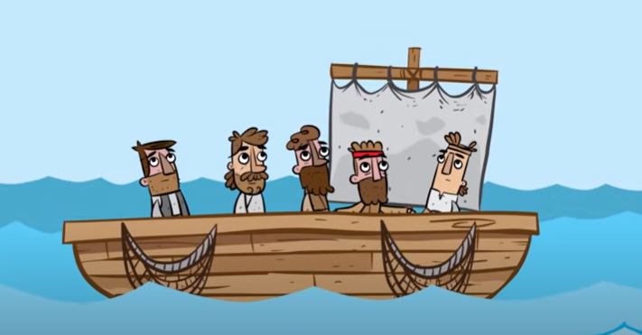
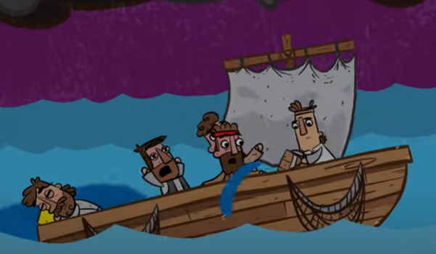
Gospel of Mark 4: 35-41 Jesus calms the sea (Video 2 minutes in length).
Watch the video 2 minutes in length: Jesus Calms the Sea. Cut and paste:
https://youtu.be/uYLHqdSO9OY
Notes:
YOUTUBE LINK
seconds.

Slide 4
Discuss together as a form …
What sort of things stress you?
Has there ever been a time when you had to remain calm and it was difficult to do?
What advise would you give to a friend who needs help to remain calm?
Do you think when we remain calm the situation becomes better? Why do you think that is?
What colour reminds you are calm, explain why?
Task:
This week sometime, why not write a Prayer or reassurance to a friend that you are there for them for someone that you know who needs to remain calm.

Slide 5
What is the Gospel about? And what is it teaching us to do? (Mark 4: 35-41)
The Gospel is teaching us how Christ calmed the sea and reassured his disciples everything was ok.
There are times when most of us have been grateful to someone who was calm when we were in trouble.
Calmness is an inner peace that is good for our well-being.
Calm people can help others to keep calm too.- just like Jesus was on the boat with his friends.
The more we get to know and trust Jesus, the calmer and more at peace we become within ourselves and are nicer with one another because we show no anxiety or fear to others, but instead demonstrate a calm peaceful aura amongst ourselves and those around us.
Try it this week, being more patient, less stressed and calmer.
Whenever we are afraid or troubled, we can just pray to Jesus. Just sitting quietly with Jesus can be enough to calm us.

Slide 6
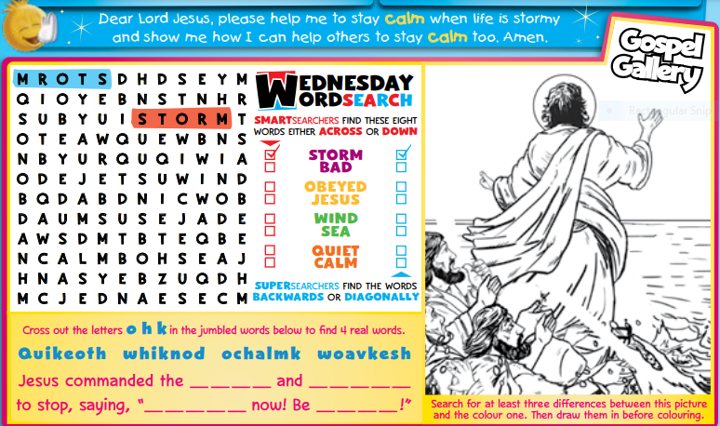
Task:
This week sometime, why not write a Prayer or reassurance to a friend that you are there for them for someone that you know who needs to remain calm.

Slide 7
Final Prayer
Dear Lord Jesus,
Please help me to stay calm when life is stormy and show me how I can help others to stay calm too. Amen.
St John Fisher… Pray for us.
In the name of the Father, and of the Son, and of the Holy Spirit.
Amen

