Slide 1
Wednesday 13th January 2021
Teachers: Worksheet slide: 7
Youtube clips slide:3
Notes if you prefer slide:4, 5 and 6
“New Start”
Gospel Reading: (John 1: 35-42)
“Let us all allow God’s constant help to make us new people.” Pope Francis

Slide 2
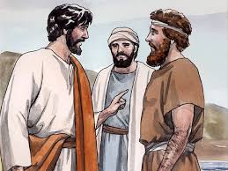
Gospel of John 1: 35-42 The 2nd Sunday of Ordinary Time, Year B ’
As John stood with two of his disciples, Jesus passed, and John stared hard at him and said, “Look, there is the lamb of God.” Hearing this, the two disciples followed Jesus. Jesus turned round, saw them following and said, “What do you want?” They answered,
“Rabbi,” – which means Teacher –“where do you live?” “Come and see,” he replied; so they went and saw where he lived, and stayed with him the rest of that day. It was about the tenth hour. One of these two (who became followers of Jesus after hearing what John had said) was Andrew, the brother of Simon Peter. Early next morning, Andrew met his brother and said to him, “We have found the Messiah,” - which means the Christ - and he took Simon to Jesus. Jesus looked hard at him and said, “You are Simon son of John;
you are to be called Cephas,” – meaning Rock.
Adapted from John 1:35-42
Notes:
YOUTUBE LINK
seconds.

Slide 3
Gospel of John 1: 35-42 The 2nd Sunday of Ordinary Time, Year B
Video: 2 minutes 20 seconds in length

Slide 4
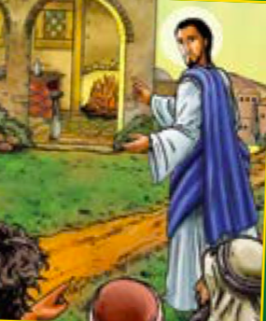
Discuss together…
What did Jesus reply when the men asked him where he lived?
Which word or words stood out for you in the Gospel, and why?
What does this picture make you think about?
John’s followers made a new start after discovering Jesus. This new year in 2021 presents an opportunity for us to make a new start.
Each of you say what is the best thing that you’ve ever started.
What did you like about it?
What new starts in 2021 have you made?
How are your new promises/ resolutions going to help you or others?

Slide 5
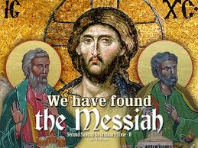
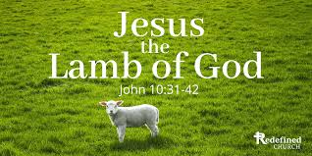
The Gospel Message for this coming Sunday and this week in school is about how we make a New Start?
Today’s Gospel refers to Jesus as ‘The Lamb of God’ and Simon Peter as ‘The Rock’
NEW START
“Yesterday is gone. Tomorrow has not yet come. We have only today. Let us begin.”
St Teresa of Calcutta
John’s Gospel states Jesus said to Simon: ‘…
(as Jesus looked hard at him and said, “You are Simon son of John;
you are to be called Cephas,” – meaning Rock.
The Holy Spirit is active in the world and works through us. The Holy Spirit can help us all to change, make a new start and become a new person.

Slide 6
What is the Gospel about? And what is it teaching us? (John 1: 35-42)
In this Gospel, we hear about the two disciples of John the Baptist making a new start.
They may not have known what John meant when
he said ‘Look, there is the Lamb of God,’ but they knew what he wanted them to do:
They had to start afresh and get close to Jesus.
Once John’s disciples got to know Jesus, they couldn’t wait to tell their friends and share their joy with them.
Regardless of our past, God is always ready to help us to begin again.
God invites each one of us to ‘Come and See’ – to make a New Start with Him, each and every day.

Slide 8
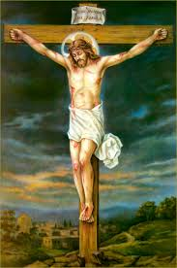
Final Prayer
Dear Lord Jesus,
Please help me to be always ready to make a new start with you and with others as we start this new year 2021
St John Fisher… Pray for us.
In the name of the Father, and of the Son, and of the Holy Spirit.
Amen
.

