Slide 1
Welcome Back!

Slide 2
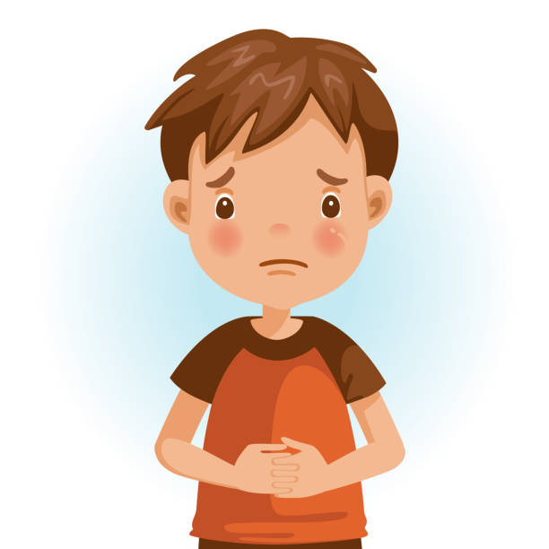
All change!
Over the last few months, we have seen lots of changes happen in our lives. Why does that matter? When there are lots of changes happening at once, this can cause our brains to feel uncertain about things and can set off fear circuits. This can trigger our bodies to respond in different ways. For some people, it might be the feeling of butterflies, having a tummy ache, finding it hard to get to sleep or perhaps feeling a little more grumpier than you usually do.

Slide 3
All change!
What can help you?
Sometimes, the best thing you can do is to face the thing you are worried about. You might have been worried about coming back to School, but now you are here in the classroom, you might already feel better.
There are other things that help.
Talking to a trusted adult is really important. Adults have probably gone through this themselves and can reassure, advise and encourage you.
Sharing how you feel with your friends can also help. Here at Winterfold, you are all really good at looking out for each other. By being honest about how you feel gives your friends an opportunity to be there for you.

Slide 4
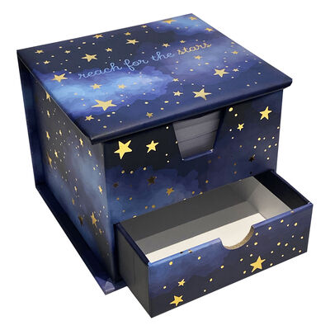
All change!
What can help you?
Talking about things is a brilliant way to help you process what is going on. It helps to let out the worries so that it doesn’t get stored up inside.
In every classroom, we now have Winterfold Worry Boxes for you to write down your worries. This is just as helpful as telling someone about it but allows you to share it in a private way.
You can write down or draw any worries you have on one of the pieces of paper. This could be anonymous or you can include your name.
You can then post your cards into the Worry Box drawer. We, your teachers, will keep an eye on the drawer and address them in the best way we feel will help the situation.

Slide 5
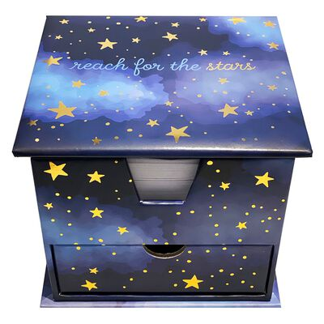
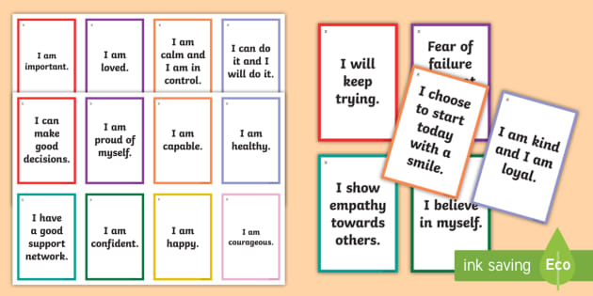
All change!
In the top compartment of the box, there will be some positive affirmations. You are welcome to take one of these whenever you need it.
Make sure you read it and keep it with you – perhaps in your pencil case or bag, and come back to it throughout the day. Whenever you need, it is there to keep positive words present in your thoughts.
Positive Affirmations

Slide 6
All change!
Your Task:
Our class needs some positive affirmations to fill the top of the Worry Box.
Each of you needs to write at least five. They need to begin with something positive such as I am, I will or I can… You can also decorate them and add some illustrations. Remember, this is your opportunity to brighten someone’s day who might really need it.
Positive Affirmations

Slide 7
Prayer
After a difficult few months, another way of finding support can be through prayer.
We can pray as a class during our class prayer time.
You can also add your prayer requests into the prayer box, which is located in the front office.
Please Pray for me…
For example
I am struggling with my exams
My next door neighbour is not well

Slide 8
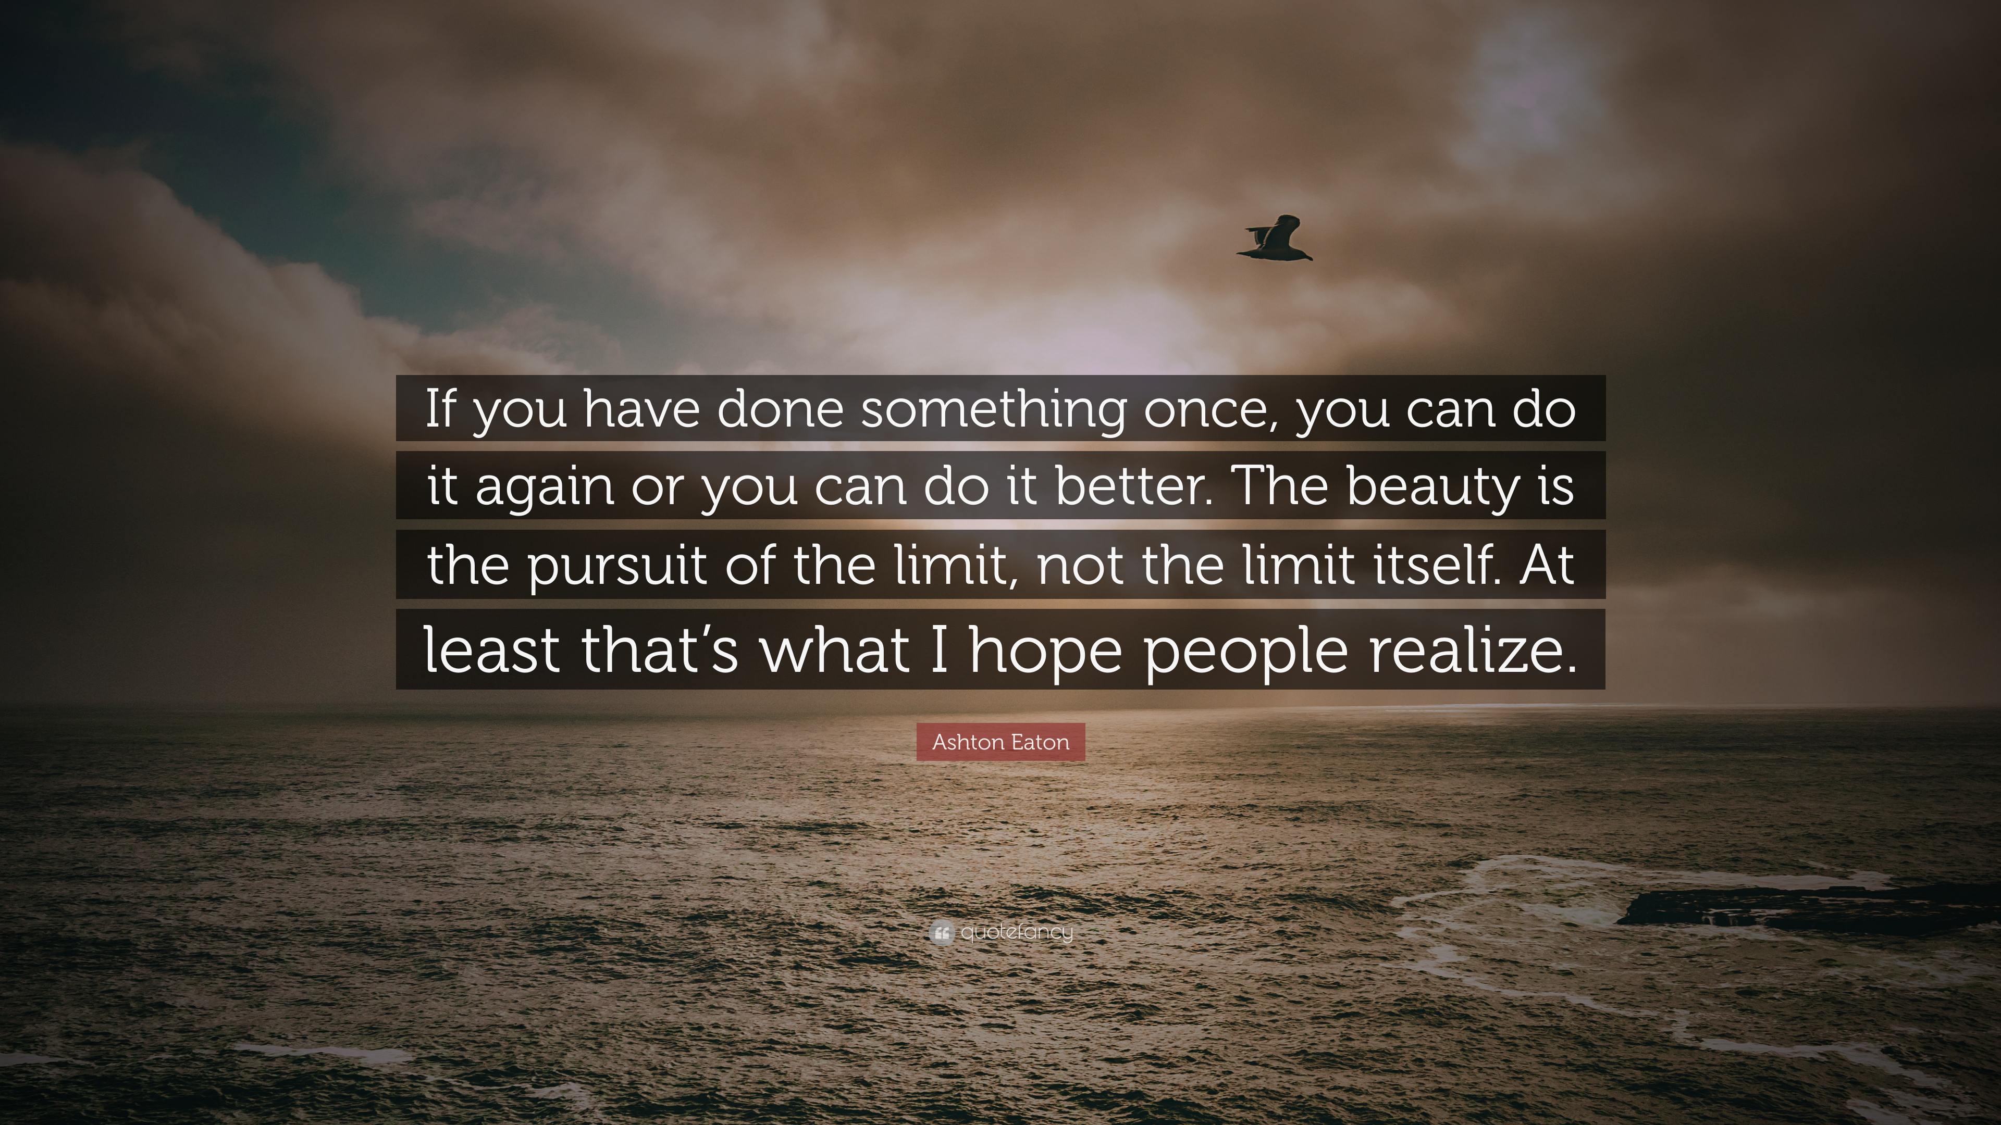
Celebrating Success
Reflecting on what you have achieved and the challenges you have overcome also plays a part in overcoming your worries.
Reminding yourself what you have accomplished and how you felt as you did it can give you the confidence to keep going in the next challenge you face.

Slide 9
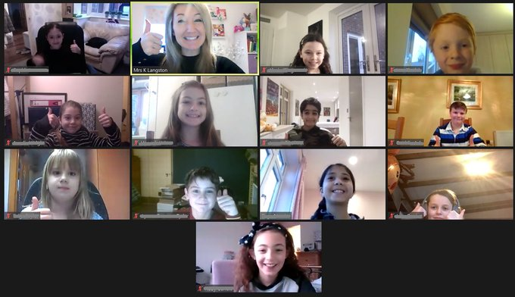
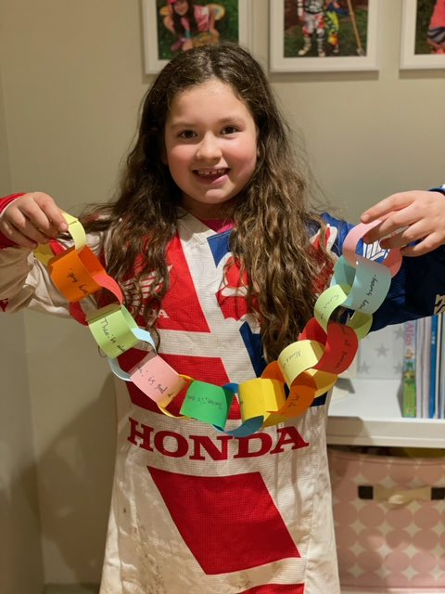
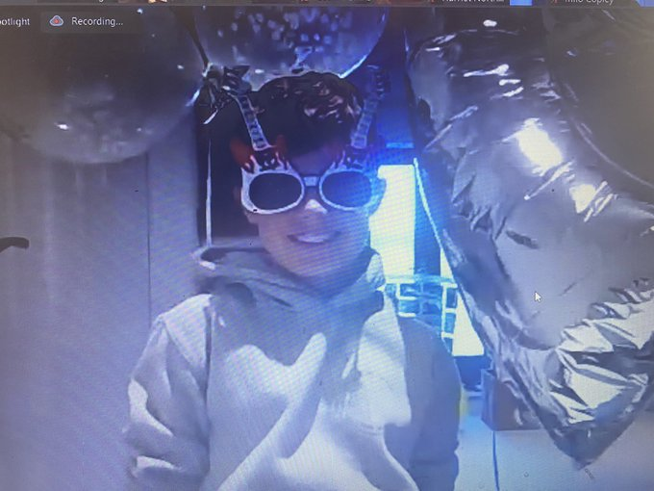
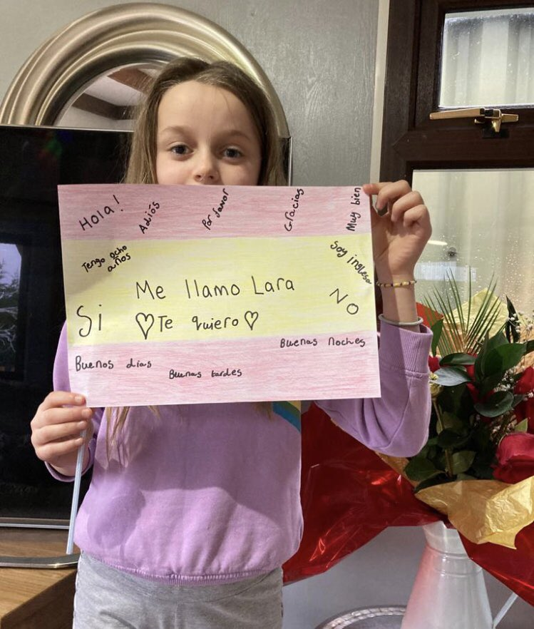
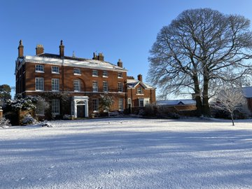
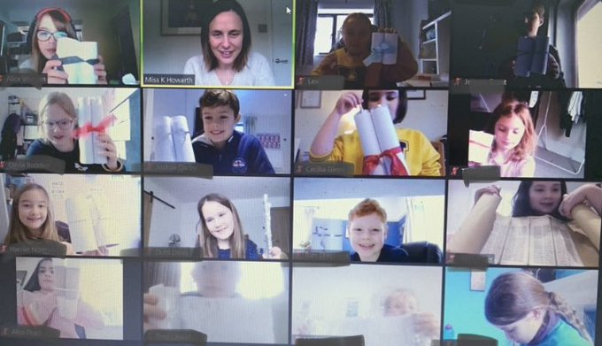
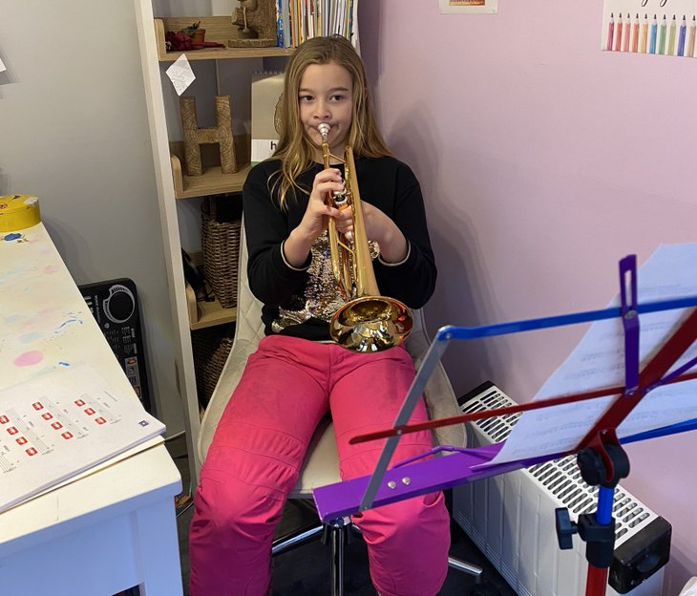
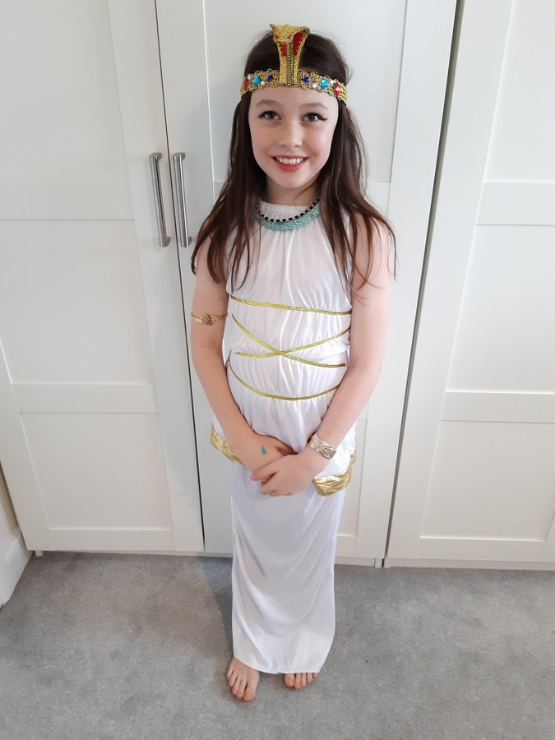
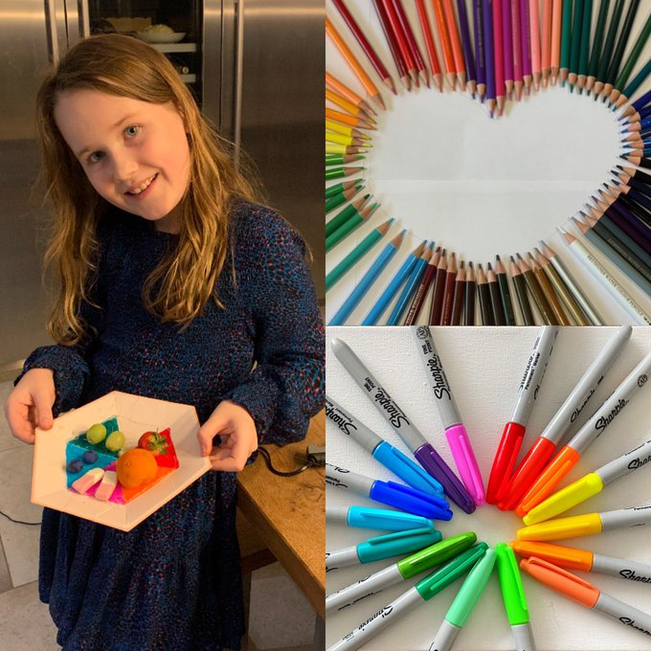
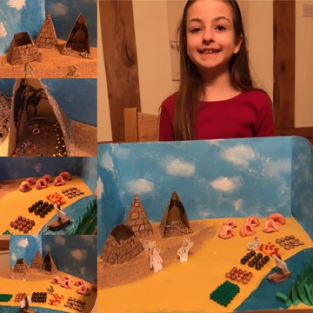
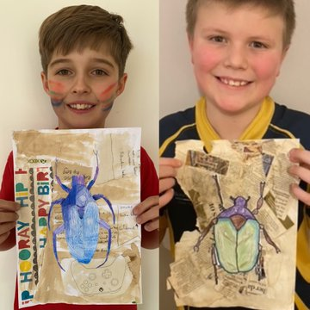
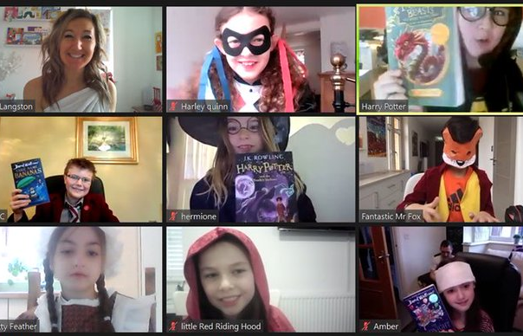
**You may want to select a few photos of your form here from Twitter to celebrate what they have achieved.

Slide 10
Self-Reflection: RSE Books
What has been your favourite memory?
2. What surprised you?
3. What piece of advice would you give to yourself if you could go back in time to Christmas?
Where do you feel you really saw success?
(Perhaps a subject or a piece of work?)
5. Where have you found the most challenge?
6. What did you do to overcome it?
7. What three things are you grateful for?

Slide 11
Self-Reflection
• Have you learnt any new skills?
• What has the weather been like?
• Who has been working from home with you?
• How have you felt being away from school?
• What was the most fun part of lockdown?
• What have you missed most about school?

Slide 12
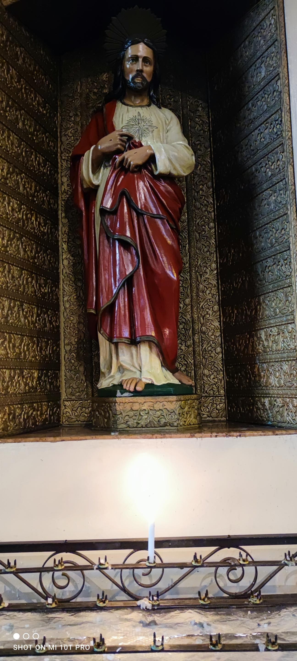
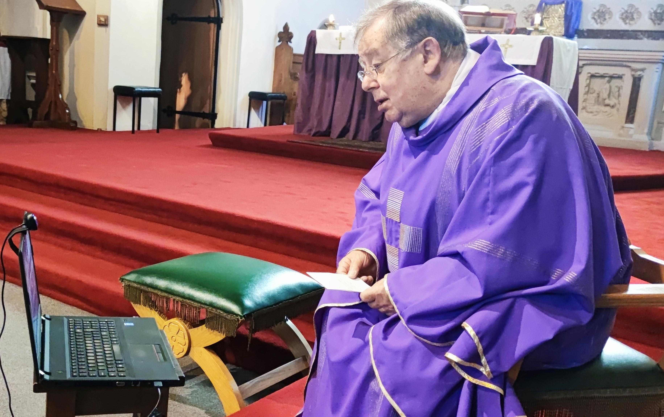

Slide 13
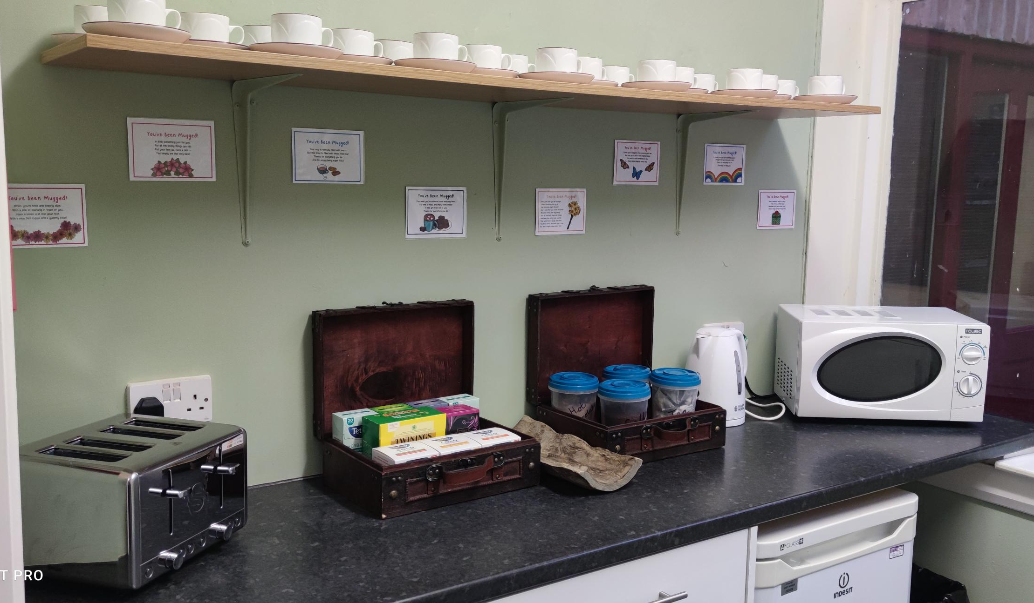

Slide 14
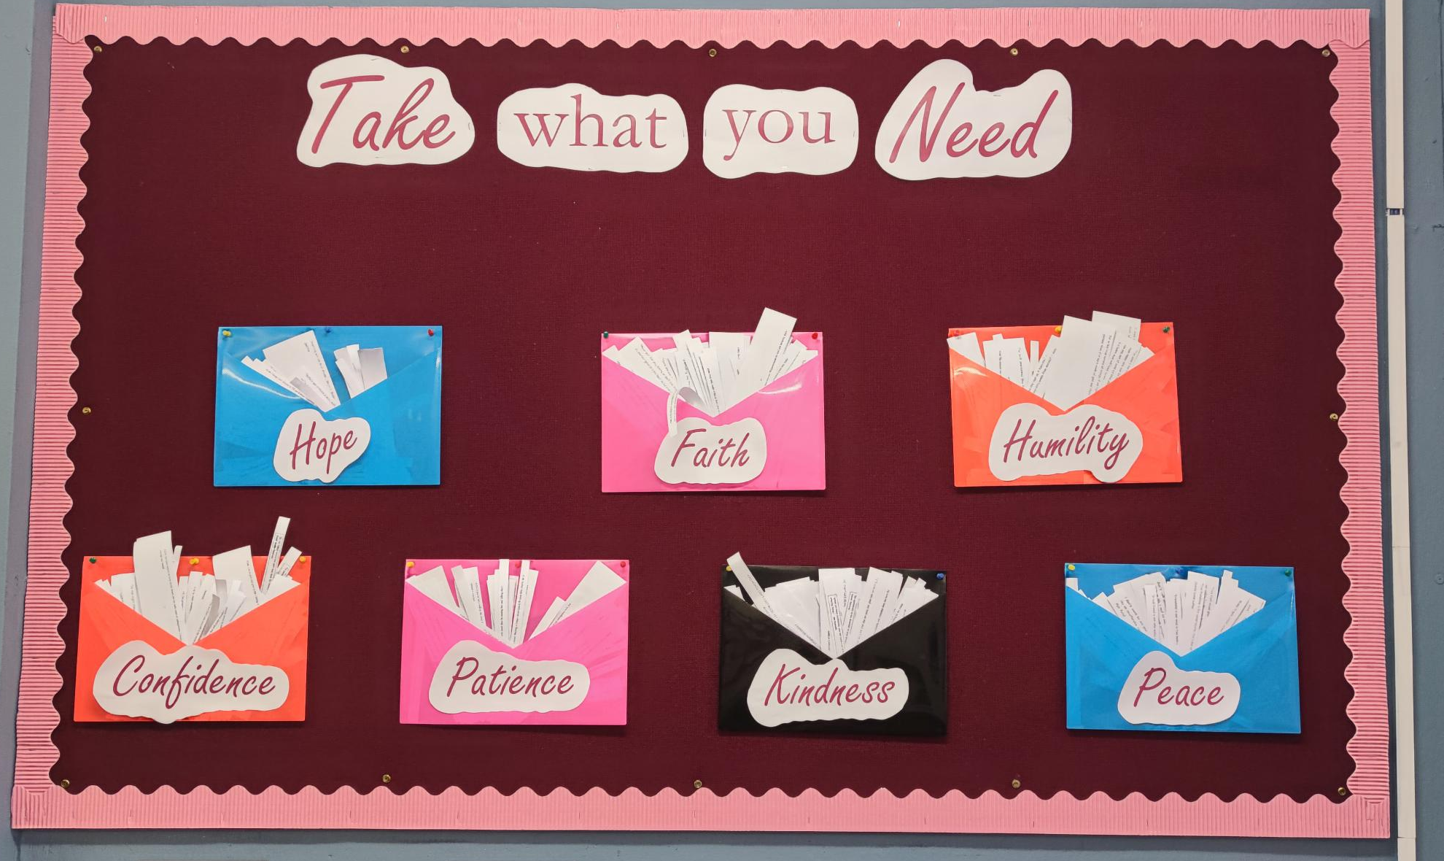

Slide 15
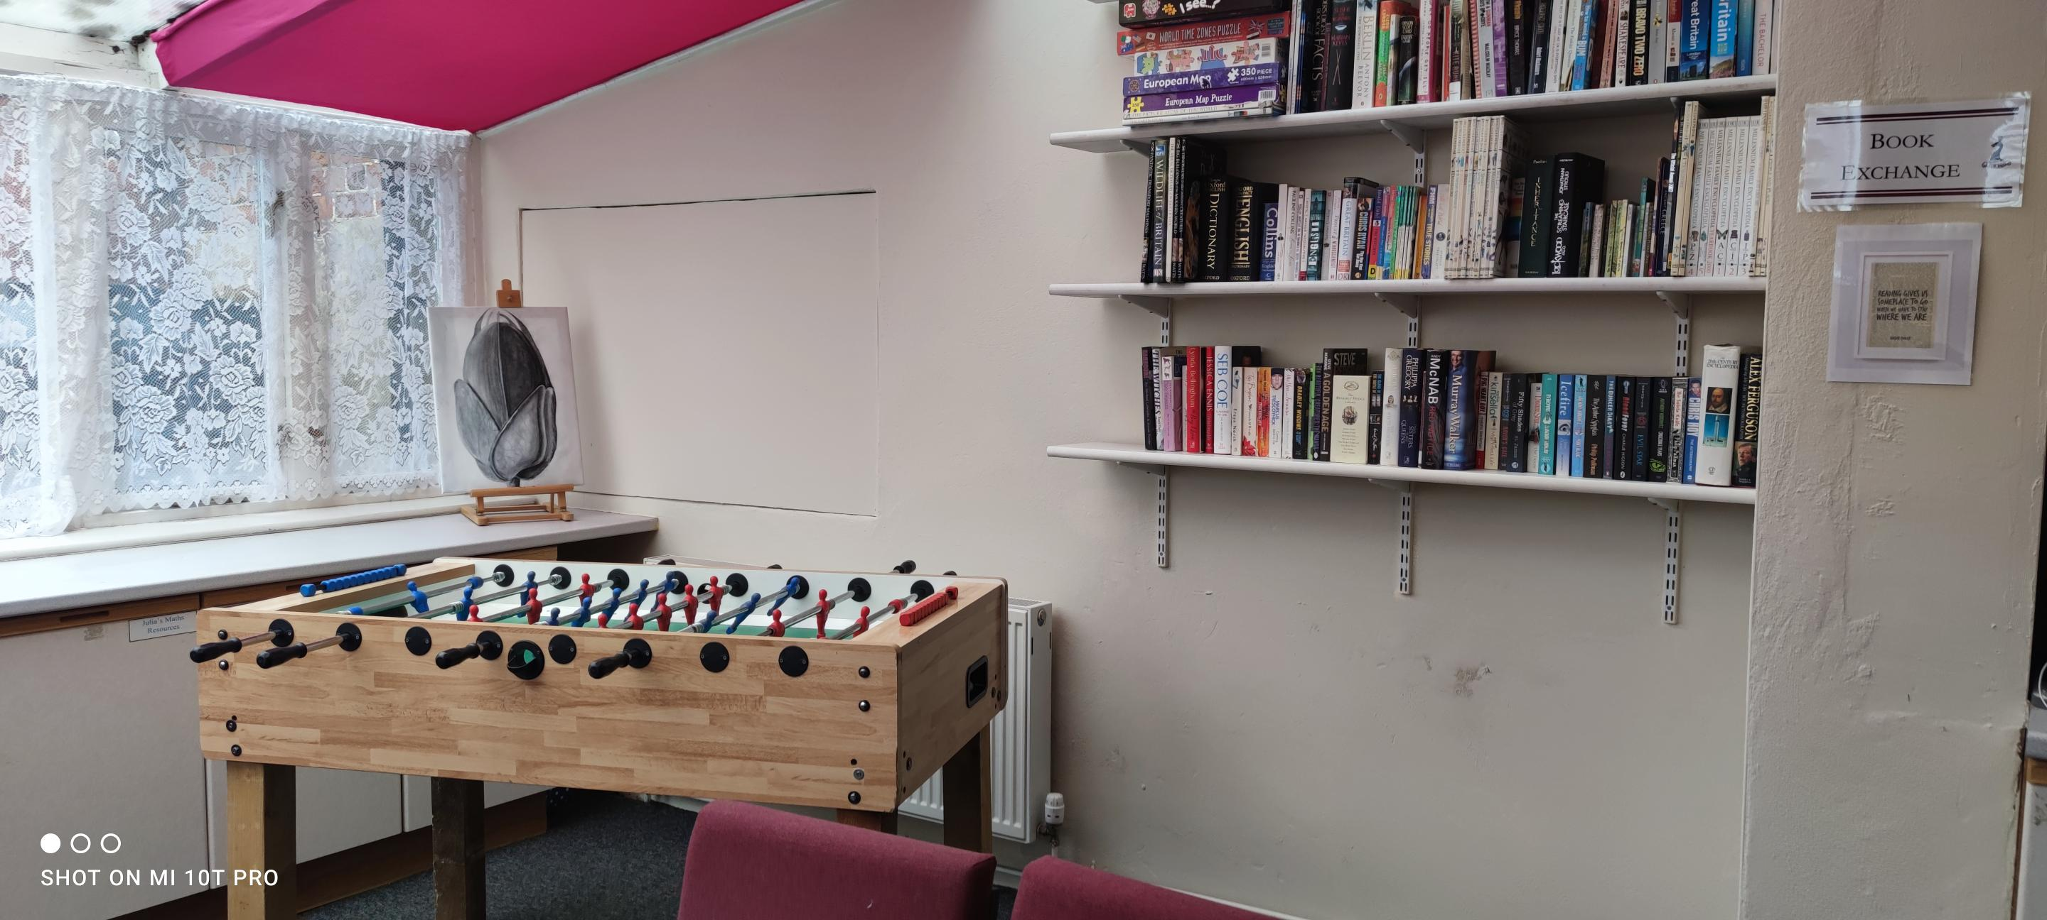

Slide 16
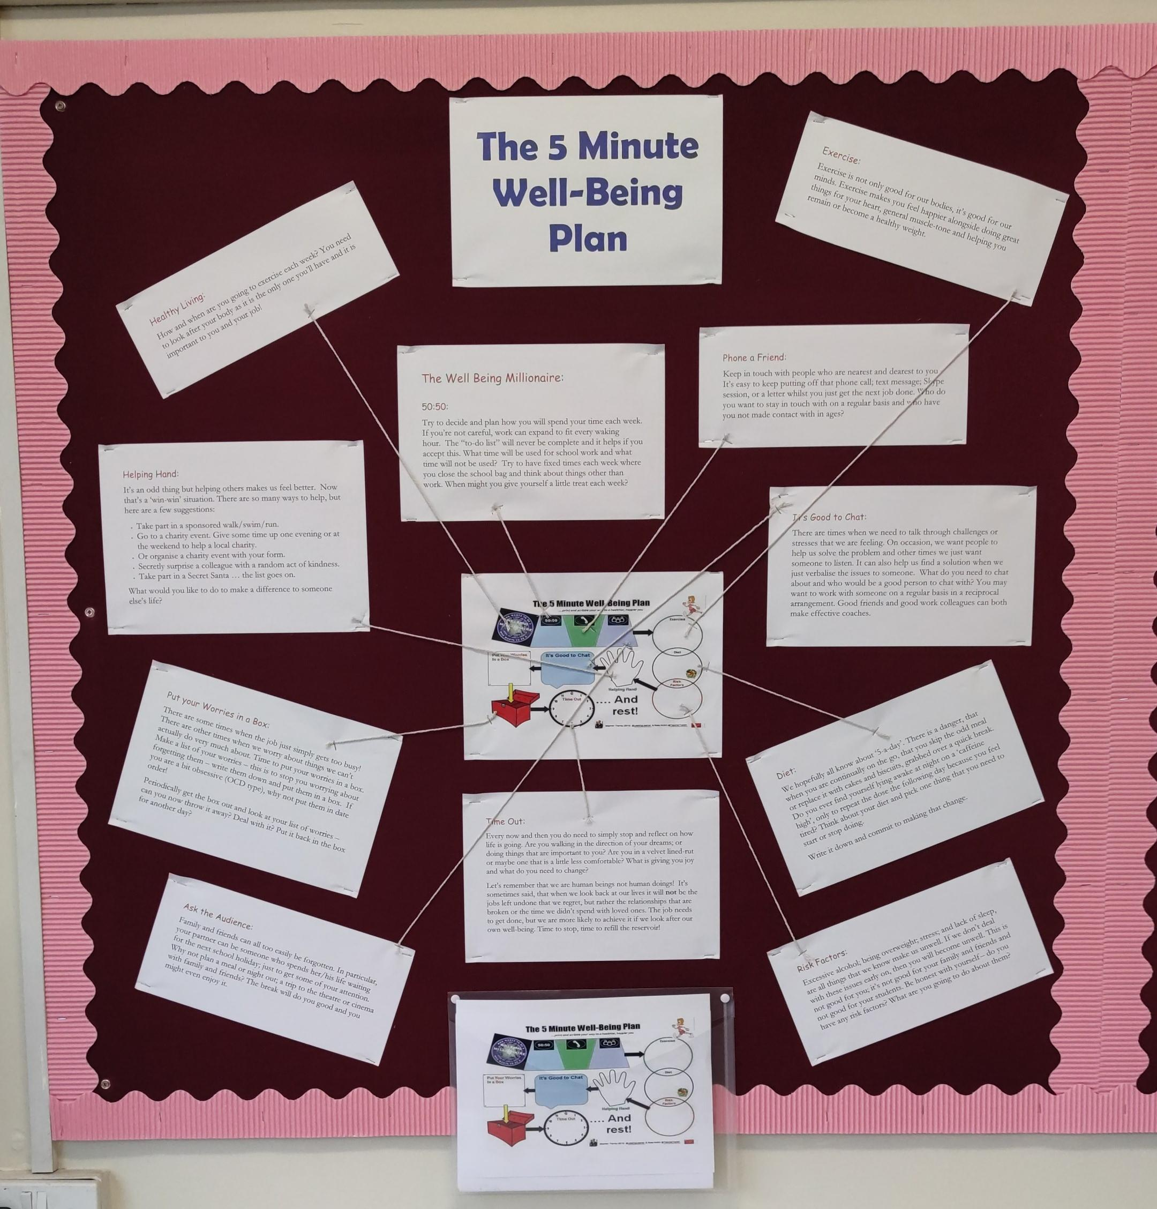

Slide 17
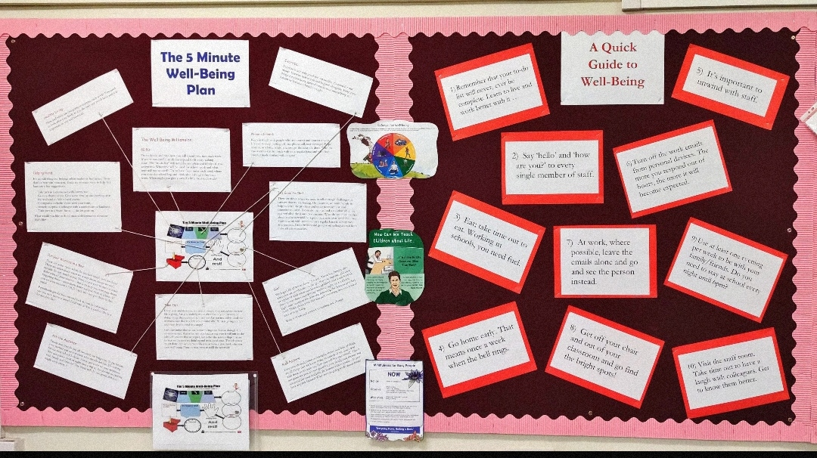

Slide 18
