Slide 1
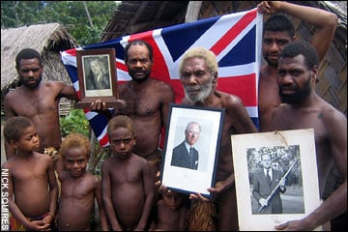
What questions do you have about this image?
What do YOU think is special about this photo?

Slide 2
Home learning review
Last lesson you were asked to prepare a short statement as to what you think are:
The origins of the human race.
Today you will be picked at random by the fruit machine and if your name/number comes out then you must present your homework to the class.
Good luck!
http://www.classtools.net/education-games-php/fruit_machine

Slide 3
Who wants to be a millionaire
Key skill a vocabulary
Rules:
You must stand up when you think the right answer is called out.

Slide 4
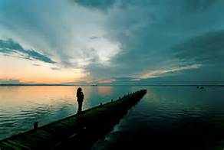
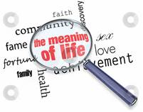
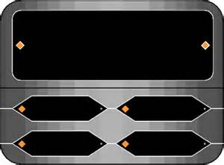
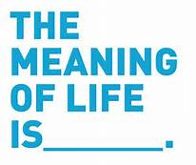
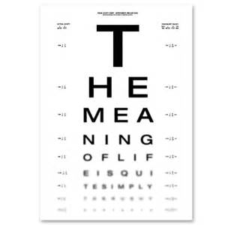
£100
What is meant by creatio ex nihilio
A) Creation
B) Creation out of nothing

Slide 5
£500
If God is omnipotent, what is he …?
A) All-knowing
B) All-loving
C) Everywhere
D) All-powerful

Slide 6
£1,000
When you look after the environment for future generations, this is called…
A) Stewardship
B) Caring
C) Transubstantiation
D) Environment

Slide 7
£5,000
Imago Dei means you are made in the image of who…?
A) Jesus
B) God
C) Your parents
D) Justin Beiber

Slide 8
£10,000
When animals change and adapt to their surroundings over a long period of time is…
A) Progress
B) God’s plan
D) Natural Selection
C) Evolution

Slide 9
£60,000
The word ‘Transcendence’ means that God exists outside of space and _____.
A) Hebburn
B) Time
D) The Bible
C) The World

Slide 10
£100,000
Which of the below words means ‘the way in which God reveals himself to the world’?
A) Eternal
B) Revelation
C) Inspiration
D) Transcendence

Slide 11
£1,000,000
Which of the words below literally means ‘God breathed’. This means how God shows us what is right and wrong to do.
A) Eternal
B) Revelation
C) Inspiration
D) Transcendence

Slide 12
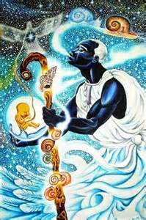
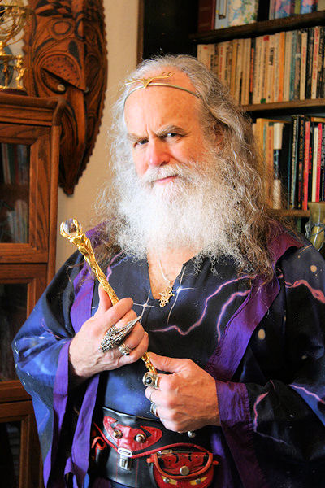
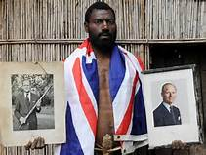
GCSE Religious studies:
Eduqas
Unit 1: Origins and meaning
Lesson 3: What are origins and meaning?
Learning objective:
To explore the need for origins and meaning.
To understand different religious origins and meaning.

Slide 13
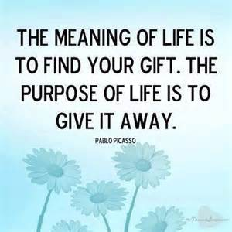
The big picture
Where is our learning going?
1. Key Skill A vocabulary.
THIS LESSON: What are origins and meaning?
3. What do Catholics believe about the origins of the universe?
What does success look like in today’s lesson?
You MUST be able to define the term origins and meaning.
You SHOULD explain examples of the beliefs of different religious traditions towards origins and meanings.
You COULD argue what you think are our origins and meanings.
Learning objective:
To explore the need for origins and meaning.
To understand different religious origins and meaning.

Slide 14
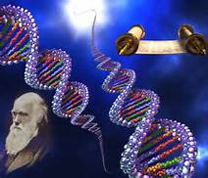
Switch on 2 learning discussion
Do you think it is important to know where you came from and why we are here?
Give 2 reasons for your point of view.

Slide 15
Key vocabulary for today
Some key terms we need to know today are:
This means our beginnings. Where did we come from? How is it we exist?
Origins:
What is our purpose?
What makes our life special?
Meaning:

Slide 16
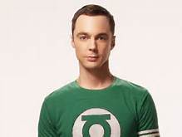
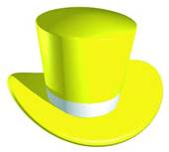
What is the meaning of life?
In the Big Bang Theory Sheldon Cooper is often quite an emotionless driven man. In this episode he looses a hero from Star Wars and is visited by him in a dream.
Red hat: How do the videos make you feel?
White hat: What happens in the clip?
Yellow hat: What would be the benefits of life having a clear meaning?
Green hat: Do you agree with this message about the true meaning of life?
Or do you think there is a different meaning to life?
https://www.youtube.com/watch?v=0gMDY8zumZ0
https://www.youtube.com/watch?v=ZJIt0vlsJ8Q

Slide 17
Class survey challenge
Challenge 1: Interview around the room 20 people and record their answers to the following question:
What is the meaning of our lives?
Challenge 2: Analyse the answers you got and present some data graphs on:
How many people believe there is a meaning to our lives vs. how many think life is pointless.
Is there a difference between boys vs. girls?
Learning objective:
To explore the need for origins and meaning.
To understand different religious origins and meaning.

Slide 18
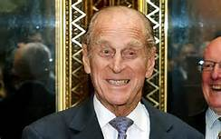
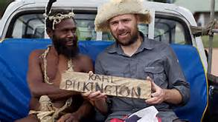
The importance of meaning and origins – the Religion of the tanna tribe
The Tanna Tribe of the South Pacific (who live 15,826km away from London) believe that God is Prince Philip. They believe God created the world from nothing, he gave them nature and they must respect his works. Nature should not be exploited.
They believe that God - Prince Philip visited them in 1974 and ever since has blessed them with good luck, good harvests and happiness.
The Village Chief stated: ‘He is a god and when we talk about him and believe in him, it gives us life’.
The tribe have ritual dances for him, sacrifice to pictures of him and pray to him for guidance.
Watch Episode 1: (17mins-26mins).
Why do the people worship Prince Philip?
How does this belief give their lives meaning? Why is meaning important?

Slide 19
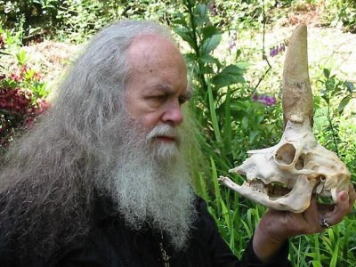
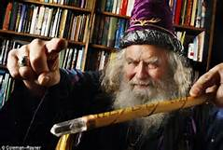
The church of all worlds (CAW)
https://www.youtube.com/watch?v=nZ4zL_0UtUw
The Church of All Worlds was a New-age Religion set up by its founder Oberon Zell-Ravenheart in 1962.
Oberon and his wife were inspired by a book which had a Church for all Worlds and peoples from across the universe in. Their core beliefs include:
Respecting the world, believing that the world is a living Goddess and building community and harmony.
The CAW believe that the world was created by the Goddess Chaos who created Gods like Zeus and Gaia (Mother earth). Chaos gave us the earth to inhabit and made us protectors of the world.
They believe Unicorns exist and sometimes babies born into CAW have their heads moulded as their heads fuse together. to help them grow a corn shaped horn.
They base their worship and meaning on key texts that they believe have sacred messages, including Harry Potter and Lord of the Rings.
The Church of All Worlds has even set up its own ‘Grey School for Wizardry’. The school has 16 subjects and 40 teachers.
Its ideals are that everyone studies the magic nature of the world, learns to respect it and it encourages its members to use magic in this world for the good of the earth and the people who live in it.
http://www.greyschool.com/

Slide 20
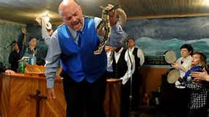
Watch the clip about the Evangelical Christian Movement in Tennessee.
What is their meaning in life?
Where do they get their meaning from?
https://www.youtube.com/watch?v=g5O1RVWB8MQ
Learning objective:
To explore the need for origins and meaning.
To understand different religious origins and meaning.

Slide 21
HW: Skill question practice
Skill C question:
From two different religious points of view, explain their views on both our origins and the meaning of our lives.
Today we have looked at:
The Tanna Religion who worship Prince Philip.
The Church of All Worlds.
The Evangelical Tennessee Snake Handlers.
Use the help sheet to help you structure your answer.
Learning objective:
To explore the need for origins and meaning.
To understand different religious origins and meaning.

