Slide 1
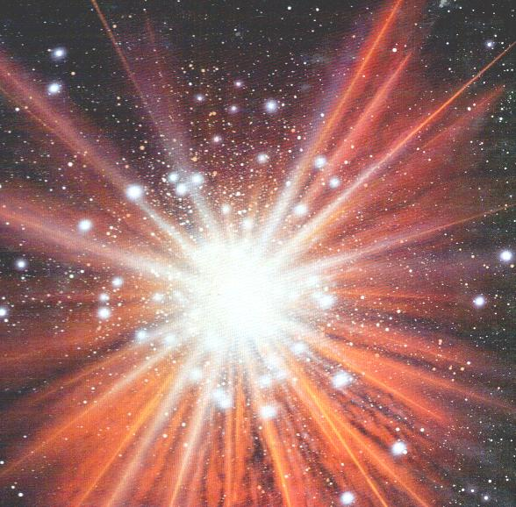
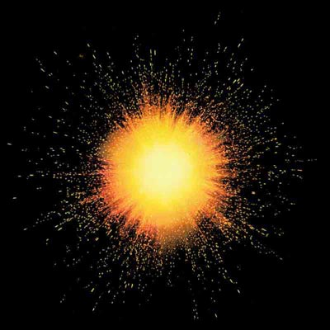
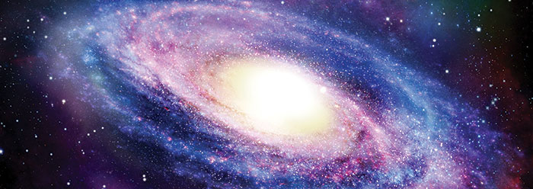
Hook: What is our topic today?
Notes:
Could also play ‘big bang theory’ song as they enter

Slide 2
What are the non-religious views about the origin of the universe and human beings?
To know what the Big Bang is.
To understand how it compares to Catholic views on creation.
To be able to express how far we agree with the non-religious view.
To use and define key words.
To compare and contrast opinion.
To evaluate a concept.

Slide 3
In your book, mind map all the things you already know about the Big Bang. You can discuss your ideas with the person sitting next to you.
The Big Bang
Now watch the clip and with the green pen, add anything else you learn to your brainstorm.
Notes:
http://www.bbc.co.uk/learningzone/clips/the-big-bang/12236.html

Slide 4
What is the Big Bang theory?
I will give you 2 minutes to prepare an answer to this question for someone who doesn't know anything about the Big Bang theory.
Challenge: Do you believe this theory?
Notes:
Using lolly sticks, choose a few pupils to answer the question and ask the other pupils to comment on what was good/what could be improved in their answer.

Slide 5
Analyse and Explore
http://www.hawking.org.uk/the-origin-of-the-universe.html
Read what Hawkins teaches about the Big Bang.
What are his three main points?
Notes:
It’s a long speech so it may need breaking down into smaller chunks for ability.

Slide 6
In pairs discuss these questions
Can you believe in God and believe in the Big Bang?
If the universe was created through the Big Bang, do we still need God in our life?
Does the big bang prove that God is not real?

Slide 7
Questions: What do you think about the big bang? Do you believe that God made the world or science?
Questions
Walk around the room and when the music stops, question people about their beliefs about God and the Big Bang. Make a few notes if you need to.
Notes:
Give pupils a piece of lined paper to write their notes on, so it doesn’t mess up their books.
http://www.youtube.com/watch?v=HxDcOxXQI-k

Slide 8
d) “Religion and science clash over the Big Bang” (15+6) Discuss this statement showing that you have considered more than one point of view. (You must refer to religious and non-religious beliefs such as those held by humanist and atheists, in your answer)
The big bang theory is…
Religion and science might clash because… For example…
Secondly… For example…
Thirdly… For example…
Others might say they do not clash because…
Secondly… For example…
Thirdly… For example…
Word Bank
Science Religion God Facts Trust Explosion Evidence

Slide 9
Chatterbox

