Slide 1
Monday, 11 July 2016
Driving Question: What is a Covenant?
Warm
I can identify the meaning of covenant
Hot
I can explain the covenant relationships in the Old Testament.
Scorching
I can compose an argument based on the evidence.

Slide 2
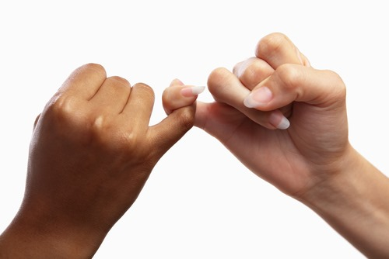
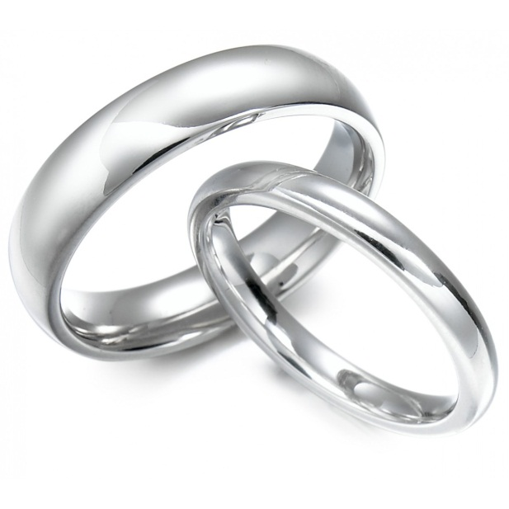
What does covenant mean?
Use the images to come up with a definition for the word covenant.
In full sentences, give some example of modern day covenants and explain how you know they are a covenant

Slide 3
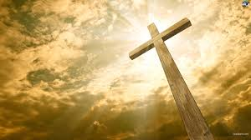
What is a covenant agreement?
If an agreement is a promise between two or more people, what is a covenant agreement?
A covenant agreement is …
Use a dictionary and this image to help you.

Slide 4
The Jews – A chosen people?
1) The Jewish people have c _ _ _ _ _ _ _ agreements with God, which are described in the T _ _ _ _ .
2) These covenants require the Jewish people to a _ _ in a certain way, if they follow these covenants they will be r _ _ _ _ _ _ _ by God.
3) It is because of these covenants that Jews see themselves as a c _ _ _ _ _ people.
4) Jews believe they have been chosen by God for a s _ _ _ _ _ _ responsibility: to receive; learn; live and t _ _ _ _ _ God’s word and will.
covenant Torah Act Rewarded Chosen special teach
Notes:
Missing words: covenant Torah Act Rewarded Chosen special teach

Slide 5
The Covenant Agreements...
Torah Reference | Who was the Covenant between? | What did the Covenant require of each party? | What was the symbol of the Covenant?
Genesis 9 vs 1-17
Exodus 19 vs 1-6
Exodus 34 vs 10 - 28

Slide 6
The Covenant Agreements
Your mission is to find out about the different Covenant relationships from the Torah.
In pairs, look up the passages and fill in the information.
Clarify: What is the Torah?

Slide 7
The Covenant Agreements
Torah Reference | Who was the Covenant between? | What did the Covenant require of each party? | What was the symbol of the Covenant?
Genesis 9 vs 1-17 | God, Noah and his Sons | Noah: Not to shed the blood of man God: never to flood the earth again | Rainbow
Exodus 19 vs 1-6 | God and Moses | God: Make the Jews a Chosen People Israelites: obey God follow and keep the covenant | Promised land
Exodus 34 vs 10 - 28 | God and Moses | Moses: Follow Ten Commandments and other laws God: Make the Jews a Chosen People | Tablets of the 10 Commandments

Slide 8
Explain one covenant made between God and his people.
I can identify the meaning of covenant in my answer and describe one covenant made between God and his people.
I can explain one of the covenant relationships in the Old Testament, using evidence.
I can do all of the above and consider why the covenant agreement I have explained is important.
Writing Frame
A covenant agreement is...
One covenant agreement made between God and his people is...
The covenant required people to...
I know this because...
I think that this covenant was important because...
Key word Box
Noah
Moses
God
Covenant
Chosen people
Israelites
Commandments
Blood
flood

Slide 9
Produce an acrostic diagram answering the question: What is a covenant?
C
O
V
E
N
A
N
T

Slide 10
Learning Passport
List 2 things that you have learnt in todays lesson:
1)______________________________________
2)______________________________________
List 1 aspect of your learning today that you are unsure about:
1)______________________________________
List 1 aspect (if any) of your learning today that you did not understand.
1)______________________________________
Happy with my learning:
Ok with my learning:
Unhappy with my learning:
Remember to get it stamped!!

