Slide 1
Starter- On White boards
Recap- 2 minutes to refresh your memory on last lesson by reading the information on your timeline.
State ONE reason why you think peace has not been achieved in Israel.
What do you think is a possible solution to the war in Israel?

Slide 2
Tuesday, 15 March 2016
Driving Question: Do the Jew’s have any right over the country of Israel?
Warm
I can explain with evidence, both perspectives for the current conflict in Israel.
Hot
I can evaluate the reasons and motivations behind the current conflict and conclude what should happen to Israel.
Scorching
I can compose and construct a balanced argument, with evidence, to explain if anybody has the right to the land of Israel.

Slide 3
Create 3 questions to test
Your partners knowledge on the Israeli conflict.

Slide 4
Silent Debate
To practise our evaluating skills we are going to hold a silent debate.
PREDICT
What do you think a silent debate might involve?

Slide 5
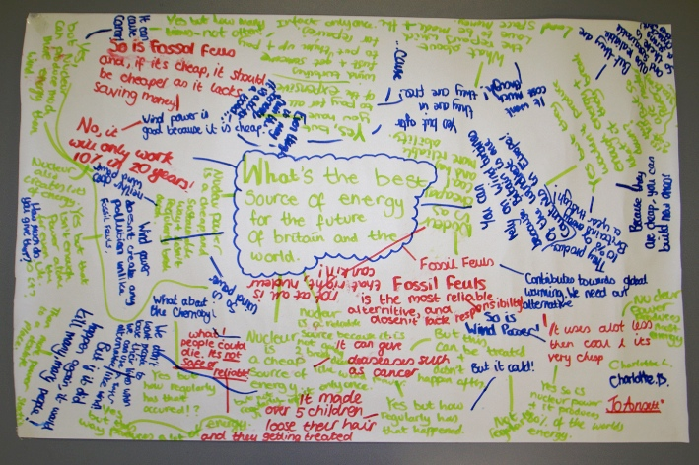

Slide 6
I am able to express an opinion on the statement and make a response to other people’s arguments
Rules of the debate
SILENCE!!!!!!!
You have two minutes with each statement.
You rotate each statement in a clockwise direction.
You should be engaged in a dialogue in which you must respond to the points raised by others: not simply asserting your own views.
You can write any comments that occur to you (so long as they are relevant)
Draw a connecting line between related comments or circle around a point/word you want to aid clarity to.
Each person should use a different colour pens to enable tracking / assessment of their individual contributions.
I am able to express an informed opinion on the statement and make an informed response with Historical evidence
I am able to use persuasive language and evidence to evaluate other people’s viewpoints.

Slide 7
Do you agree or disagree?
What Historical evidence is there?
“ After the atrocities of World War II, the Jewish people deserve to keep Israel- it is the least that we can do to give them a land in which they are safe”
What is the alternative point of view?
What would Jesus do?

Slide 8
Do you agree or disagree?
What Historical evidence is there?
“The Arabs/ Palestinians lost the fight 1948. The Jew’s won the land fair and square. If you conquer a land you should keep it.”
What is the alternative point of view?
What would Jesus do?

Slide 9
Do you agree or disagree?
What Historical evidence is there?
“ The Palestinians had been living peacefully for 1300 years. The land belonged to them and still does.”
What is the alternative point of view?
What would Jesus do?

Slide 10
Do you agree or disagree?
What Historical evidence is there?
“ The Arab leaders never agreed to the Jewish state of Israel. The vote was unfair so the state should never have been changed from ‘Palestine’ to ‘Israel’ without the consent of ALL people.”
What is the alternative point of view?
What would Jesus do?

Slide 11
“The Jewish people have no right to own the land of Israel.”
Do you agree?
I can provide one detailed paragraph using one piece of historical evidence.
I can provide one detailed paragraph using more than one piece of historical evidence.
I can do a further paragraph explaining why some people may disagree with me.
P
I agree/disagree that Jewish people have no right to the land of Israel because…..
The evidence from (insert year) shows that….
Therefore……
Evidence Box
Link in Historical evidence:
Persecution of Jews throughout History.
UK controls Palestine
WWII
At war with the Arabs
UN takes control.
Modern fighting
Unfair distribution of land
Exile of Palestinians during war.
E
E

Slide 12
“The Jewish people have no right to own the land of Israel.”
Do you agree?
Green Pen at the ready!
C
R
E
A
M
Come to a stop.
Read what you’ve produced.
Evaluate success criteria.
Ask yourself, is this the best I can do?
Make at least one change before you move on!
Highlight where you have used evidence.
Write one sentence explaining how you have met the success criteria.
Write one sentence explaining what you need to do next to meet the success criteria
DO IT!!!!

Slide 13
Plenary
What does the picture suggest about one of the possible solutions to the Israeli conflict?
What do you think is the best possible solution?

