Slide 1
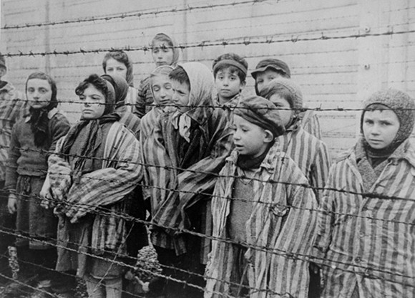
Who?
THINK (Individually)
What?
When?
Where?
PAIR
How?
Why?
SHARE
Notes:
Think , Pair, Share
Whose shoes are these? Tasks which help find out

Slide 2
Wednesday, 09 March 2016
Driving Question: What is the Holocaust and why might it challenge Jewish beliefs about God?
Warm
I can explain what the Holocaust is and how it relates to Judaism.
Hot
I can consider how evil and suffering during the Holocaust may have had an effect on Jewish belief in God.
Scorching
I can evaluate why the Holocaust is still significant today and the impact it may have had on Jewish belief in God.
Challenge Question: Why are the lessons learnt from the Holocaust still relevant today?

Slide 3
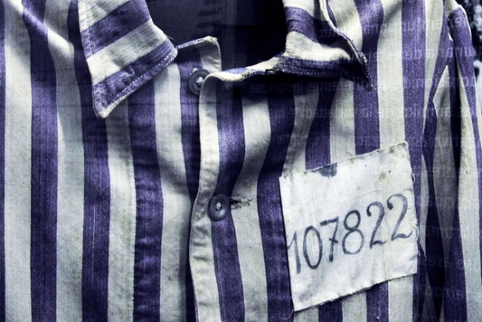
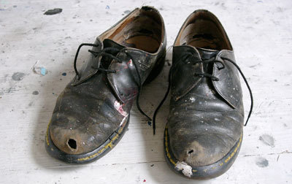
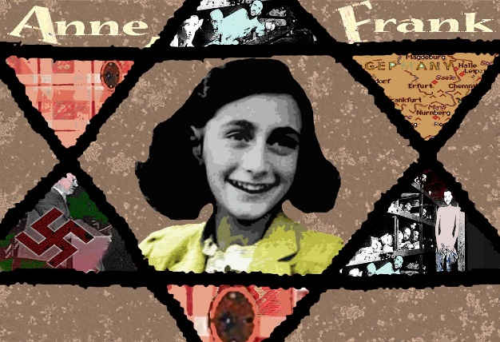
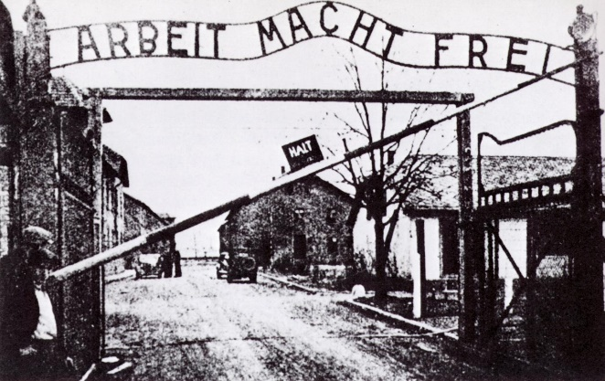
What do you already know about the Holocaust?

Slide 4
The Holocaust was the mass murder of approximately six million Jews during World War Two by Nazi Germany, which was led by Adolf Hitler and the Nazi Party.
http://www.bbc.co.uk/learningzone/clips/the-holocaust/3675.html
CLARIFY
Whilst you are watching, write down any new words/phrases OR any words/phrases that you don’t understand.
SUMMARISE
In as little words as possible, summarise the key facts about the Holocaust that you learnt from the video. Add these to your Mind Map
Notes:
http://www.bbc.co.uk/learningzone/clips/the-holocaust/3675.html

Slide 5
What do Jews believe about God?
Group Task…
Each group will be given an image that they must use to work out one Jewish belief about God.
In your group you must:
discuss what the image shows
Explain what it tells us about Jewish beliefs about God
Consider why the Holocaust might have made a Jew doubt that belief about God.
Consider why some people why a Jew might still believe that about God regardless of the evil and suffering of the Holocaust..
You will then be given 1 minute to explain your work to the rest of the class.

Slide 6
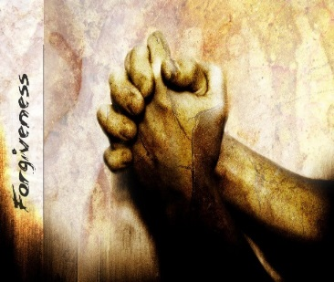
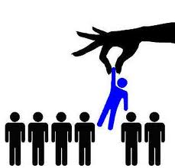
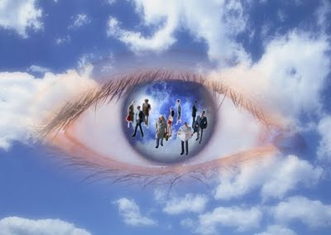
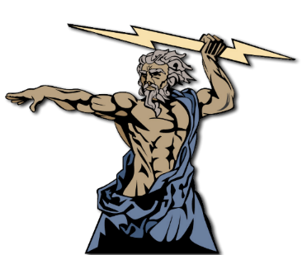
What do Jews believe about God?
Omni-benevolent
All loving God
A fair God
A forgiving God
Jews believe that they are God’s chosen people
Omniscient
All Knowing God
Omnipotent
All powerful God
Notes:
Each group cheat sheet available

Slide 7
Driving Question: What is the Holocaust and why might it challenge Jewish beliefs about God?
“If Jewish beliefs about God were accurate the Holocaust would not have happened”
TRUE
FALSE
Notes:
Be ready to justify your position on the continuum.
Wy might someone disagree?
Why do you think women might want to be priests?

Slide 8
“If Jewish beliefs about God were accurate the Holocaust would not have happened”
Key word box
Omni-benevolent
Omni-potent
Omniscient
Forgiveness
Evil
Suffering
Chosen
Do you agree? Give reasons for your opinion. (3)
Why might someone disagree with you? (3)
i) I agree/disagree with this statement
because…………………
I also agree/disagree with this statement because……………..
Finally, I agree/disagree because………………..
ii)
Conversely, people may disagree with me because......
Furthermore, they may disagree because………………
Finally, they may disagree with me ………………………
I can provide 3 points for my own view and 3 points for the views of others, applying key words
I can provide 3 reasons for my own point of view applying three key words and consider the alternative point of view.
I can give a simple reason for my own view applying key words from todays lesson.
Notes:
How do we answer a question like this?
Can use the points people made in the continuum

Slide 9
Big changes…
On your sheet you have 6 things that happened to certain people during the Holocaust.
You must read each statement and then give it a mark out of ten for how difficult the change would have been for the Jewish person.
1 = Not difficult
10 = Very difficult
Notes:
Question pupils about which change they thought was easiest/most difficult. Pick up any disagreements and explore them through questions about the reasons for why they have chosen specific ones.

Slide 10
Homework/ Extended task
My prayer/poem explains what the Holocaust is.
Reflections: Write your own prayer or poem for the Holocaust victims.
My prayer/poem considers how evil and suffering during the Holocaust may have affected belief in God.
My prayer/poem offers support to the victim of the Holocaust considers how it may be affected them.
Be Creative!

Slide 17
Cheat Sheet
Cheat Sheet
What does the picture actually show?
What does the picture actually show?
How could this link to the way someone might act?
How could this link to the way someone might act?
How could it link to beliefs about God?
How could it link to beliefs about God?
Why might the evil of the Holocaust suggest that this is untrue?
Why might the evil of the Holocaust suggest that this is untrue?

