Slide 1
Academisation and Support Services
January 2020

Slide 2
Focus on Financial Matters
Key Current Trends:
Academisation in the Catholic Church
Diocesan oversight/CES policies and protocols
Growth of MATs/MACs (conversion & merger)
School Improvement Capacity Framework – Trust Capacity Fund (closed but…)
Increasing focus on demonstrating financial efficiency
MAT financial health
Director risks
Centralisation & Lean Leadership

Slide 3
Reminder of Academy Pros and Cons
Opportunities | Threats
More freedoms | Increased accountability
Greater financial autonomy | Removal of LA safety net
Catalyst for change/improvement | Management of change
Safeguarding Catholic vision | Isolation
Reinforcing collaboration | Overburdening leadership
Breaking down location barriers | Greater demands on Governors
Pooling resources and expertise | Collective responsibility
Staff development and training | Reducing budgets
Capital – no 10%, VAT recovery on capital costs and new grants | Increasing costs, additional administrative burdens

Slide 4
Implications for the MAC
New MAC
WS will incorporate the MAC and prepare company books
Adopt CES Articles of Association
Members: Director of DES, Diocesan Treasurer and Director of Education
Directors: Min. 4 Foundation Directors, 2 Chairs of the LGBs
Simplified Scheme of Delegation
MAC expansion
Special resolution to adopt new CES Articles of Association
Changes to MAC Board to reflect new Articles (no Principal Directors and no Staff Directors)
Simplified Scheme of Delegation
MAC merger achieved by transferring academies to one of the MACs (re-academisation)

Slide 5
Catholic MAT Mergers
Recent Examples:
Nottingham
Northampton
Hexham & Newcastle
What’s worked well?
Vision
Consultation
Consolidation
Flexibility

Slide 6
Experience from Northampton
2 MATs (North and South) – involved a merger of 3 MATs in North and 2 in South
Combined with a restructure of operational teams – no redundancies but some natural loss
Transparency as to rationale - cost cutting and capacity building
Issues – protecting pay, ensuring harmonisation, introduction of new financial systems, Union and Diocesan engagement

Slide 7
Growth - Due Diligence
Focus on sharing information and building relationships
Consider external support
More than a desk top exercise
Focus on viability and sustainability
Carry out in stages:
Phase 1 – pupil numbers, staffing structure, contracts, reserves
Phase 2 – educational outcomes, progress scores, inspections
Phase 3 – statutory staffing information, absences, premises

Slide 8
Building Trust
Emphasis on relationships
Renew focus on Catholic education and mission of the Church
Rewrite the narrative
Provide opportunity beyond local community
Embrace the collective
Proactive leadership – acting on the system not just in the system

Slide 9
Financial Efficiency & Oversight
School Resource Planning – ESFA support
Policies on levies and reserves – MAT picture
Increasing tendency to centralise operations but less so leadership
Benefits in terms of auditing and risk management
CEO pay still an issue
MAT Growth Grants

Slide 10
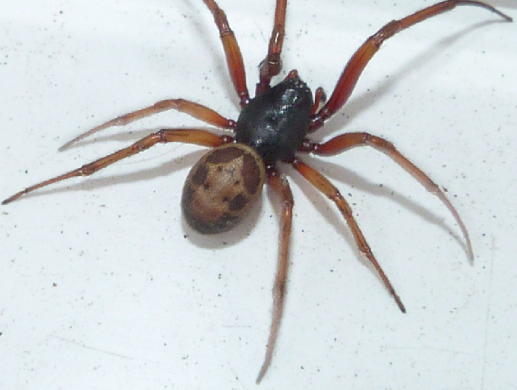
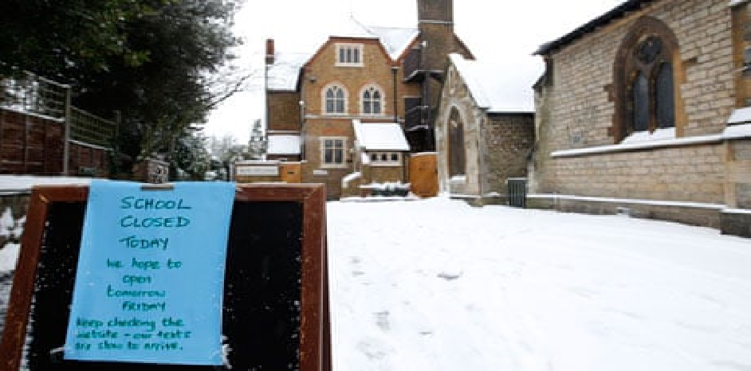
Divider slide

Slide 11
Wider Trends and Issues
Complaints and exclusions
SEND and discrimination claims
Defamation and harassment
Employment flexibility (changes to calculation of holiday pay, fixed term contracts, IR35)
Forced academisation and position of Unions
Contract management
GDPR

Slide 12
Questions

Slide 13
Our School Support team
eDUCATION
ANDREA SQUIRES
THERESA KERR
Cassandra hurley
Caroline rowlands
LAURA MARTIN
Ezra mCkenzie
STEPHANIE HUGHES
William cowell
Partner
Senior Associate
Senior Associate (Employment matters)
Senior Associate (Employment matters)
Associate
Solicitor (Property matters)
Solicitor
Solicitor
“Winckworth Sherwood LLP has experience advising the full spectrum of education clients, including schools, colleges, multi-academy trusts and universities. Andrea Squires leads the team …Theresa Kerr heads up the schools support service”
The Legal 500, 2019

Slide 14
SOLICITORS AND PARLIAMENTARY AGENTS Minerva House 5 Montague Close, London, SE1 9BB DX 156810 London Bridge 6 020 7593 5000 020 7593 5099 www.wslaw.co.uk
ANDREA SQUIRES Partner asquires@wslaw.co.uk 020 7593 5039

