Slide 1
The Catholic Community’s Collaborative Purchasing Service
Save money
Save time
Buy in confidence
Birmingham Archdiocese
CMP update November 2019

Slide 2
Nov’19 NEW Energy e-Booklet
Emulate success of the Parish Scheme 2? Dioceses now in!
Schools Contract, 8 Dioceses are now participating:
Birmingham
Nottingham
Southwark
Clifton
Lancaster
Northampton
Salford
Westminster
Notes:
Our new Energy e-booklet will be sent out during November. Target audience School Commissioners/ COO/ Trustees/ Governors.
Brown and Green energy quotations will be provided by IFM from which schools can then choose to purchase.

Slide 3
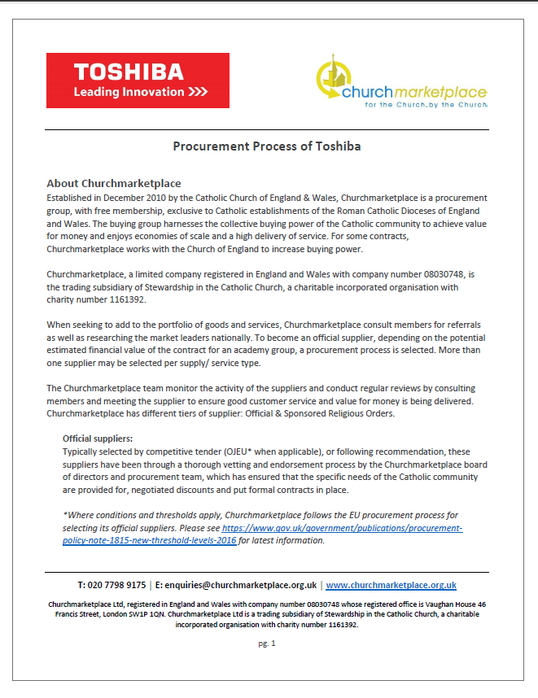
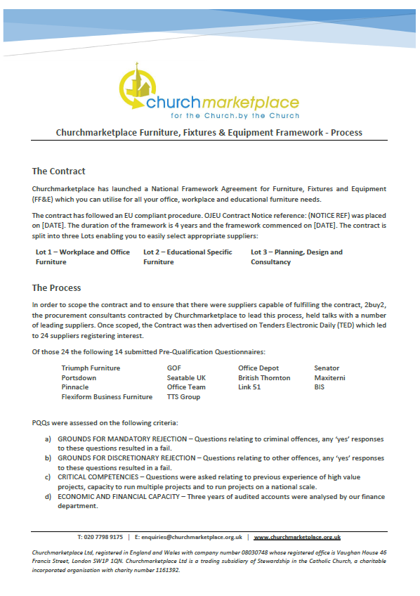
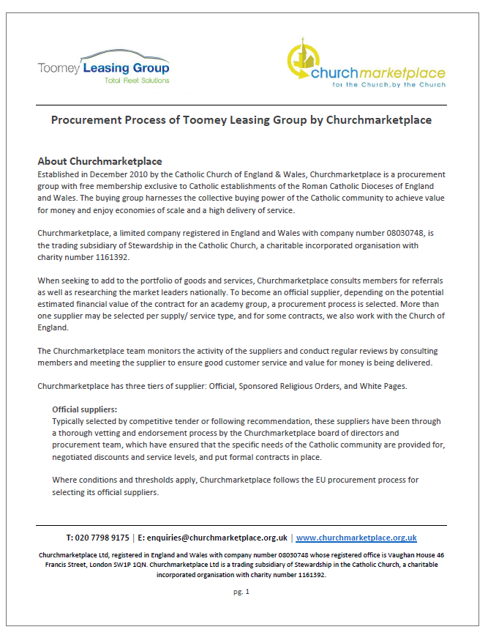
Nov’19 Due Diligence e-Booklet
Due diligence and ethical values:
Anti-slavery
Corporate Social Responsibility
Living wage
Financials
CES /diocesan policies
Value for money/ best value
Summary of selection process - PDFs
Downloadable from supplier page
Include in documentation
Notes:
Aimed at COOs/ Trustess/ Governors to raise awareness of the robustness of the CMP contracts and provide at your fingertips evidence of tall the tender processes for the CMP frameworks. Available to download now from our member area. Information to support the frameworks- help you prove due diligence has been done for you by us- saving your time!

Slide 4
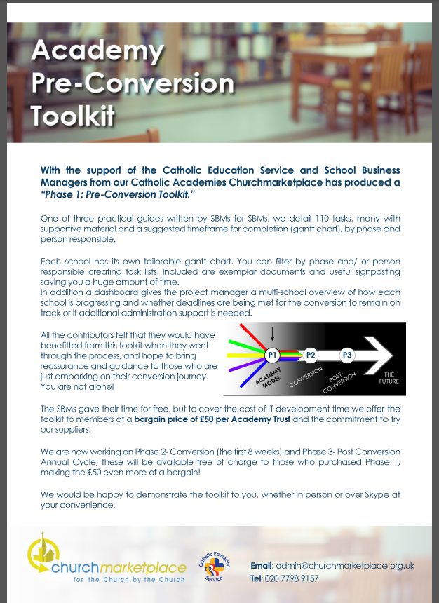
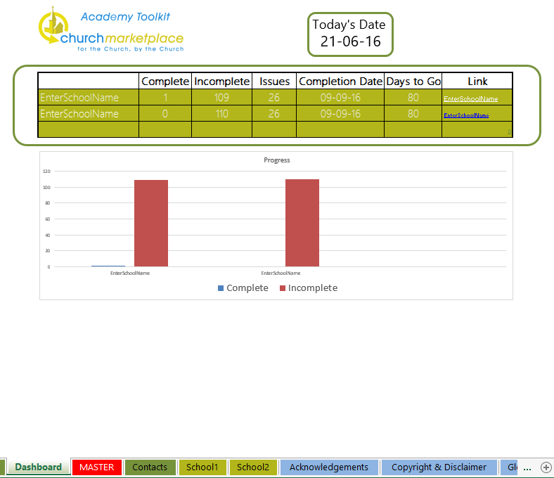
Reveiwed: CMP Academy Conversion Toolkit’19
FREE resource
Toolkit created by SBMs for SBMs to fill in the gaps!
“Horizon” tasks
“Merge” tasks added
Reviewed and ready to go!
Notes:
Birmingham colleagues contributed to writing this and it is now widely used around the Country – a great example of the Catholic Schools collaborating with CMP
The toolkit has been updated and the latest version is available free of charge from the CMP website.

Slide 5
Strategic Collaborative Buying
Nationally: Energy
Diocesan Level: Stationery. Liv/ Wes/ Ply
In-House Catering
AND/ OR
MAT Level: PAT Testing/ 5yr Electrical Inspection
VA Schools: SALIX Scheme-energy managment
Notes:
Energy: process needs to start 5 months before contract end date
Stationery Tender: need June/ July stationery orders from as many schools as possible to run a mini tender, takes 4 months to complete
In- house catering, looking fro clusters of schools to geographically collaborate together
Salix scheme- Calling all VA Schools- benefit from this prior to academy conversion- unlimited pot avaialble

Slide 6
Coming soon…
Due to popular demand: going Live Summer 2020
Contract Catering
Contract Cleaning
1st Planner (referral from Bir) Going live Autumn 2019

Slide 7
Next steps….
Subscribe to our website- it’s free! www.churchmarketplace.org.uk
Invite CMP suppliers to have a place at the table
Consider the Energy collaboration- diocese wide/ MAC!
Consider the other opportunities-Water/ Stationery etc.
Consider CMP collaborative buying service
DC happy to schedule a follow up call with you
Notes:
How many people present are members already?

Slide 8
Contact details
David Carne
Email: procurementmanager@churchmarketplace.org.uk
Jenny Williamson, Director
Email: jwilliamson@churchmarketplace.org.uk

