Slide 1
What is the liturgy of the word?
“Reading the Bible during Mass is the most important part…..”
1 2 3 4 5 6 7 8 9 10
Strongly agree
Strongly Disagree
Which other parts of mass do you think are more important? Why?
Why would someone disagree with you? Use key words in your answers.

Slide 2
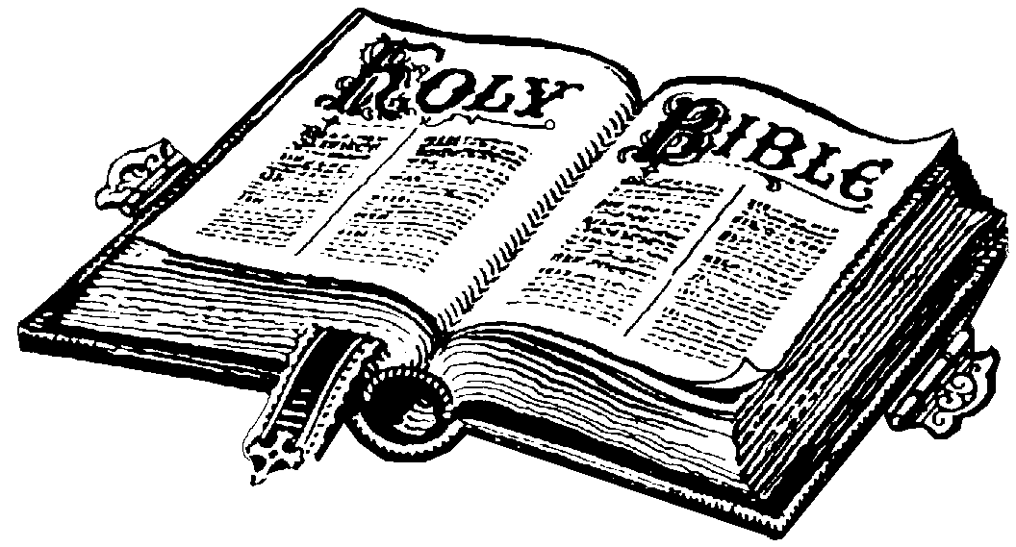
Liturgy of the Word
All: Explain what is the Liturgy of the Word
Most: Assess why this is an important part of the mass
Key words:
Liturgy – worshipping God in Public
Word – readings from the Bible

Slide 3
The Liturgy of the Word
The readings are from the Old Testament and New Testament. They include the Psalms, Letters and the Gospel stories.
There is the First Reading, the Responsorial Psalm, the Second Reading, the Gospel and a Homily.
They are called the ‘Word of God’ as the writers were inspired by God.
The stories we hear are not just messages from the past, they have a message for us today.
After the Bible passages have been read, the priest will explain their meaning for us today, this is called the Homily.
What is the Liturgy of the Word?
Why is the Homily important?

Slide 4
How does the Bible relate to my life?
Read the following passages and choose one you like the most
“The Lord is my shepherd there is nothing I shall want” (Psalm 23)
“Do not let your hearts be troubled, trust in God still, and trust in me” (John 14:1)
“If you ask for anything in my name, I will do it. If you love me you will keep my commandments” (John 14:14-15)
“You are precious in my eyes” (Isaiah 43:4)
“Your word is a lamp to my feet and a light to my path” (Psalm 119:105)
“Love your enemies, do good to those who hate you, bless those who curse you, pray for those who treat you badly” (Luke 6:27-28)

Slide 5
How does the Bible relate to my life?
“The Lord is my shepherd there is nothing I shall want” (Psalm 23)
“Do not let your hearts be troubled, trust in God still, and trust in me” (John 14:1)
“If you ask for anything in my name, I will do it. If you love me you will keep my commandments” (John 14:14-15)
“You are precious in my eyes” (Isaiah 43:4)
“Your word is a lamp to my feet and a light to my path” (Psalm 119:105)
“Love your enemies, do good to those who hate you, bless those who curse you, pray for those who treat you badly” (Luke 6:27-28)

Slide 6
What does the quote mean?
How does it relate to your life?
“You are precious in my eyes” (Isaiah 43:4)
What could be the challenges associated with following this?

Slide 7
Luke 15:11-32 (New International Version)
The Parable of the Lost Son
11Jesus continued: "There was a man who had two sons. 12The younger one said to his father, 'Father, give me my share of the estate.' So he divided his property between them. 13"Not long after that, the younger son got together all he had, set off for a distant country and there squandered his wealth in wild living. 14After he had spent everything, there was a severe famine in that whole country, and he began to be in need. 15So he went and hired himself out to a citizen of that country, who sent him to his fields to feed pigs. 16He longed to fill his stomach with the pods that the pigs were eating, but no one gave him anything.
17"When he came to his senses, he said, 'How many of my father's hired men have food to spare, and here I am starving to death! 18I will set out and go back to my father and say to him: Father, I have sinned against heaven and against you. 19I am no longer worthy to be called your son; make me like one of your hired men.' 20So he got up and went to his father. "But while he was still a long way off, his father saw him and was filled with compassion for him; he ran to his son, threw his arms around him and kissed him.
21"The son said to him, 'Father, I have sinned against heaven and against you. I am no longer worthy to be called your son.^{[a]}'
22"But the father said to his servants, 'Quick! Bring the best robe and put it on him. Put a ring on his finger and sandals on his feet. 23Bring the fattened calf and kill it. Let's have a feast and celebrate. 24For this son of mine was dead and is alive again; he was lost and is found.' So they began to celebrate.
25"Meanwhile, the older son was in the field. When he came near the house, he heard music and dancing. 26So he called one of the servants and asked him what was going on. 27'Your brother has come,' he replied, 'and your father has killed the fattened calf because he has him back safe and sound.'
28"The older brother became angry and refused to go in. So his father went out and pleaded with him. 29But he answered his father, 'Look! All these years I've been slaving for you and never disobeyed your orders. Yet you never gave me even a young goat so I could celebrate with my friends. 30But when this son of yours who has squandered your property with prostitutes comes home, you kill the fattened calf for him!'
31" 'My son,' the father said, 'you are always with me, and everything I have is yours. 32But we had to celebrate and be glad, because this brother of yours was dead and is alive again; he was lost and is found.”
Who was in the story?
Who do they represent?
What is the message of the story?
What can we learn from this story?

Slide 8
Your Homily...
Imagine you are a priest and you have to talk about a story to the people in your parish at mass on Sunday
You need to explain to them why this story is important and what we can learn from this story
You don’t want to bore them and you want them to try to understand it in terms of a modern situation
Remember to make it interesting! You don’t want people daydreaming during your sermon
Summarise the story in your own words
Relate the story to people’s lives/why is it important
Think of some of the challenges that people may face when trying to follow the teachings of this story

Slide 9
b) Do you think the Liturgy of the Word is an important part of mass? (4)
d) “The liturgy of the Word is the most important part of mass” (6)

