Slide 1
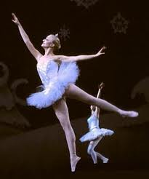
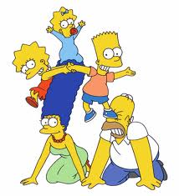
Who am I?
What do we know about Jesus?
What makes me who I am?
Design a mind map showing what makes you, ‘you’!
Challenge: Include characteristics of yourself. For example. I am honest.
Superstar: Circle the characteristics you think are like Jesus

Slide 2
Learning Outcomes To be able to describe what facts we know about Jesus To be able to explain how these things can teach us in our lives.

Slide 3
Who was Jesus?
Make 3 bullet points of what you learn from this clip.
Key word:
Messiah = someone who is sent by God to save humanity

Slide 4
Quick fire Quiz.
(see other Power point)

Slide 5
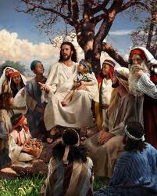
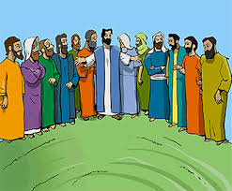
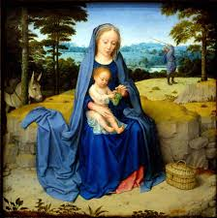
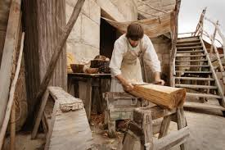
Describe what we know about Jesus.
“Jesus was a …….”

Slide 6
What can we learn from Jesus in his early life?
“Jesus as a friend teaches us…”
“Jesus as a carpenter teaches us…”

Slide 7
“Jesus was a liar”
“Jesus was a prophet”
Put these quotes about Jesus in order of the one you agree with most on top.
“Jesus was both man and God”
“Jesus was a good moral teacher”
“Jesus was a saviour”
How does the quote you agree with most guide you in your life?
“Jesus was a good moral teacher – therefore we should follow his teachings and listen to his parables”
“Jesus never lived”
“Jesus was a good man but not the messiah”

Slide 8
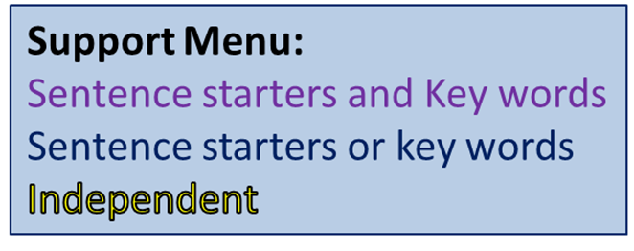
“Jesus was not the Messiah” Do you agree? Why?
Key Words:
Evidence
Belief
Man
God
Messiah
Mary
Son
Bible
Christian
Carpenter
Friend
Guide
teacher
Atheist
Liar
prophet
I agree/disagree because…
Also I agree/disagree because…
For example…
Furthermore…
Someone would disagree with me because…
They would also say that….
Examples of things to include and key words
Examples of things to include or key words
Notes:
Template on Word Document (shared area – Chaplaincy – Amy – Teaching – Year 7)

