Slide 1
The Order of Mass
Catholics go to mass to:
Worship God our Father
To pray with the Catholic community
Think of a community that you are part of.
How does being part of a community make you feel?
What benefits come from being part of a community?
Why is it important to worship God as a community?

Slide 2
Learning Objectives
To understand the order of the mass.
To explore the importance of parts of the Mass.
To justify your opinion about the most important part of Mass.
Key Words:
Eucharist: Literally ‘Thanksgiving’. It is sometimes used for the Mass or the body and blood of Jesus in particular.
Liturgy of the Word: Readings from the Old and New Testament.
Offertory: That part of the Mass in which the unconsecrated bread and wine are offered to God.
Penitential Rite: It is a form of words we use when we ask for forgiveness and healing for any sin that separates us from God, and in which we receive God’s forgiveness.
Communion: We receive the body and blood of Christ.

Slide 3
Class Activity:
As a class we’re going to go into the chapel. Whilst we’re in there Miss is going to talk you through what certain parts of the Mass mean.
Put the correct number in the box when you hear the definition.

Slide 4
Put the number of the correct definition in the correct box.
Event in Mass |  | Why is this an important part of Mass? | What other events happen during mass?
Penitential Rite
Liturgy of the Word
Offertory
Eucharistic Prayer and Consecration
Communion
Final Blessing and Dismissal
We receive Jesus
We listen to God speaking to us
We tell God we are sorry for the times we have hurt God and each other
The bread and wine become the body and blood of Jesus
The Priest tells us to “Go in peace to love and serve the Lord”
The gifts of bread and wine and other offerings, are brought up to the altar
Notes:
Yellow: e.g. opening and closing hymn, alleluia, holy holy etc.

Slide 5
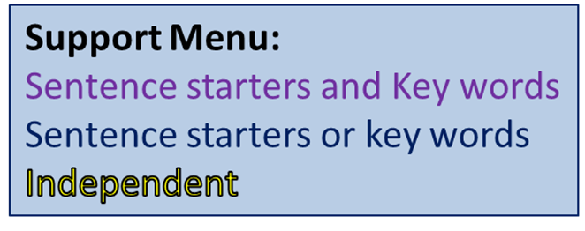
b) Do you think the Liturgy of the word is the most important part of mass? (4)
Yes/No because…
For example…
Also because…
For example…
Key Words:
Communion
Eucharist
Consecrated
Gloria
Liturgy of the Word
Offertory
Blessed Sacrament
Penitential Rite
Responsorial Psalm
What is your favourite part of Mass? Explain your answer.
Clues:
Word of God
Priest’s homily
Teachings of Jesus

Slide 6
Peer Assess
WWW:
You have used ……… key words.
You have made…….points and given …….examples.
You have answered the superstar question.
EBI:
What haven’t they done from the list above?
Key Words:
Communion
Eucharist
Consecrated
Gloria
Liturgy of the Word
Offertory
Blessed Sacrament
Penitential Rite
Responsorial Psalm
What is your favourite part of Mass? Explain your answer.
Clues:
Word of God
Priest’s homily
Teachings of Jesus
My Improvement:
(at least a paragraph)

